Slide 1

Americans with Disabilities Act (ADA)
Title II Public Access Requirements
Presented to the
Disability Advisory Commission
June 6, 2023

Slide 2
ADA Basics
Title I – Employment
Title II – Programs and Services of State and Local Government
Title III – Places of Public Accommodation
Title IV – Telecommunications
Title V – Miscellaneous
Notes:
Quick review, last time we covered Title I of the ADA. The ADA has 5 titles, and title II deals with requirements specific to state and local government. We are held to a higher standard than private business because our services are paid for by the public and because often our programs deal with issues of public health and safety, taxes and licensing, and so forth.

Slide 3
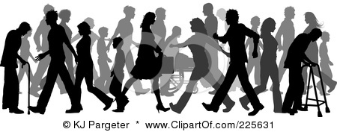
Disability Demographics
20% of Americans ages 16-64
40%+ over age 65
People who access County services:
  DHA (Welfare programs) approx. 50%
  Medical, mental health, social services – virtually 100%
Notes:
So again a quick review, last time we talked about the definition of disability under the ADA and in California the Fair Employment and Housing Act, which also covers civil rights. These statistics are general figures that have been steady across time, but are probably higher under the FEHA definition of “a medical condition that limits a major life activity.” Given the nature of many of the County’s services, mental health and safety net programs for example – it’s probable that virtually all who are qualified for the program would be covered under the ADA and FEHA.

Slide 4

Administrative Requirements
Designated ADA Coordinator
Self Evaluation and Transition Plan
Notice of Rights
Grievance Procedure
Notes:
Title II imposes some administrative requirements. Public entities must designate an ADA Coordinator to oversee ADA activities across the organization. It doesn’t specify where in the organization or at what level the ADA Coordinator should be. Here in Sac County, as most of you are aware, Cori Stillson is our County-wide ADA Coordinator and our office organizationally is within the Department of Personnel Services.
We must complete a Self Evaluation and Transition Plan, which we have just done, and we must make continuous good faith efforts toward implementation of that plan.
We must post notice of the public’s rights under the ADA – you may have observed these in the building at 700 H Street when we used to meet there. One of our first tasks in implementing the Self Evaluation will be to review all of the locations where this notice should be posted to ensure it is properly placed and current.
That notice must explain how to obtain our grievance procedure and who to contact to make a complaint of discrimination or report an access barrier. The DCO is currently updating the county-wide grievance procedure in response to some findings and recommendations in the Self Evaluation report.

Slide 5

Equal Opportunity
Must be equal to and as effective as the opportunity provided to people without disabilities
Architectural Access
Reasonable Modifications of Policies, Practices & Procedures
Effective Communication

Slide 6
Architectural Access
Ramps – permanent and temporary
Accessible parking spaces
Handrails and grab bars
Door handles, door pressure
Elevator buttons
Automatic door openers
Signage and wayfinding

Slide 7
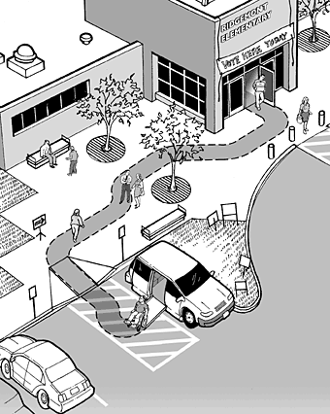
Accessible Path of Travel
From parking lot or public transit stop
Into and through the facility
Accessible restrooms, drinking fountains
Directional signage, wayfinding

Slide 8
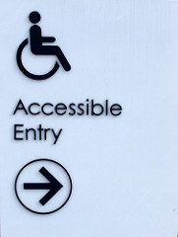
Maintaining Accessibility
Regular maintenance and repair of facilities and access features is required
During construction or maintenance:
  Safe accessible alternate route
  Temporary signage
  Staff assistance
  Move the program’s location
Notes:
Conversely, when we make upgrades or alterations, we must take the opportunity to increase accessibility.

Slide 9


Reasonable Modification
Reasonable modification to policies, practices or procedures must be made when necessary to ensure equal opportunity, unless to do so would fundamentally alter the nature of the program, service or activity.
Driver’s License – other form of ID
No animals permitted – service dogs allowed

Slide 10
Reasonable Modifications
Assisting people with cognitive, mobility, or visual disabilities to fill out an intake form
Granting extra time for public comment for a person with a speech impairment
Allowing a Deaf inmate additional time for TTY or Relay Service calls
Providing an appointment time for someone who would not be able to stand in line
Permitting exception to zoning code to allow homeowner to install a wheelchair ramp

Slide 11
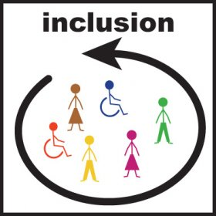
Alternate Program Delivery
The program or service can be relocated to an accessible facility, or
The program or service can be provided in an alternate manner such as
  Home visit or alternate accessible location
  Accept in-person application by phone, mail or email
  Curbside service
Notes:
Sometimes we need to make adjustments not to the program itself, but in how or where we are providing service.

Slide 12
Reasonable Modification of
Programs, Services & Activities
Does not mean preferential treatment
Always related to individual’s specific limitation caused by the disability
Proof or documentation requirements very limited – may not ask about disability
Should be provided easily in a timely fashion
NO cost or burden to the person with a disability

Slide 13
When is it Unreasonable?
Fundamental alteration of the nature of the program, service or activity
Financial or administrative burden in context of entire organization’s resources
Result in a direct threat to self or others
  Threat assessment based on research and fact, not assumptions

Slide 14








Effective Communication
The ADA requires that the County
and our contractors ensure that communication with people with
disabilities is equally effective as communication with people without disabilities.
Notes:
For some of our services, this can be really critical, even life and death!
Emergency notifications
Code Enforcement notices
Interruption or denial of benefits – food, medical care, housing, transportation, independence, child custody

Slide 15
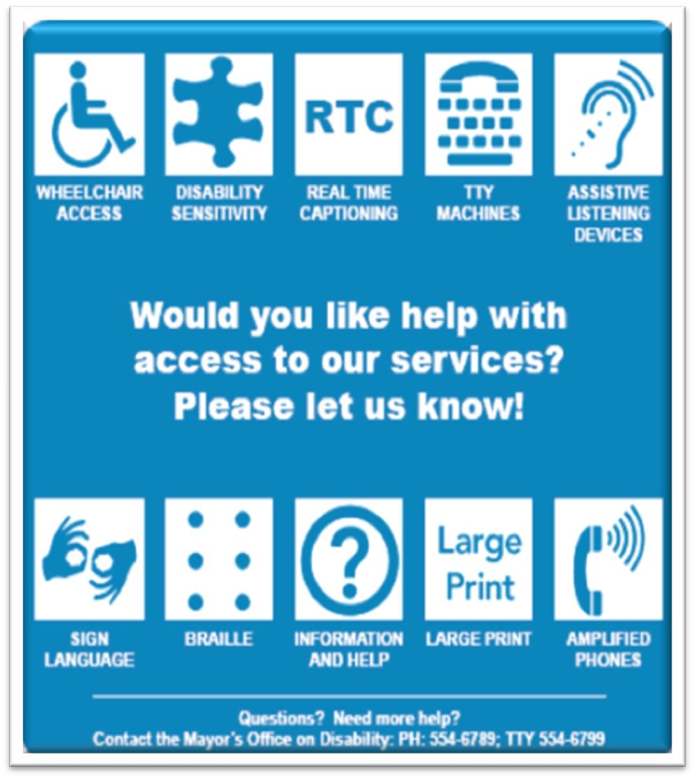
Who is Entitled to
Effective Communication?
Members of the Public
Job Applicants
Program Participants
Clients’ parent, spouse, or companion
3

Slide 16

Where is Effective Communication
Required?
Applications, Utility Bills, Tax Forms
Brochures, program information
Interactions with Customers
Medical Appointment
Websites, online forms
Signage, electronic boards, kiosks
Public events and community meetings

Slide 17
Effective Communication Methods
Alternate Formats of Documents – Large print, electronic (PDF or MS Word), Braille
Auxiliary Aids – Assistive Listening Devices, text to speech or screen reader software
Auxiliary Services – American Sign Language (ASL) or other qualified interpreters, Real Time Captioning (CART), qualified readers/scribes
Accessible websites and online forms, captioning and audio descriptions on videos, alt-tags on images

Slide 18
Accessible Public Meetings
Meeting notices, including contact information for access requests
Accessible site/location, proximity to public transit, parking, path of travel
Set up of seating, tables, AV equipment
Provide effective communication during the event

Slide 19
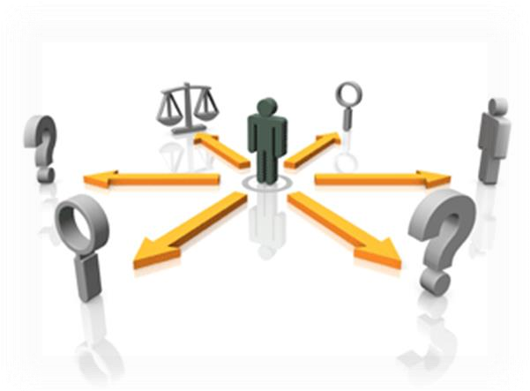
Accessibility in
Contracted Services
Departments must ensure access compliance of contracted service providers
Access considerations included in all parts of the contracting process, from the Request for Proposals (RFP) through contract negotiation
Include ADA compliance
as part of the procurement
and contract monitoring
processes.

Slide 20
Questions & Discussion
Next Steps and Goals:
  Overview of County Departments/Services
  Review ADA Self Evaluation Report Findings/Recommendations (2020)
  July 2023 – Retain Consultant to Evaluate Staffing/Resources Needed to Implement ADA Title II Countywide
      Request for Proposals, Scope of Work
      DAC Roles in Implementation Process

