Slide 1
SMForward Ground Transportation Center (GTC) Concept
Sacramento Disability
Advisory Commission
Physical Access Subcommittee
Stakeholder Outreach
April 16, 2024

Slide 2
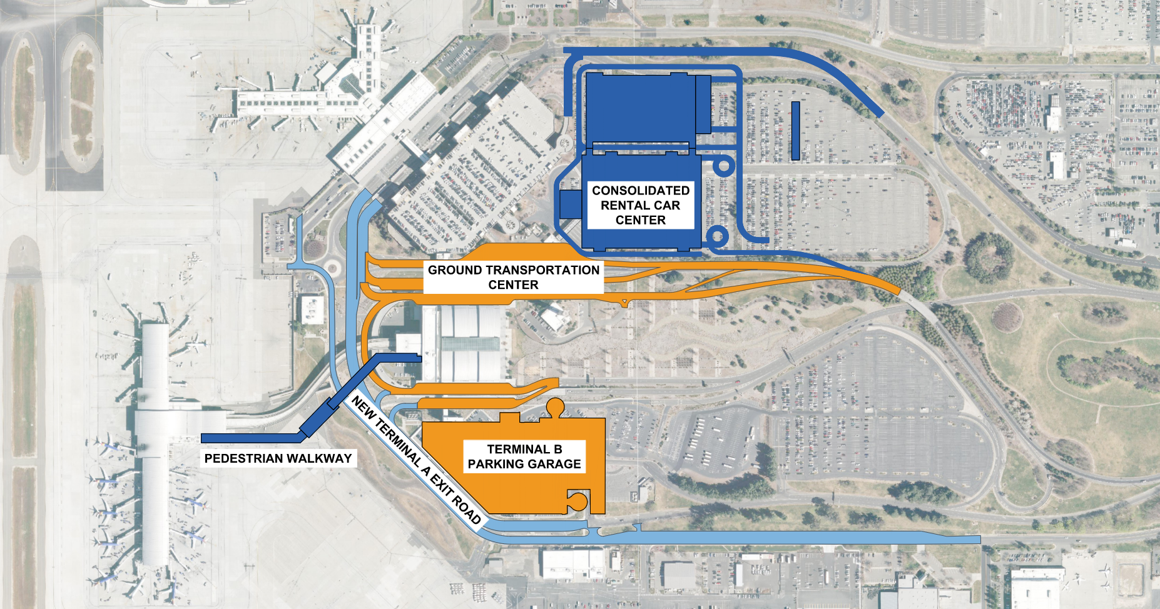
Upcoming Landside Projects

Slide 3
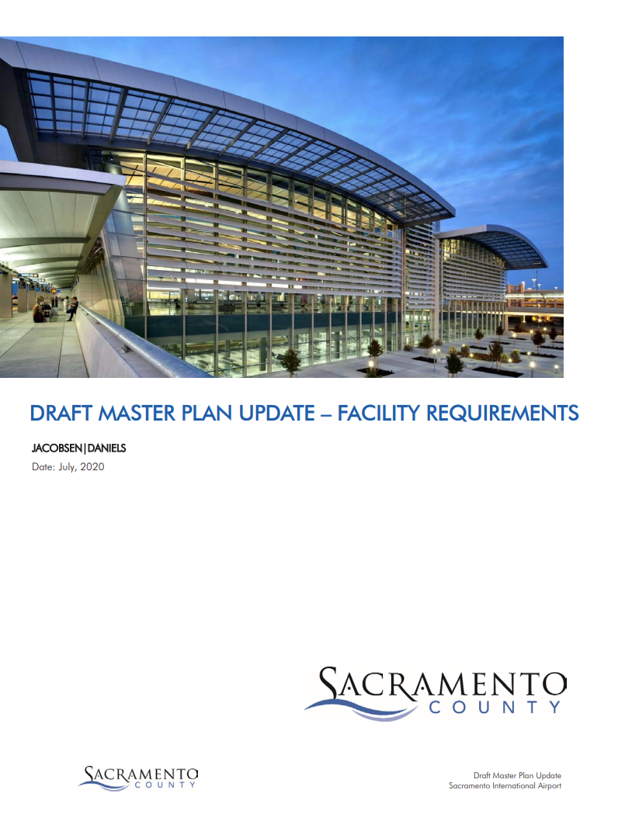
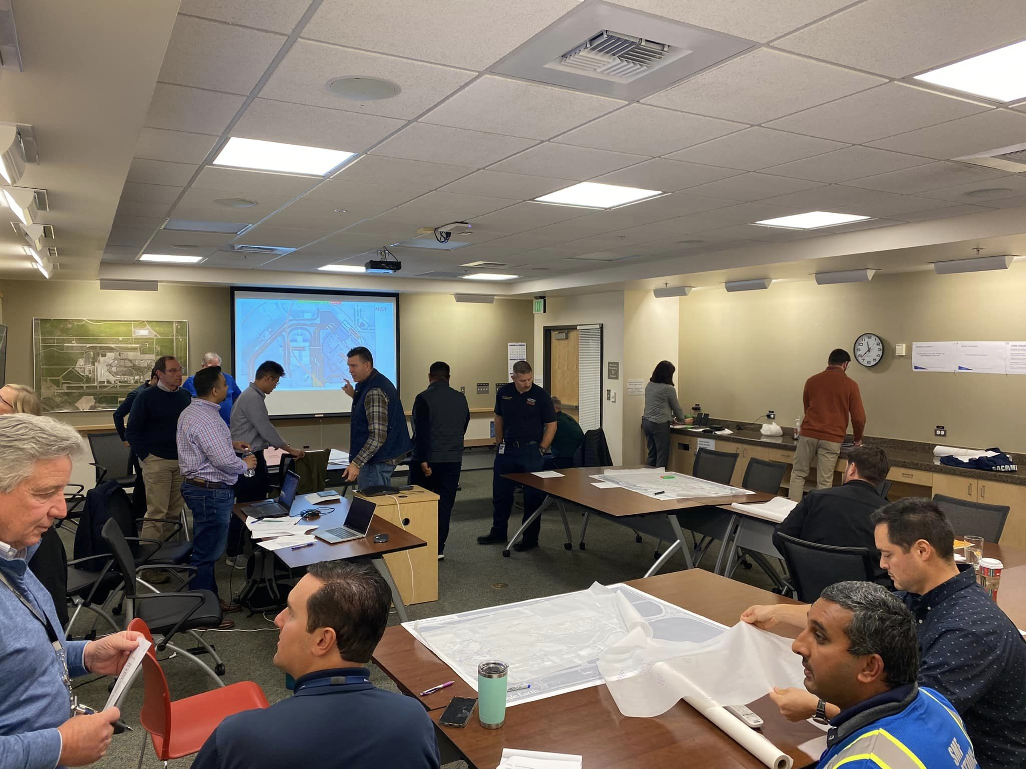
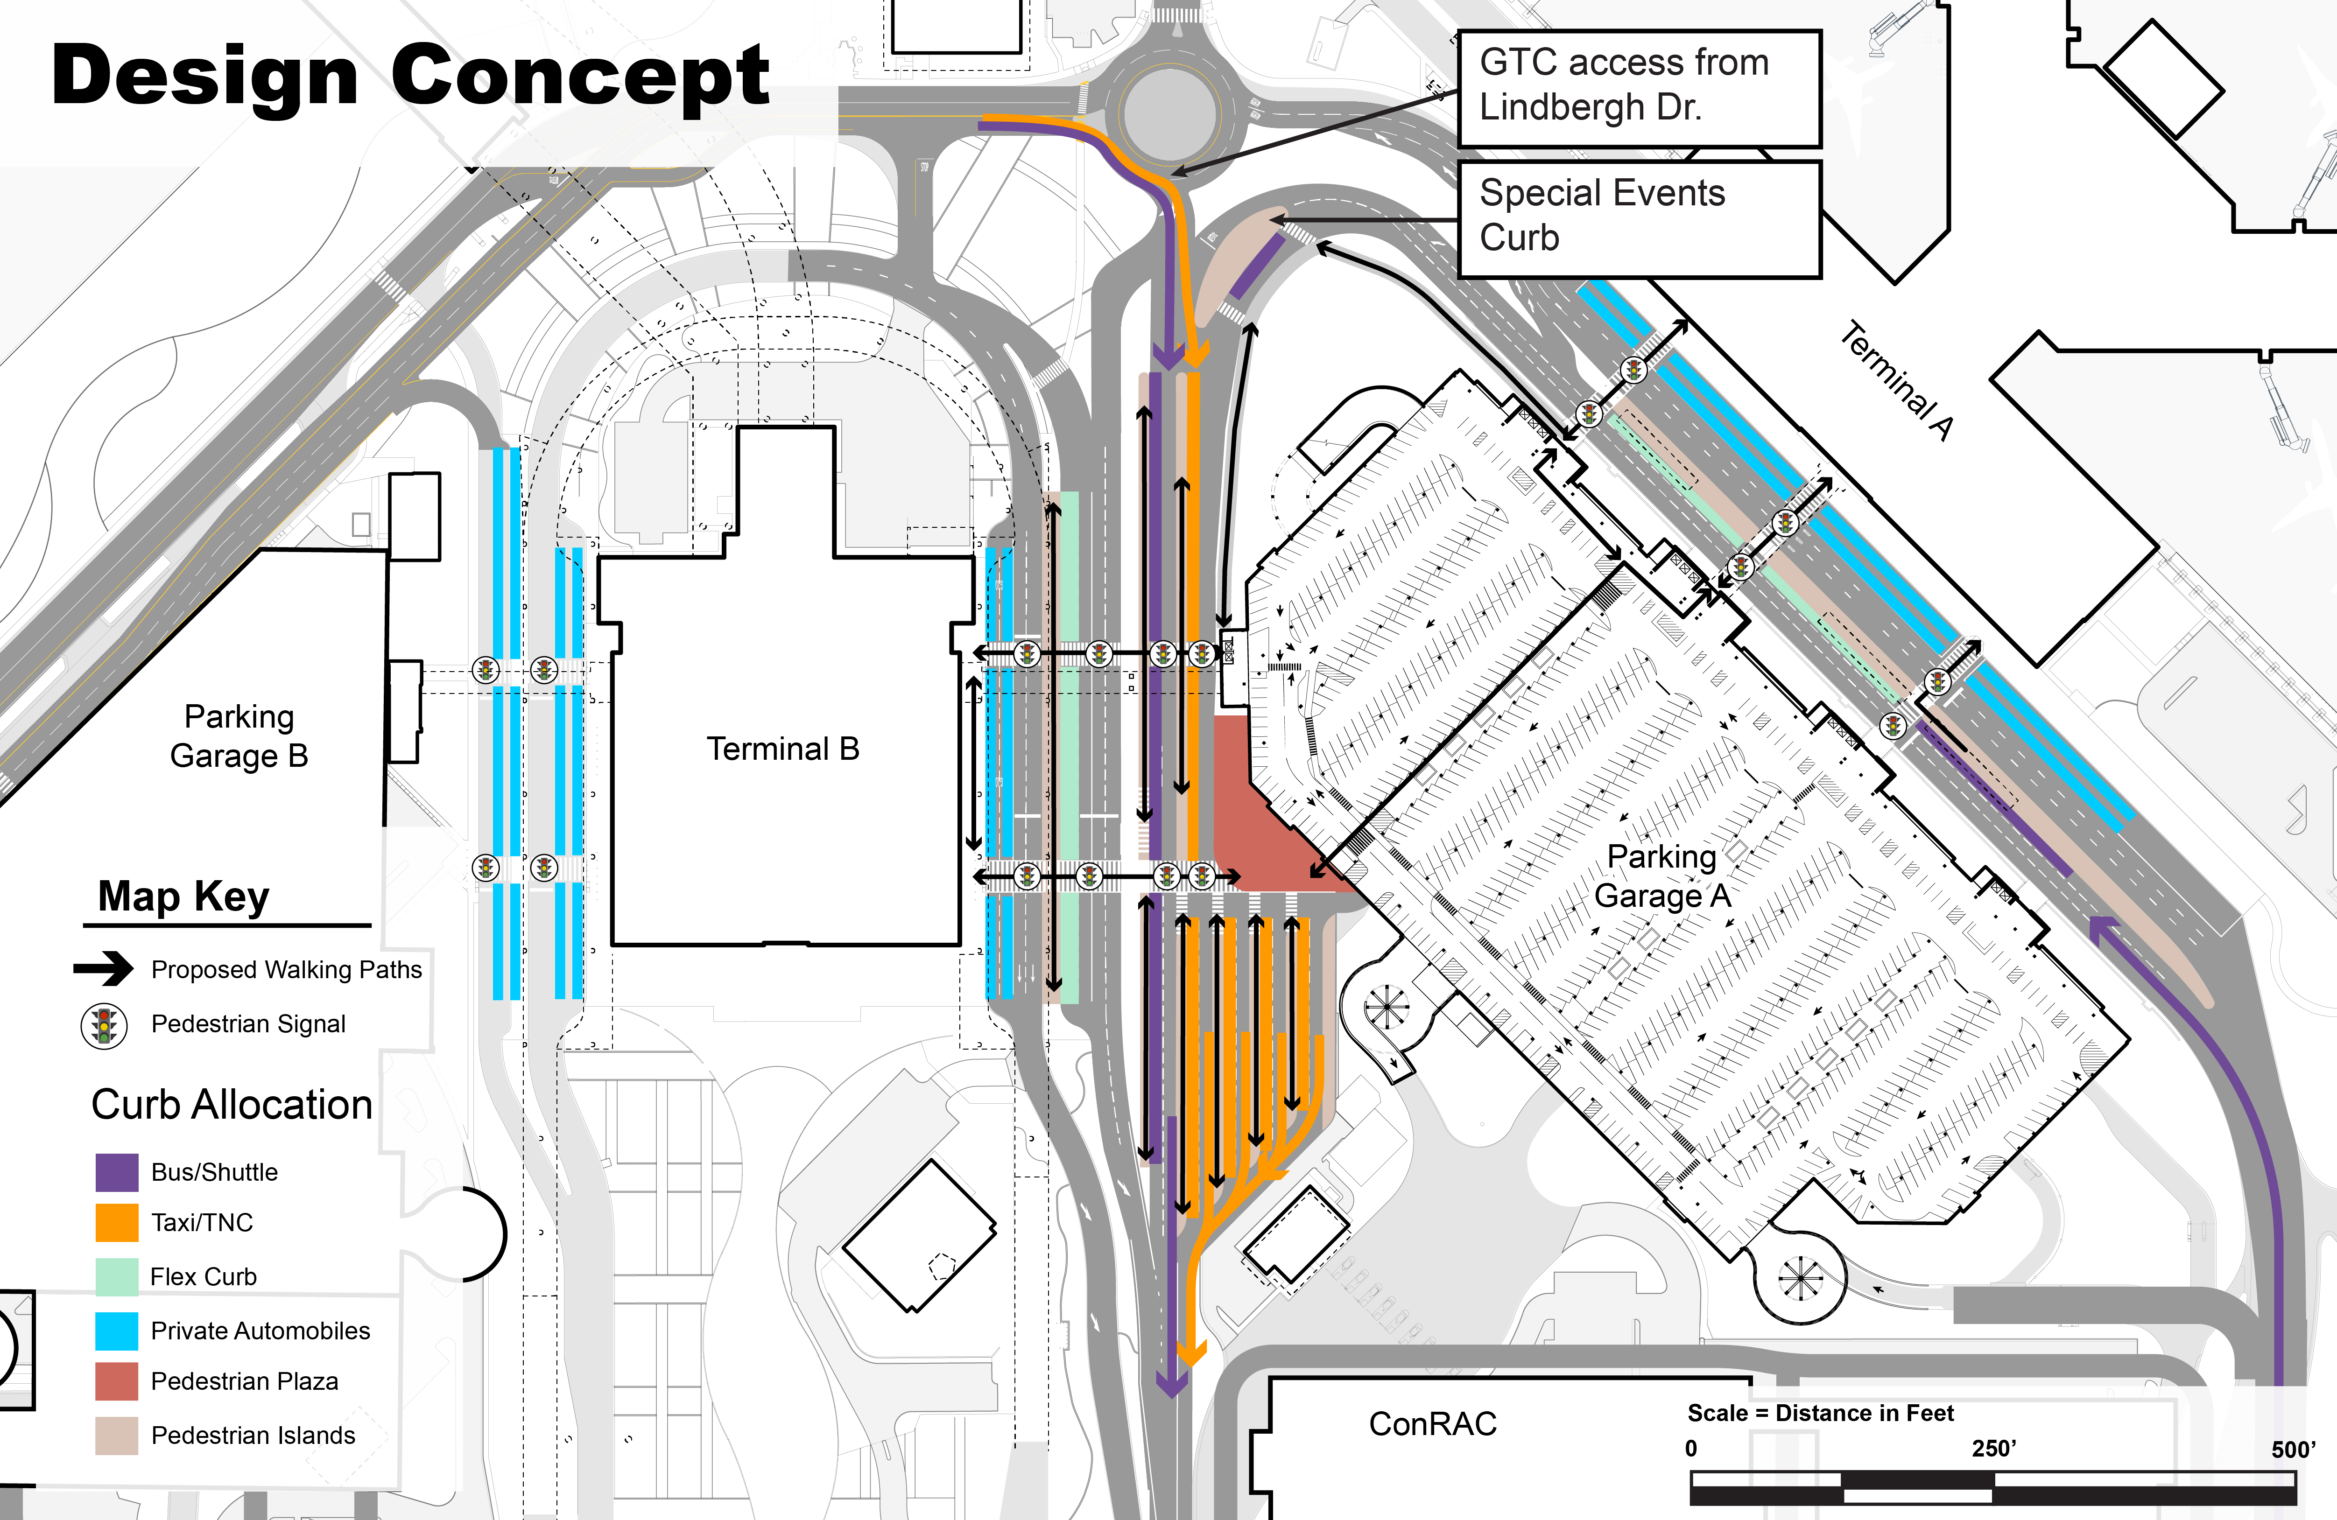
GTC Design Process
2022 Airport Master Plan Update
Internal Development
Concept
Submit comments to Chris Martin (MartinC@saccounty.gov) by:
COB May 15, 2024

Slide 4
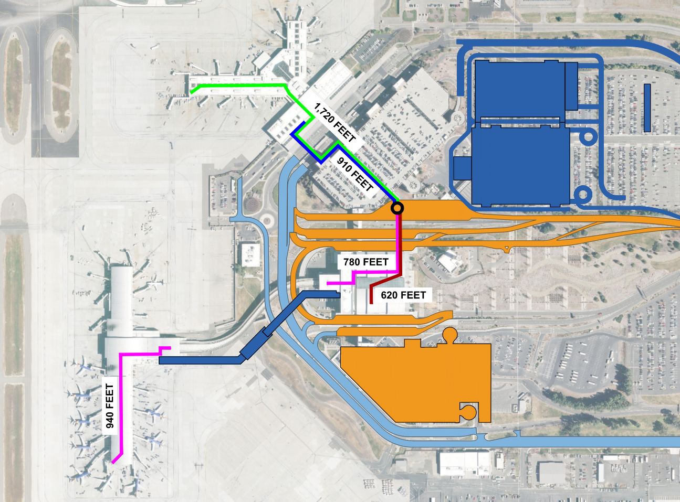
Distances to GTC
Farthest Gate to GTC:
Terminal A 1,720 feet
Concourse B 1,720 feet
Farthest Baggage Claim to GTC:
Terminal A 910 feet
Concourse B 620 feet
Paratransit Pick Up Locations Do Not Change

Slide 5
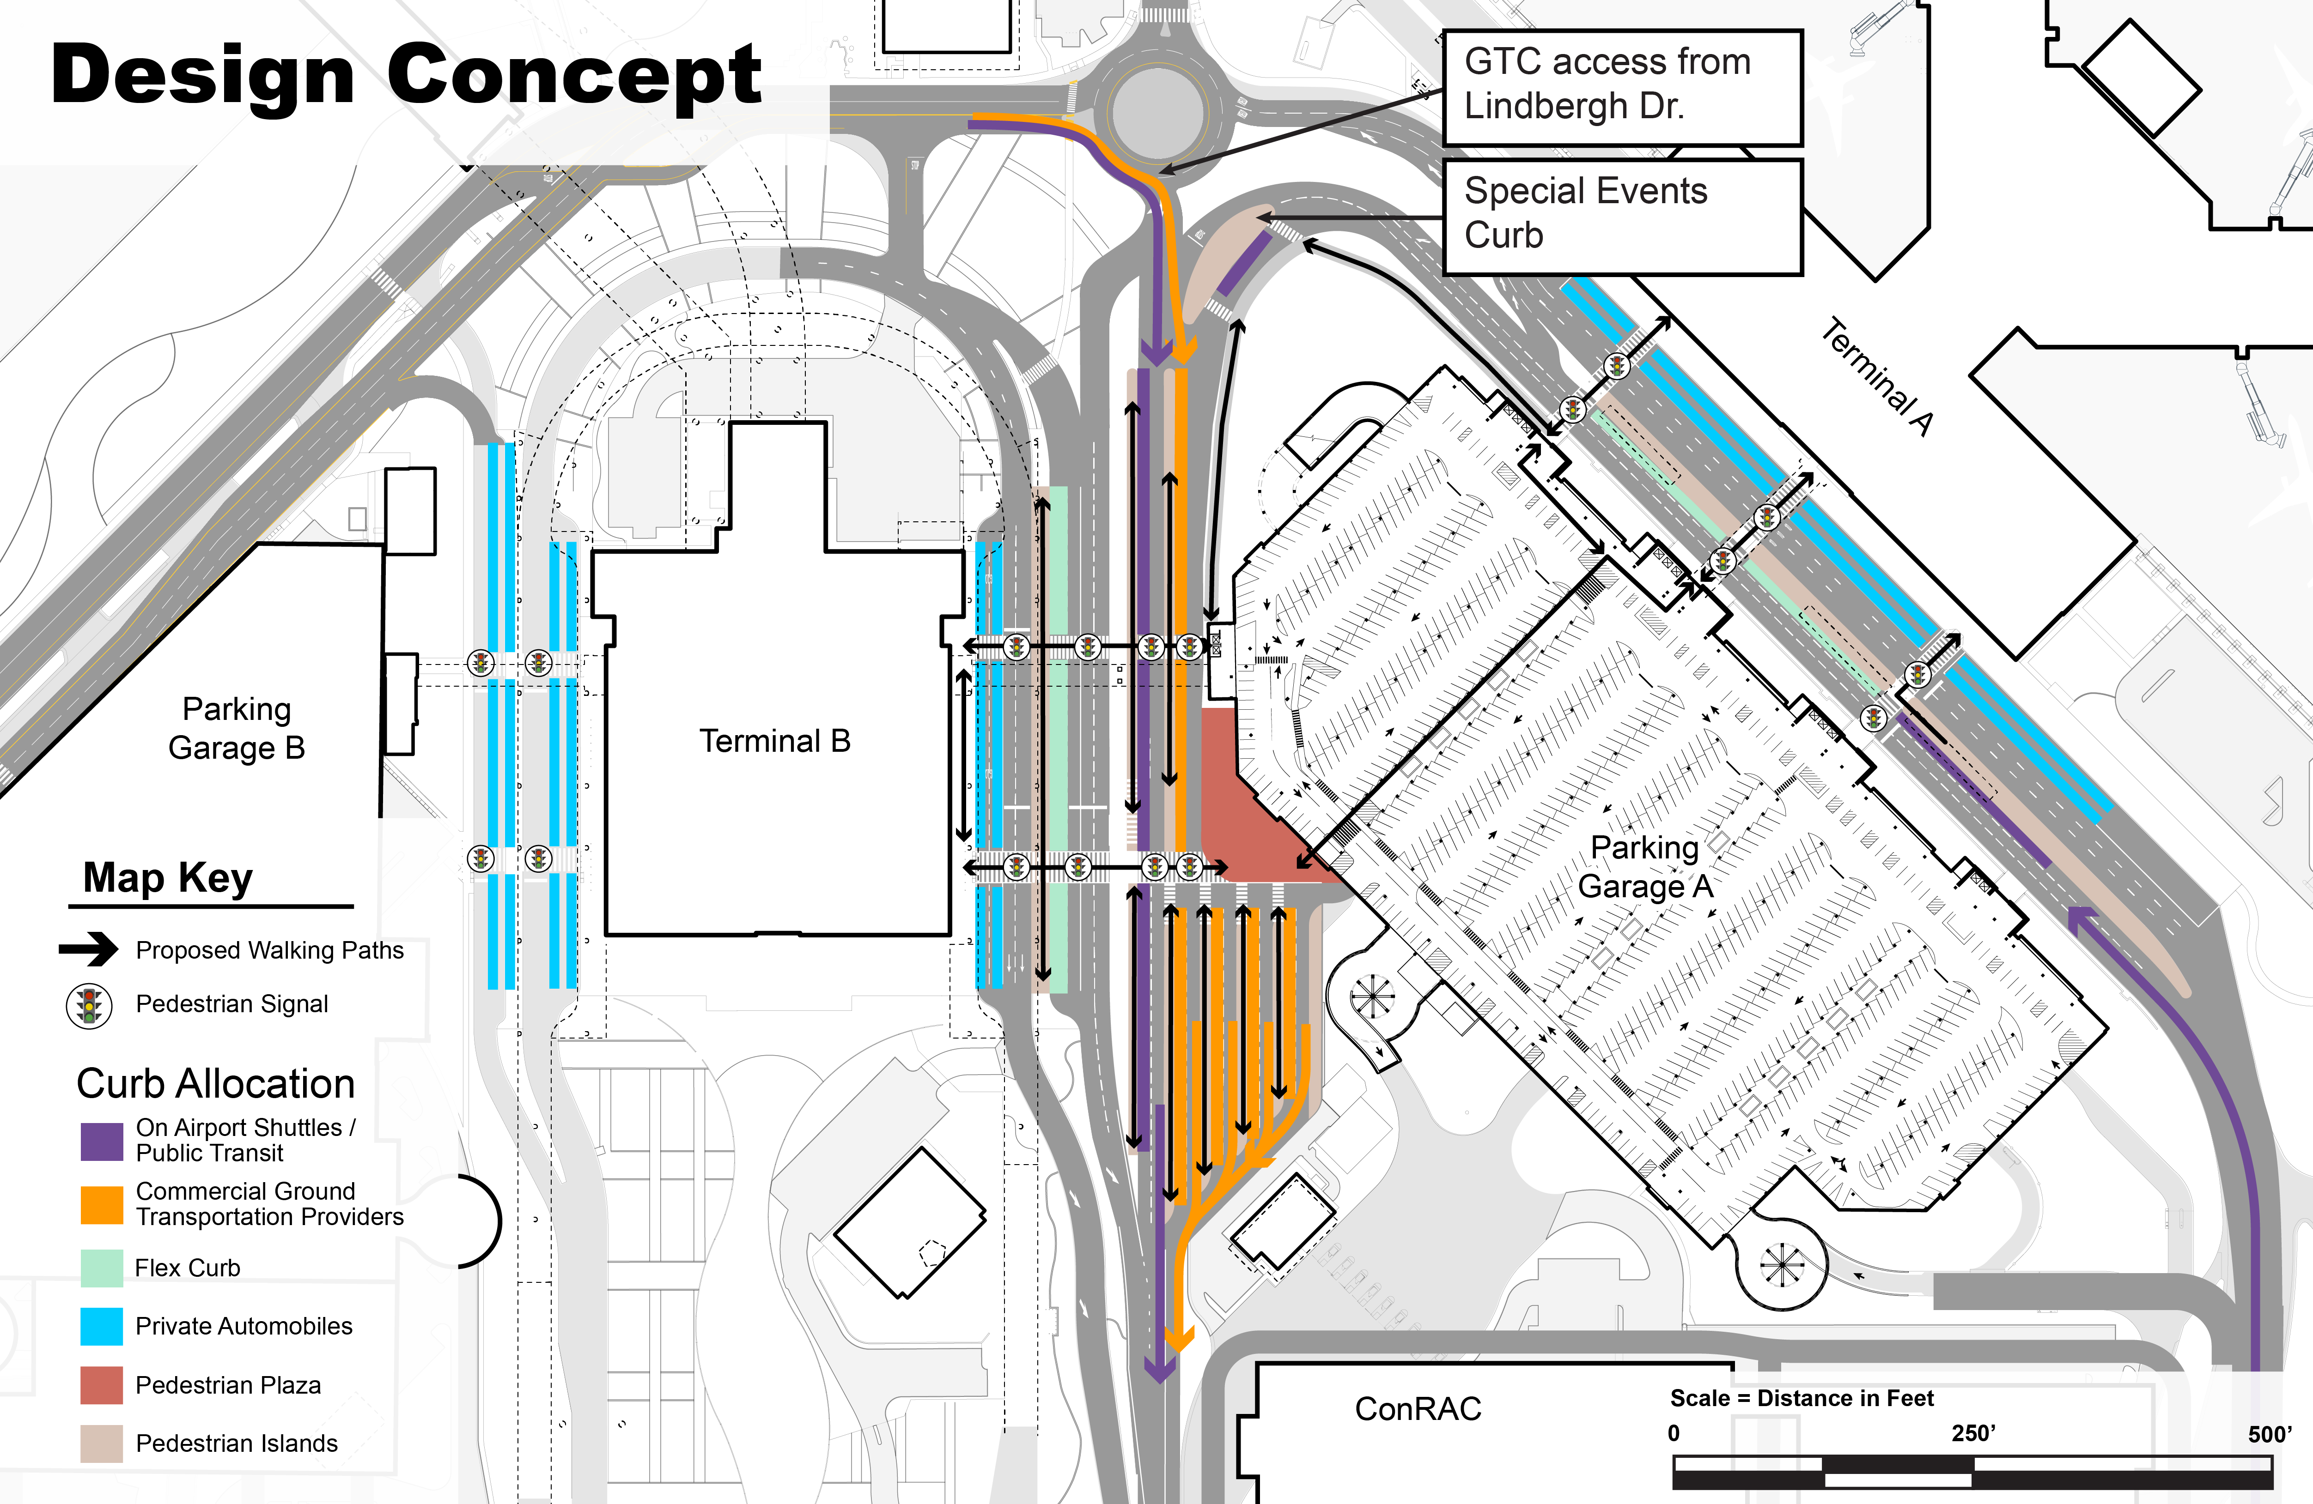

On Airport Shuttles/Public Transit
Commercial Ground Transportation Providers

Slide 6
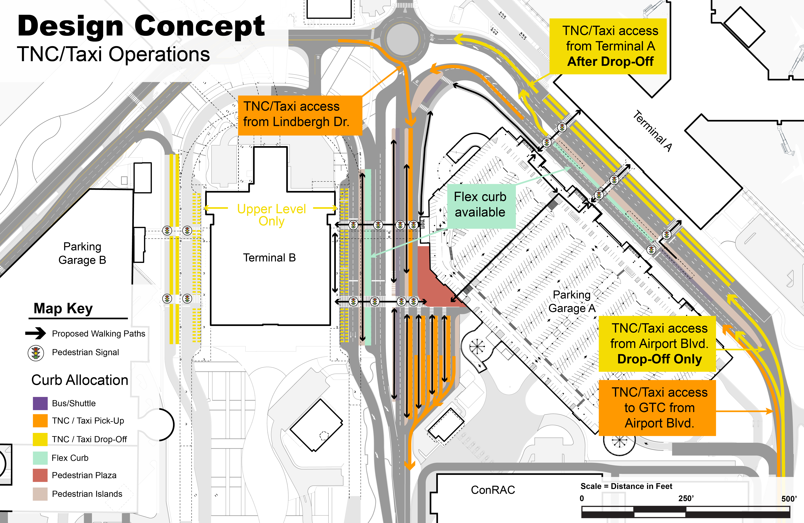
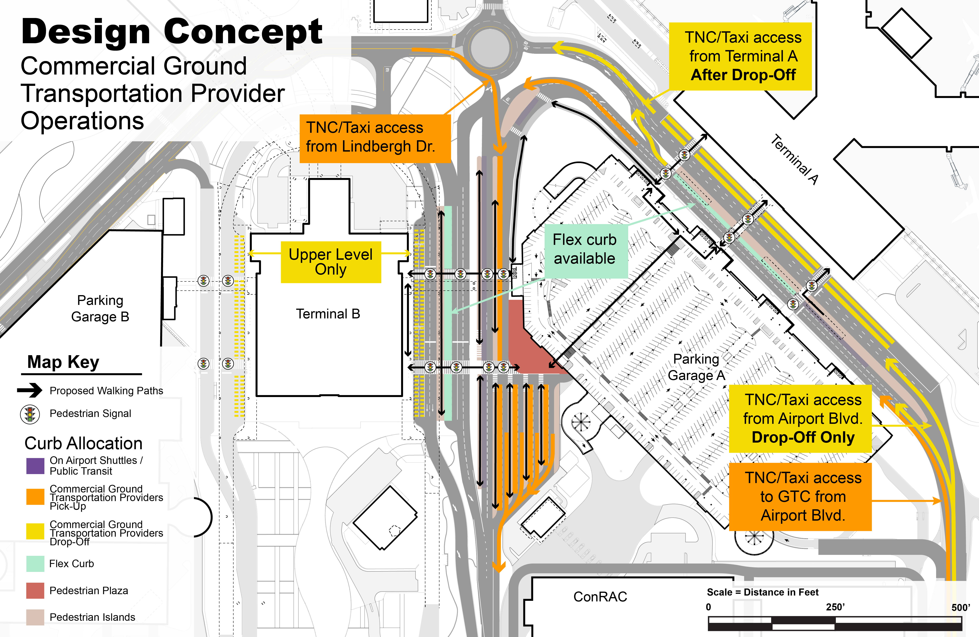
Upper Level
Only

Slide 7
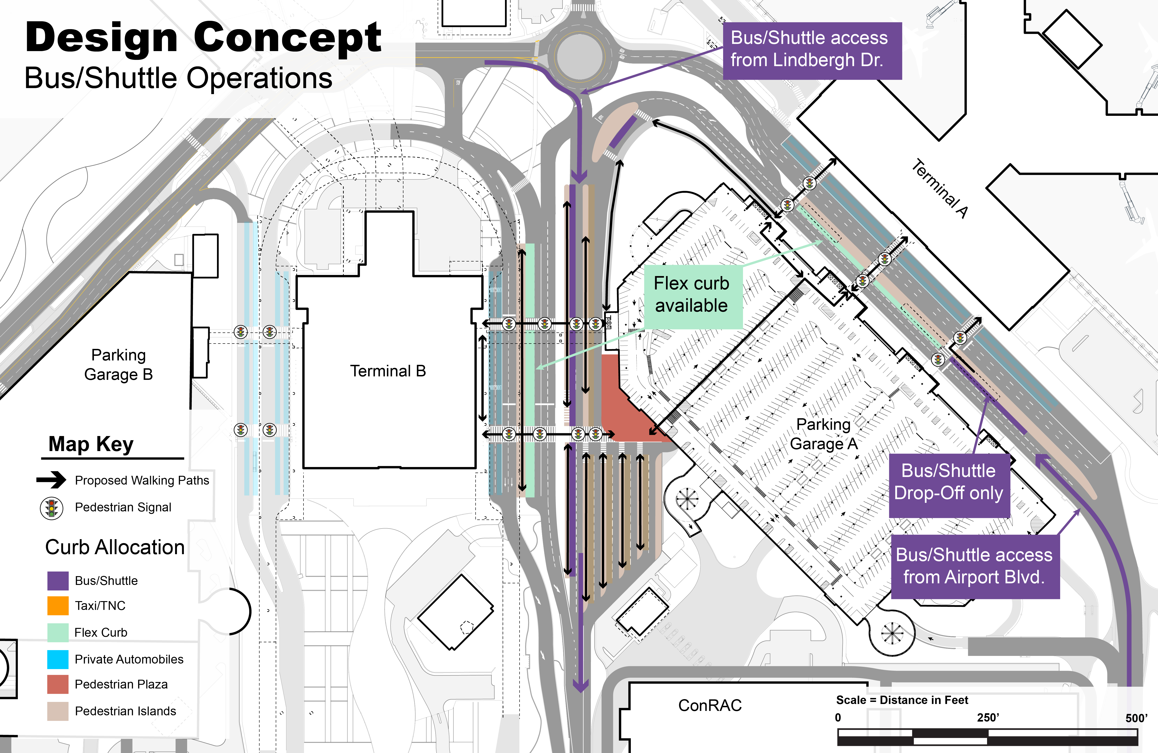
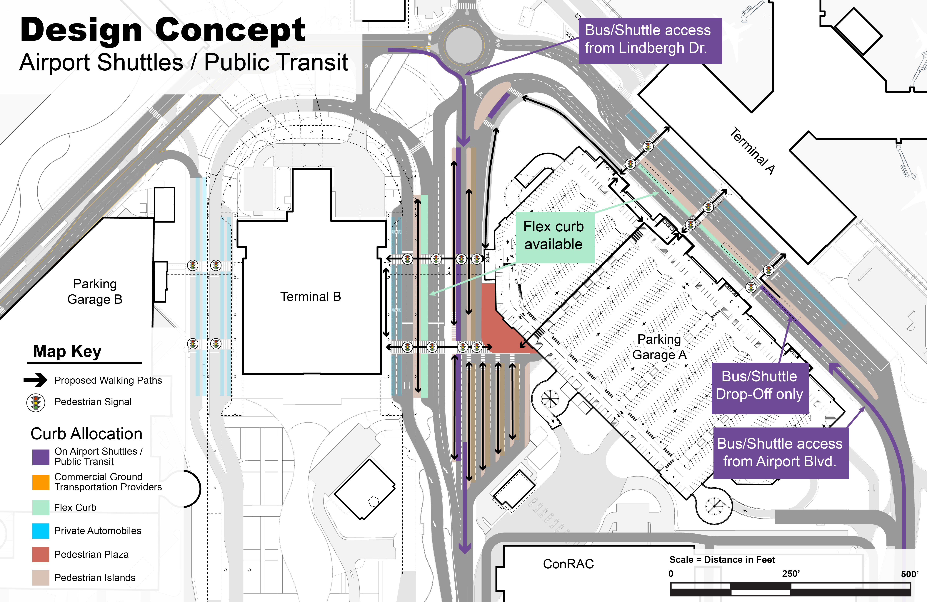

Slide 8
GTC Next Steps
Project Contact:
Name: Chris Martin
Email: MartinC@saccounty.gov
Gather Comments by COB May 15, 2024
Consider Feedback And Concept Revisions
Provide Feedback to commenters
Recommend Concept to SMForward Steering Committee
Move Concept to Detailed Design and Review
2026 Construction
2027 Open

