Slide 1
Re-Imagine North Watt
Corridor Plan Corridor Advisory Team Meeting #1 April 10, 2024
Josh Pilachowski, PhD, TE, RSP₁
Senior Transportation Engineer
josh@dksassociates.com
510.295.9741

Slide 2
AGENDA
Project Background
Project Toolbox
Alternative Review
Next Steps

Slide 3
Project Background

Slide 4
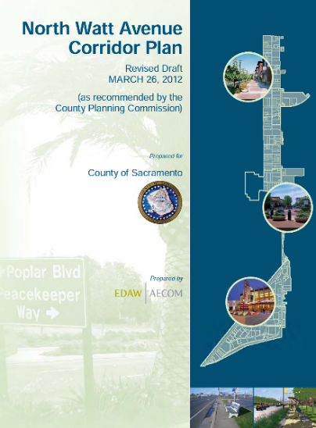

Project Background
North Watt Avenue Corridor Plan (2012)
Guide infill growth and public improvements
20-year planning horizon
Expansion of transit with mixed use development
Designation of the Corridor as a Smart Growth Street
Requirements for vehicle travel
Need for continuous bike and pedestrian facilities that meet design standards
Location of the Corridor within an Environmental Justice community (2019)
Updated Corridor Plan funded by Caltrans Sustainable Communities Grant (2022)

Slide 5
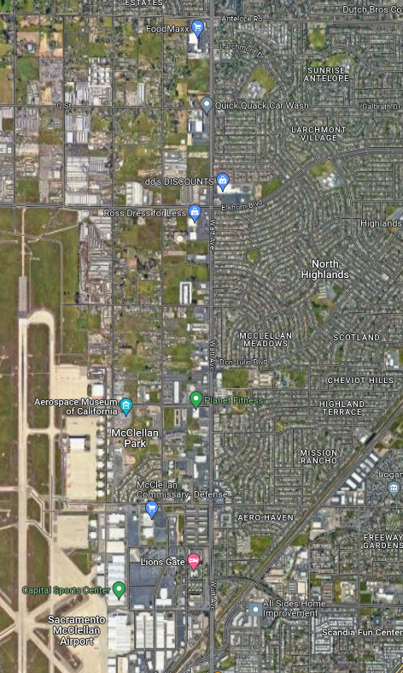
Study Area Extent
North Watt Avenue
Antelope Road to Peacekeeper Way
3.0 Mile Corridor
4-6 Lanes; 35 mph-45 mph speed limit
Adjacent Land Use
Variety of commercial use either directly adjacent or part of larger combined facilities
Churches, schools, and community centers
Residential uses either directly accessible or on adjacent frontage roads elements

Slide 6

Schedule and Status
Outreach
Existing Conditions and Site Review
Corridor Advisory Team
Existing Conditions Report
Focus Groups
Community Workshop
Alternatives Analysis
Alternative Screening
Alternative Identification
Recommended Final Alternative
Corridor Advisory Team
Community Charette
April 20
Stakeholder Interviews and Surveys
Summary Report
Corridor Advisory Team
Implementation Plan
Community Workshop
Draft Report
Final Report
Board Presentation
Committee
Presentations
Adoption

Slide 7
Purpose and Need Statement
The corridor is characterized by:
Inconsistent sidewalk and bicycle facilities
Lack of access to key locations and services
Growing vehicular demand
High collision rates at key intersections
Goal is to re-imagine North Watt Avenue as a multimodal, sustainable, and safe corridor that meets the needs of all users today and in the future. This project will:
Provide a comfortable and safer traveling environment for vulnerable road users
Improve facilities to meet current ADA requirements and County design standards
Provide transit infrastructure which improves user experience
Accommodate future traffic growth without excessive traffic congestion
Improve safety for all road users

Slide 8
Project Toolbox

Slide 9





Streetscape elements overview
MOBILITY
SAFETY
STREET FURNISHING
LANDSCAPE
PLACEMAKING

Slide 10
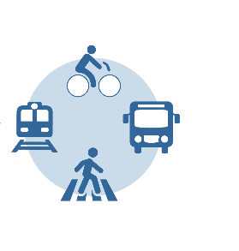
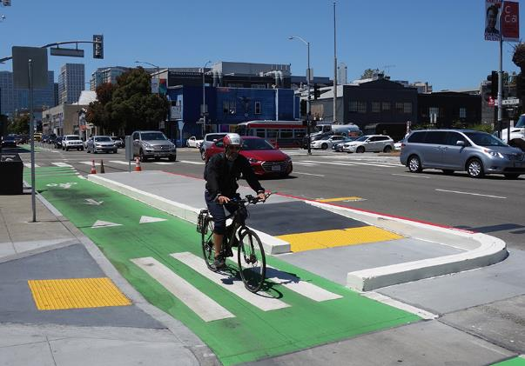
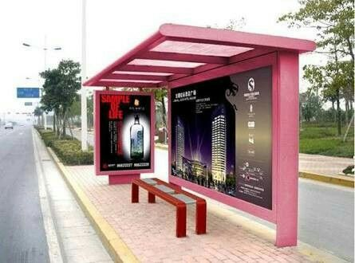
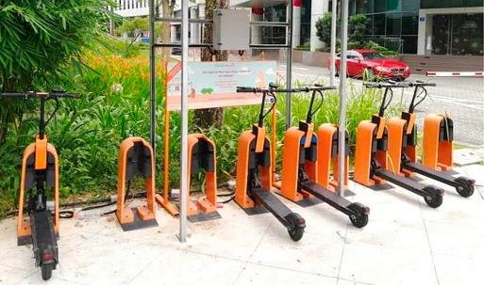
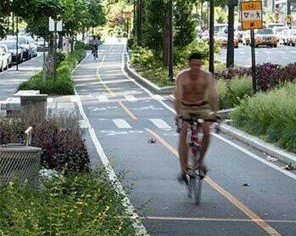
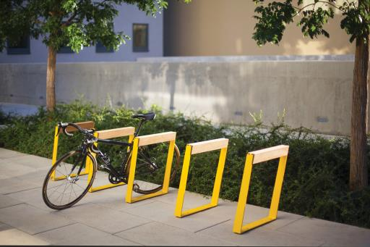
MOBILITY
Bus-stops/ Shelters
Protected Bike Lanes
Micro-mobility

Slide 11

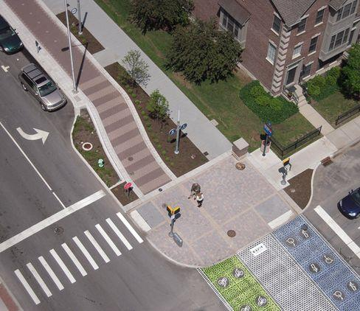
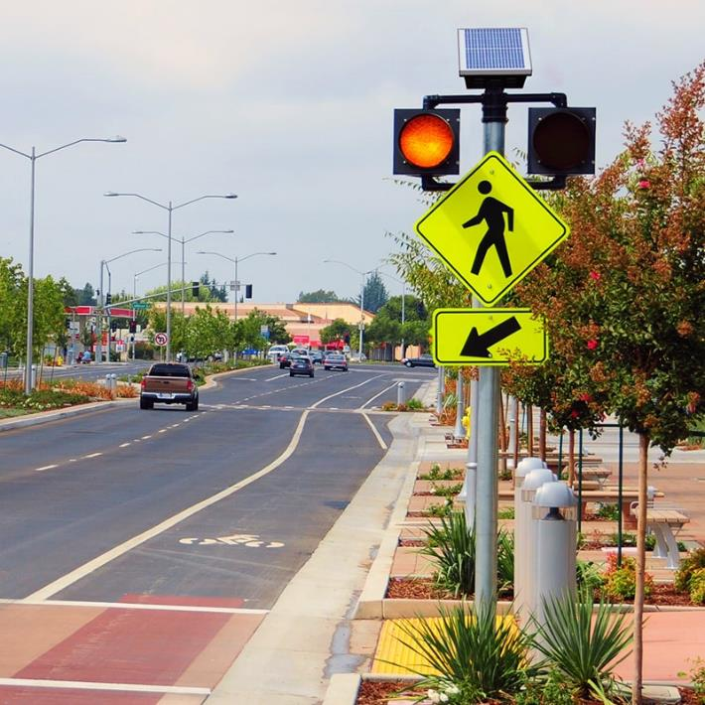
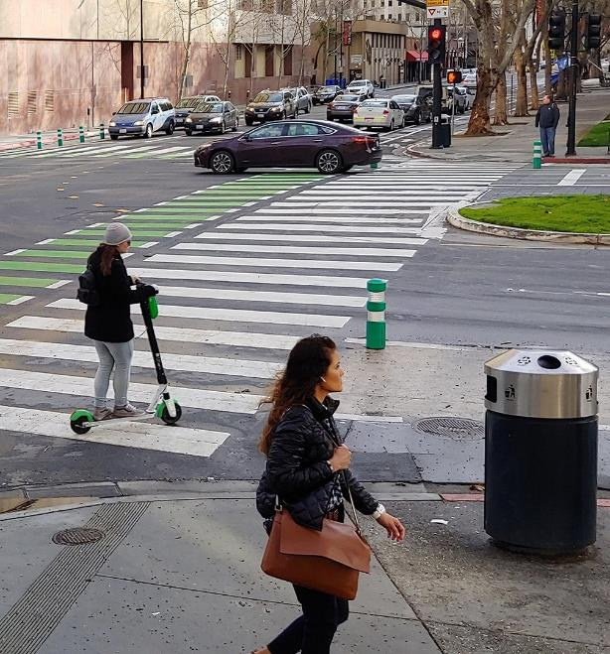
SAFETY
Bulb-outs
Pedestrian Beacons
Enhanced Crosswalks

Slide 12

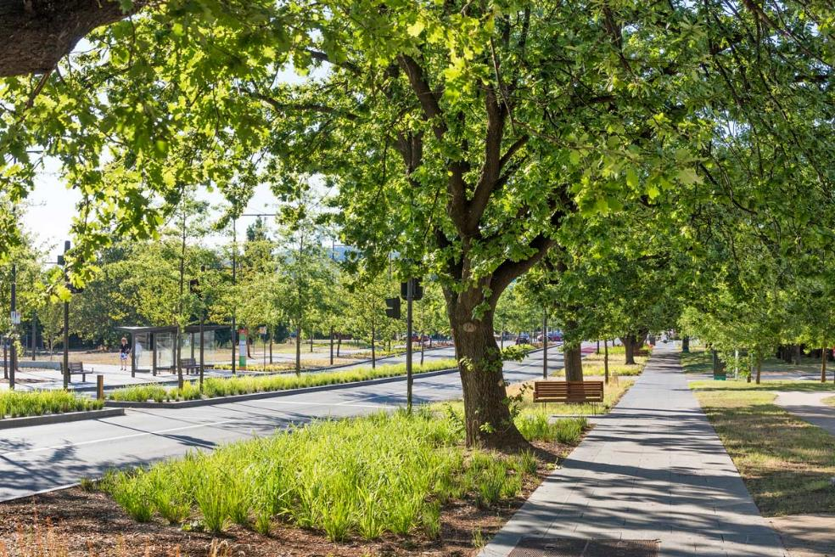
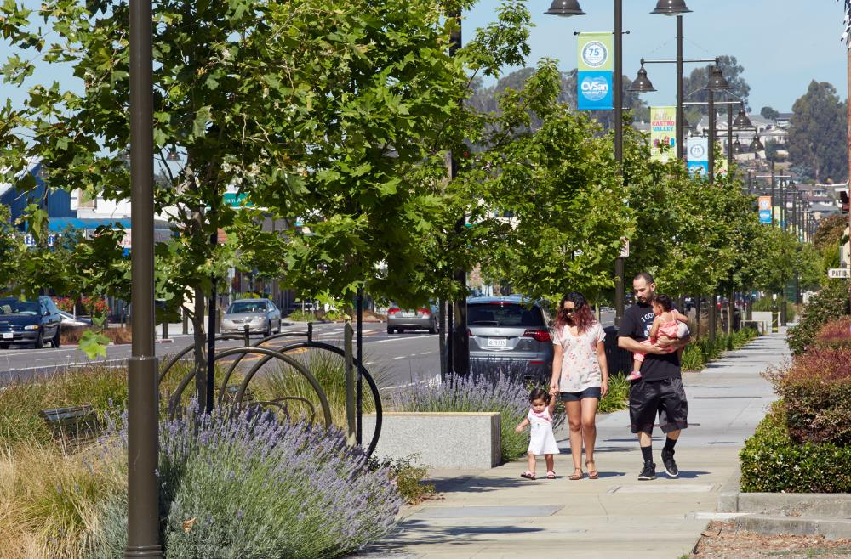
LANDSCAPE
Street Planting & Landscape Strips
Rain Gardens

Slide 13

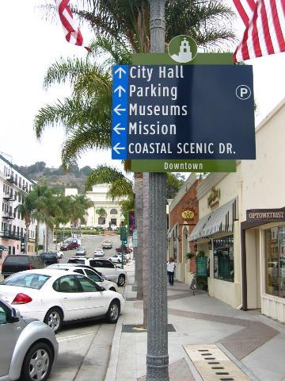
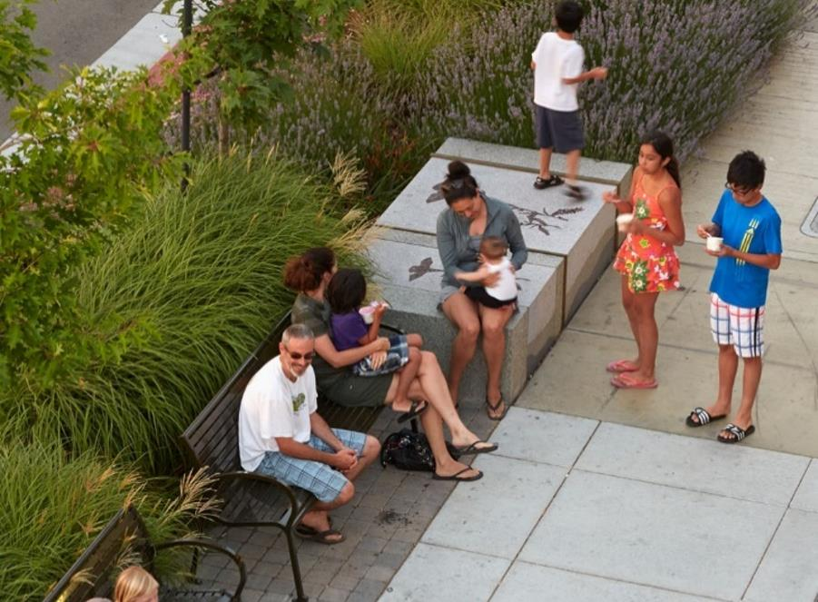
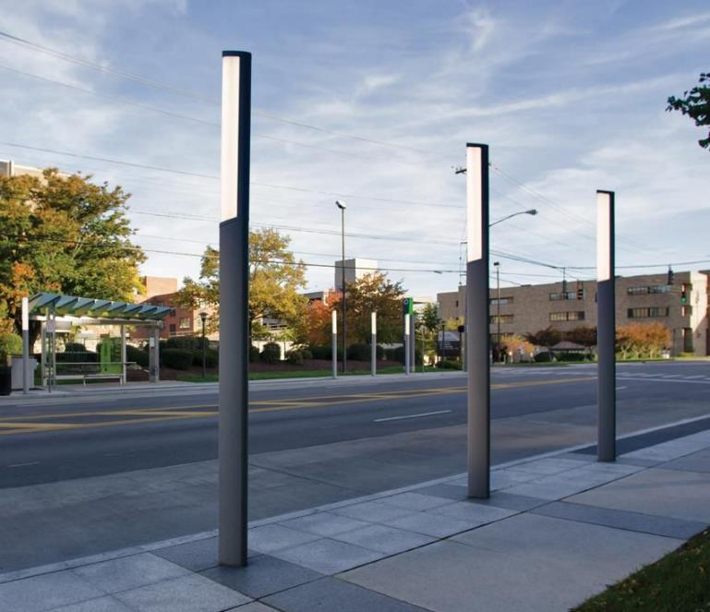
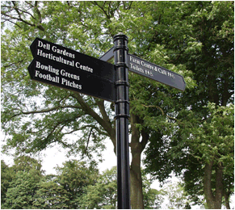
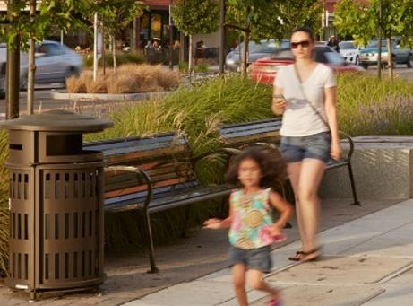
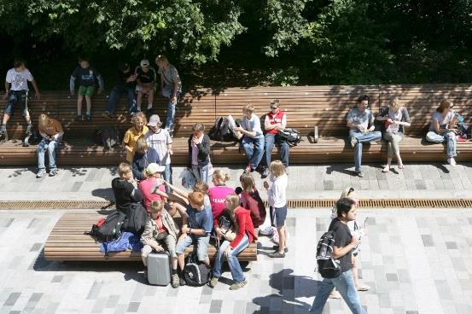
STREET FURNISHING
Signage/ Wayfinding
Seating/ Benches
Lighting
Trash Receptacles

Slide 14

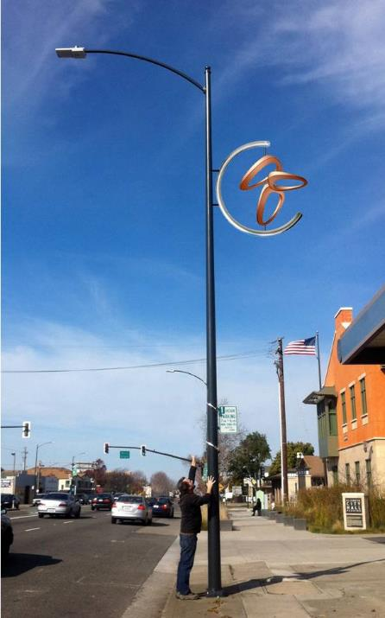
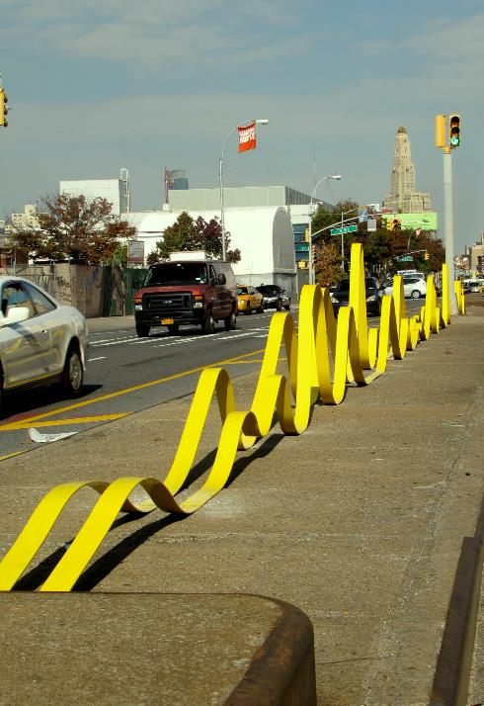
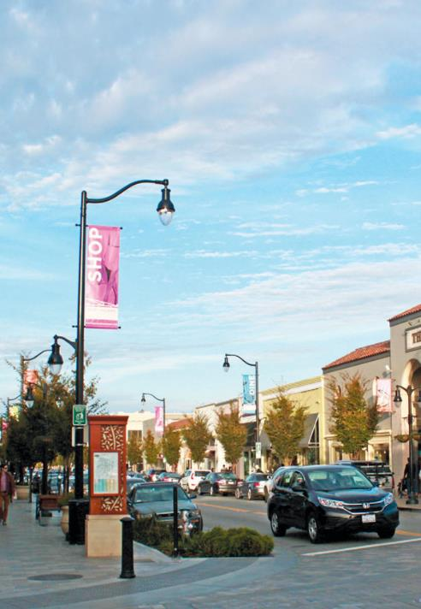
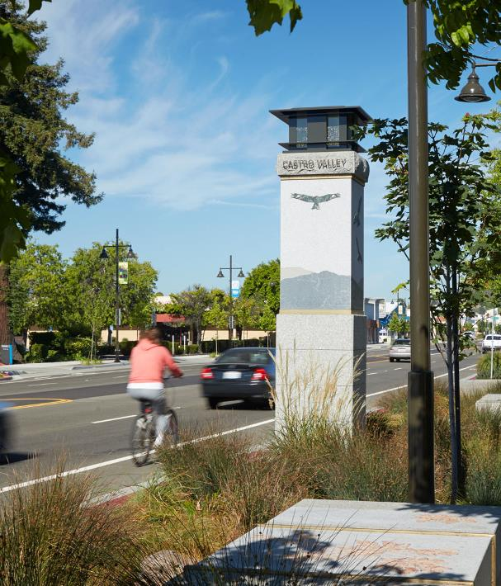
PLACEMAKING
Public Art
Identity Signage
Gateway Element

Slide 15



Roadway Elements Overview
Transit
Vehicle
Bicycle

Slide 16
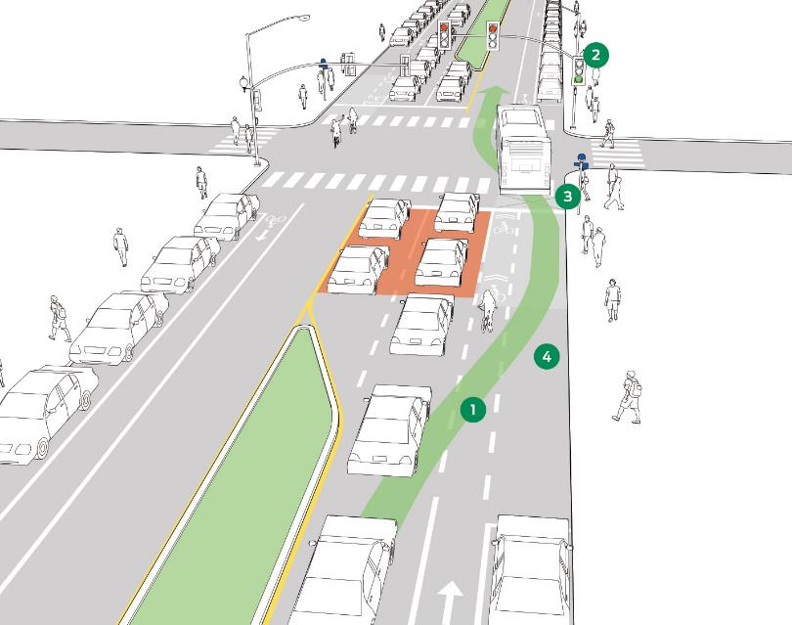
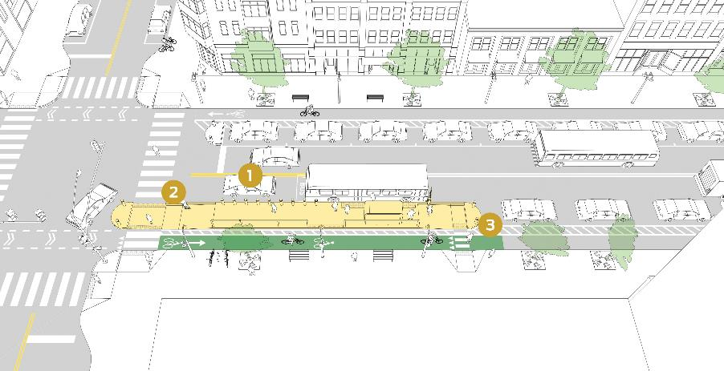
Transit Facilities
Island Stops
Bus Queue Jumps
Images Source: Transit Street Design Guide, NACTO, Accessed April 9, 2024

Slide 17
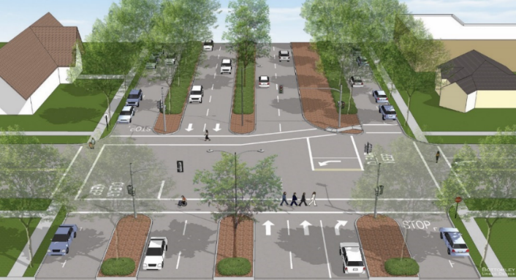
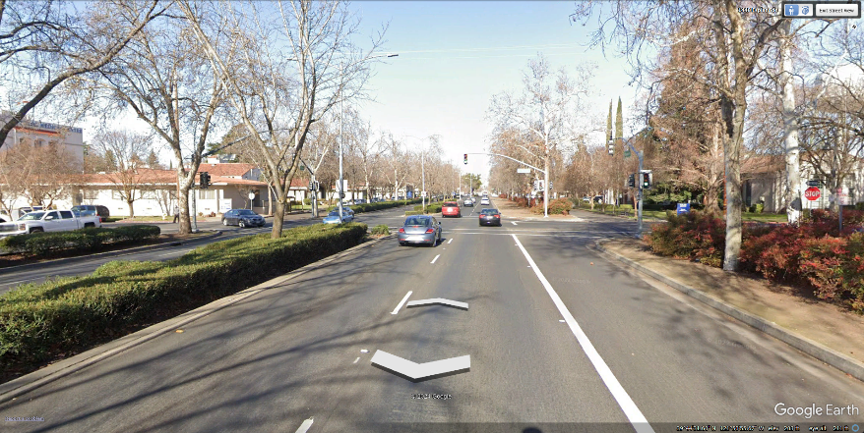
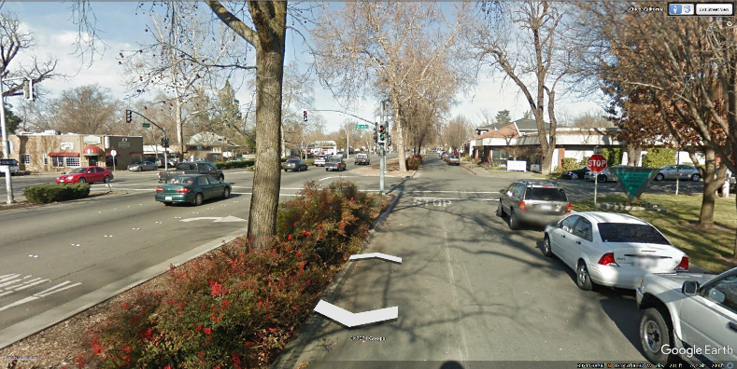
Roadway Facilities
Urban Boulevard
Image Source: Esplanade Corridor Safety and Accessibility Study, Chico, CA; W-Trans, September 9, 2016
Image Source: Google Earth Street View, Esplanade, Chico, CA
Image Source: Google Earth Street View, Esplanade, Chico, CA

Slide 18
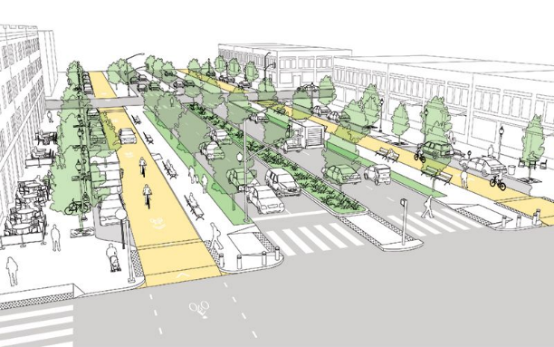
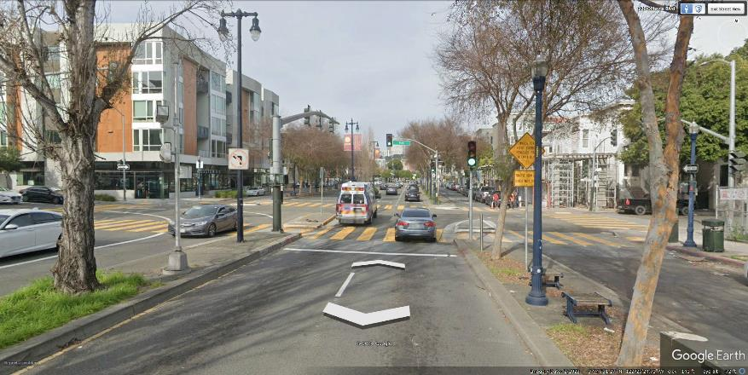
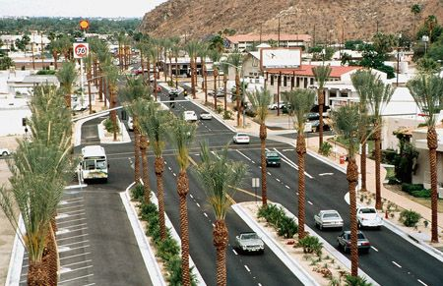
Roadway Facilities
Urban Boulevard
Image Source: Urban Street Design Guide, NACTO, Accessed April 9, 2024
Image Source: Google Earth Street View, Octavia Street, San Francisco, CA
Image Source: Urban Street Design Guide, NACTO, Accessed April 9, 2024; Original Photo credit to Urbanlandscapes.info

Slide 19
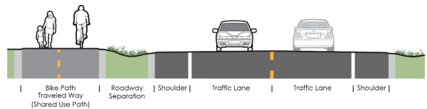
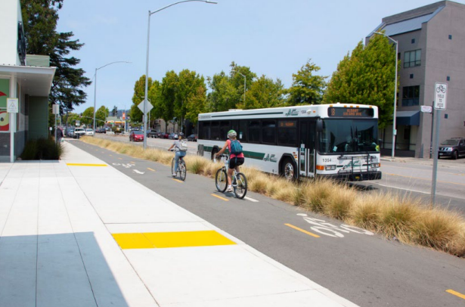
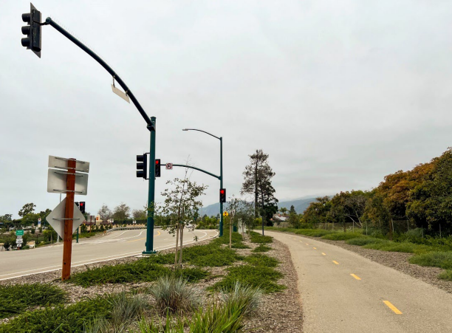
Bicycle Facilities
Class I Bike Trail
Images Source: DIB 94 Complete Streets: Contextual Design Guidance, Caltrans, January 16, 2024

Slide 20
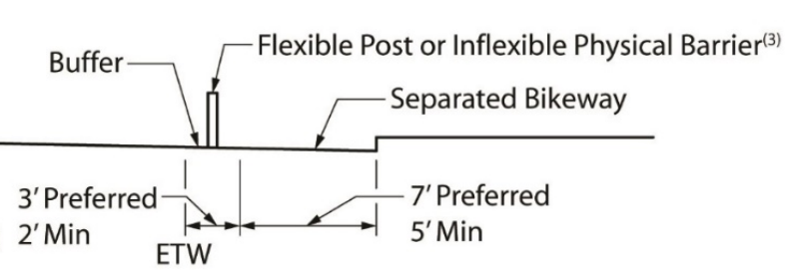
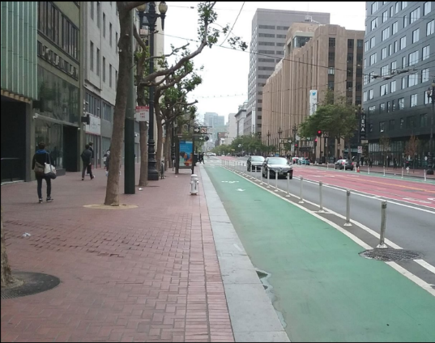
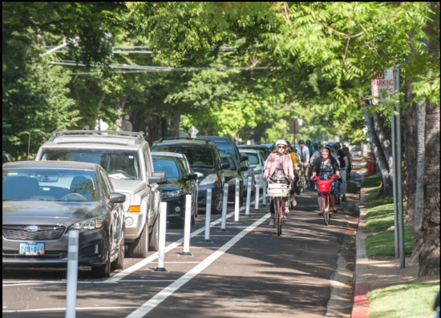
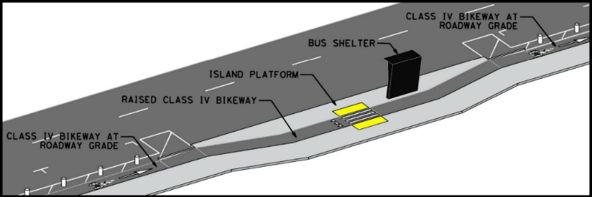
Bicycle Facilities
Class IV Bike Lanes
Images Source: DIB 89-02 Class IV Bikeway Guidance, Caltrans, February 7, 2022

Slide 21
Alternatives

Slide 22
Project Alternative Concepts
Minimum Improvements
Bring corridor up to current design standards
Sidewalk and bike lane gap closures
One-Way Couplet
Conceives North Watt Avenue as one way northbound and 34th Steet as one way southbound
Study from 2012 had this cross section as three travel lanes, one BRT lane, and one class II bike lane
Current recommendation for this alternative based on feedback removes the BRT lane and replaces the Class II bike lanes with a Class I Trail on North Watt Avenue
Vehicle/Bicyclist Priority Improvement
Options for either four or six lane cross sections
If a four lane cross section is used, requires improvements to 34th Street
Install Class IV buffered bike lanes along Watt Avenue
Urban Boulevard
Improve and expand the frontage road system along Watt Avenue
Provide lower stress bicycle and pedestrian connections along the frontage roads
Limit conflicting driveways for through traffic on Watt Avenue

Slide 23
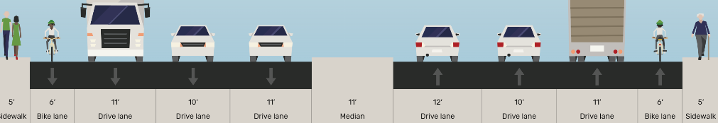
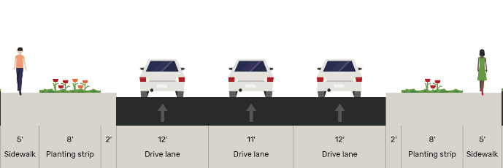
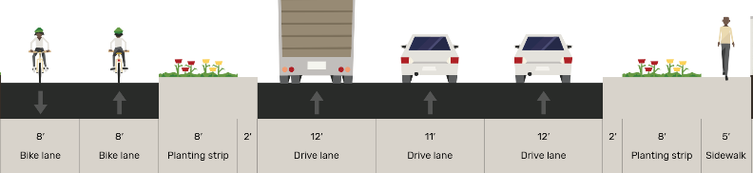
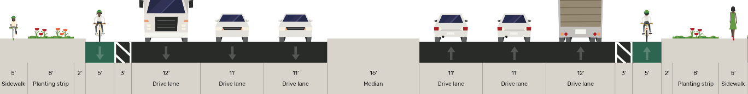
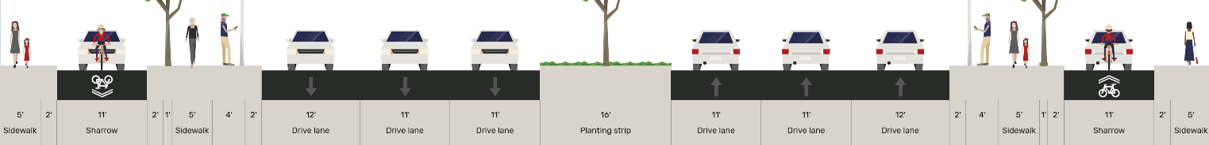
Project Alternative Concepts
Minimum Build
34th Street
One-Way Couplet
Watt Avenue
Vehicle/Bicyclist Priority Improvement
Urban Boulevard
Cross Sections illustrative, actual dimensions for design will vary by location along the corridor
Cross Sections Generated with Open StreetMix

Slide 24
Minimum Improvements
B
Key Aspects of Improvement
Bring the existing sidewalks and bicycle lanes up to standard
Close the existing gaps in pedestrian and bicycle infrastructure
Provide frontage improvements where feasible
C
D
Outcomes
Low Cost and Low Right of Way (ROW) Impact
Brings the corridor in line with current engineering standards with minimal impact to existing homes and businesses
Would not meet the needs of future traffic growth anticipated along Watt Avenue
Corridor would still be high stress for pedestrians and Bicyclists
Cross Sections illustrative, actual dimensions for design will vary by location along the corridor
Cross Sections Generated with Open StreetMix

Slide 25
One Way Couplet
A
C
34th Street
Watt Avenue
Key Aspects of Improvement
Narrows the existing Watt Avenue to three lanes Northbound and improves 34th Street to three lanes southbound
Provides a Class I Bike trail or Bus Rapid Transit (BRT) lanes in the corridor
D
Outcomes
High cost of improvement and requires significant ROW acquisition on 34th Street
Additional ROW and design challenges for transition points
Brings the corridor in line with current engineering standards
Provides sufficient through capacity for commuters
Requires significant improvement on multiple cross streets between Watt Avenue and 34th street
Would provide potential for significant improvement to bicycle access
Significantly increases walking distance for access to/from southbound transit
Cross Sections illustrative, actual dimensions for design will vary by location along the corridor
Cross Sections Generated with Open StreetMix

Slide 26
Vehicle/Bicycle Priority
B
D
Key Aspects of Improvement
Widens the existing Watt Avenue to accommodate six lanes of traffic for most of the study corridor
Adds Class IV buffered bike lanes to both sides of the street
Improves sidewalk and frontage to improve pedestrian comfort
Outcomes
Middle cost improvement with additional ROW only needed in portions of the corridor
Brings the corridor in line with current engineering standards
Provides sufficient through capacity for growth
Does not impact 34th Street
Would provide significant improvement to bicycle access
Cross Sections illustrative, actual dimensions for design will vary by location along the corridor
Cross Sections Generated with Open StreetMix

Slide 27
Urban Boulevard
C
Key Aspects of Improvement
Widens the existing Watt Avenue to accommodate six lanes of traffic for most of the study corridor
Adds one way frontage roads to much of the corridor and converts existing two-way frontage to one way
Places a significant buffer between the main travel lanes and the frontage streets which prioritize pedestrian and bicycle activity
Reduces vehicle conflicts for through lanes on Watt Avenue
Outcomes
Highest cost improvement with additional ROW needed throughout the corridor
Brings the corridor in line with current engineering standards
Provides sufficient through capacity for growth
Does not impact 34th Street
Would provide significant improvement for pedestrians and bicyclists
Cross Sections illustrative, actual dimensions for design will vary by location along the corridor
Cross Sections Generated with Open StreetMix

Slide 28
Next Steps

Slide 29
Next Steps
Alternative Refinement
Public Workshop #2 – April 20, 2024
Detailed alternative description
Evaluation and Selection of Preferred Alternative
Comparative review of each alternative
Cost estimation and displacement analysis
Outreach
Raising awareness of the preferred alternative

Slide 30
THANK YOU
Josh Pilachowski, PhD, TE, RSP₁
Senior Transportation Engineer
josh@dksassociates.com
510.295.9741

