Slide 1
Re-Imagine North Watt
Corridor Plan Sacramento County Disability Advisory Commission Physical Access Subcommittee November 19, 2024
Josh Pilachowski, PhD, TE, RSP₁
Senior Transportation Engineer
josh@dksassociates.com
510.295.9741

Slide 2
AGENDA
Project Background
Review of Alternatives
Initial Evaluation
Next Steps

Slide 3
Project Background

Slide 4
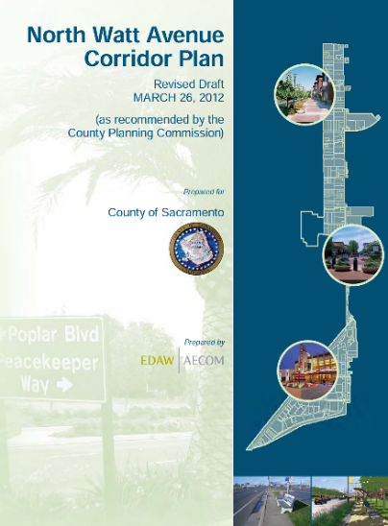

Project Background
North Watt Avenue Corridor Plan (2012)
Guide infill growth and public improvements
20-year planning horizon
Expansion of transit with mixed use development
Designation of the Corridor as a Smart Growth Street
Requirements for vehicle travel
Need for continuous bike and pedestrian facilities that meet design standards
Location of the Corridor within an Environmental Justice community (2019)
Updated Corridor Plan funded by Caltrans Sustainable Communities Grant (2022)

Slide 5
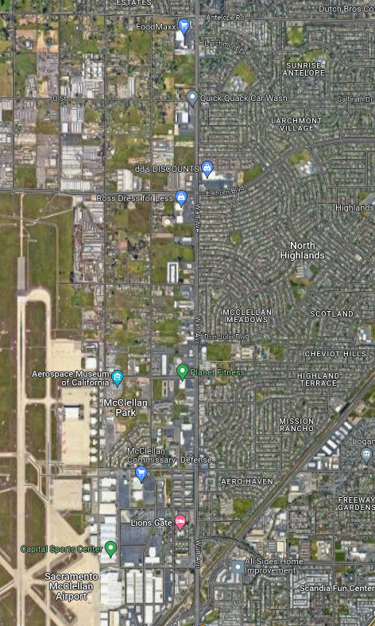
Study Area Extent
North Watt Avenue
Antelope Road to Peacekeeper Way
3.0 Mile Corridor
4-6 Lanes; 35 mph-45 mph speed limit
Adjacent Land Use
Variety of commercial use either directly adjacent or part of larger combined facilities
Churches, schools, and community centers
Residential uses either directly accessible or on adjacent frontage roads elements

Slide 6
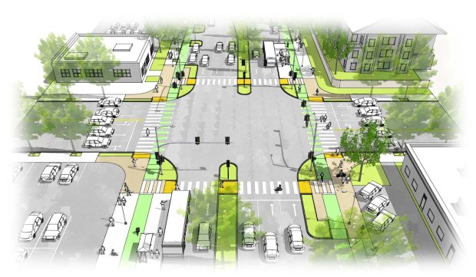
Purpose and Need Statement
The corridor is characterized by:
Inconsistent sidewalk and bicycle facilities
Lack of access to key locations and services
Growing vehicular demand
High collision rates at key intersections
Goal is to re-imagine North Watt Avenue as a multimodal, sustainable, and safe corridor that meets the needs of all users today and in the future. This project will:
Provide a comfortable and safer traveling environment for vulnerable road users
Improve facilities to meet current ADA requirements and County design standards
Provide transit infrastructure which improves user experience
Accommodate future traffic growth without excessive congestion
Improve safety for all road users

Slide 7

Schedule and Status
Outreach
Existing Conditions and Site Review
Corridor Advisory Team
Existing Conditions Report
Focus Groups
Community Workshop
Alternatives Analysis
Alternative Screening
Alternative Identification
Recommended Final Alternative
Corridor Advisory Team
Community Charette
Stakeholder Interviews and Surveys
Summary Report
Corridor Advisory Team
Implementation Plan
Community Workshop
Draft Report
December
December
Final Report
Board Presentation
Committee
Presentations
Adoption

Slide 8
Alternatives

Slide 9
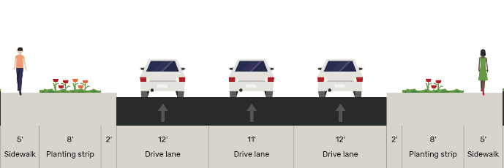
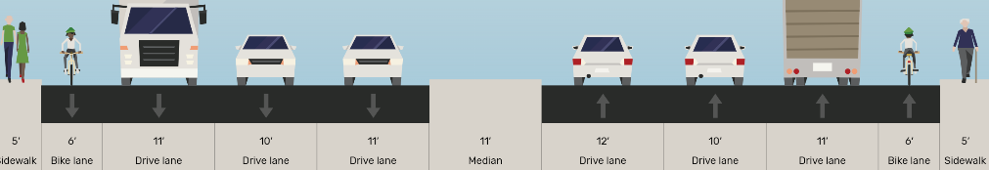
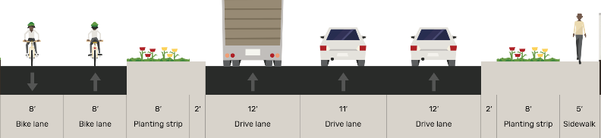
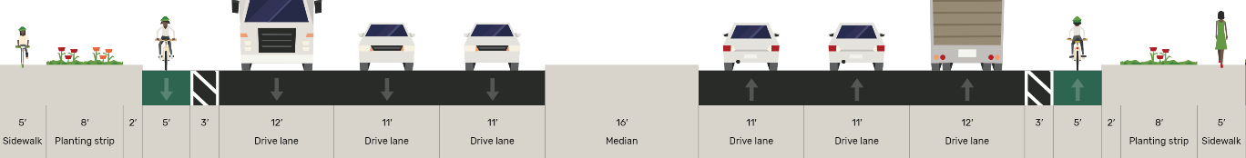
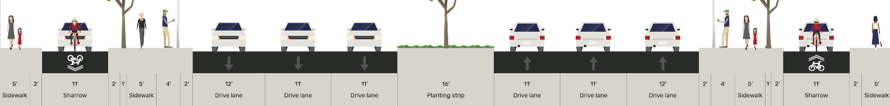
One Way Couplet
Cross Sections illustrative, actual dimensions for design will vary by location along the corridor
Cross Sections Generated with Open StreetMix
A
C
34th Street
Watt Avenue
D
No Project (Currently adopted improvement plan)
Significant impact to 34th Street
Difficult to transition from one-way to two-way flow
Inconsistent with County vision
Significant out-of-direction travel and loss of traffic to businesses

Slide 10
Minimal Impact
B
Cross Sections Generated with Open StreetMix
C
Maintain existing centerline and cross-section, as possible
Consistent bidirectional Class II Bicycle lane and sidewalk
Meet current accessibility standards
Sufficient lanes to manage traffic growth
Reduced sidewalk and landscaping to minimize ROW impacts
D
Cross Sections illustrative, actual dimensions for design will vary by location along the corridor

Slide 11
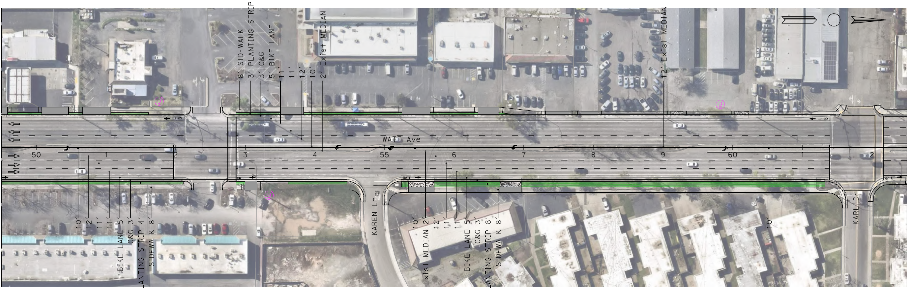
Minimal Impact
B
Cross Sections Generated with Open StreetMix
C
D

Slide 12
Hybrid Urban Boulevard
Cross Sections illustrative, actual dimensions for design will vary by location along the corridor
C
Cross Sections Generated with Open StreetMix
Widen to accommodate six lanes and include one-way frontage road
Consistent bidirectional Class IV Protected Bicycle lanes or low-volume one-way Class III Bicycle Boulevard on frontage road, and sidewalk
Meet current accessibility standards
Full 8’ sidewalk and 8’ planting strip where feasible to meet County design standards
Sufficient lanes to manage traffic growth
Future bus rapid transit (BRT) adaptable

Slide 13
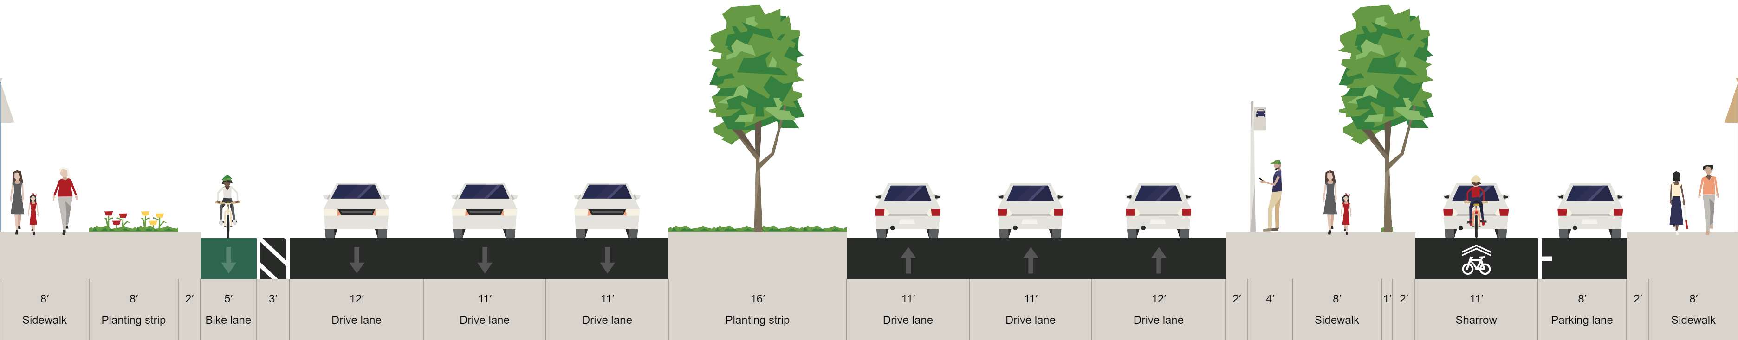
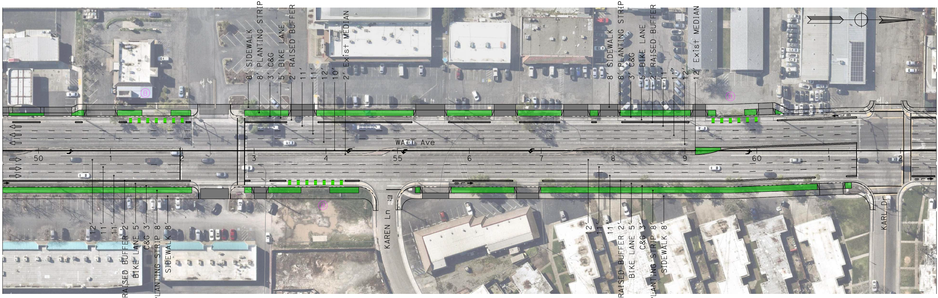
Hybrid Urban Boulevard
Cross Sections illustrative, actual dimensions for design will vary by location along the corridor
C
Cross Sections Generated with Open StreetMix

Slide 14
Initial Evaluation

Slide 15
Community and Partner Agency Feedback
Address pavement quality
Close gaps in the pedestrian and bicycle infrastructure
Improve accessibility
Add lanes (either direct requests or requests to reduce vehicle congestion)
Improve lighting conditions
Minimize Right of Way impacts on homes and local businesses
Maintain viability of County land for future development
Allow for future implementation of side-running BRT

Slide 16
Purpose and Need Evaluation
Minimal Impact
Hybrid Urban
Comfort and safety for vulnerable road users
Meet current ADA requirements and County design standards
Improves transit user experience and allow BRT
Maintain traffic operations with forecasted growth
Improve safety for all road users
Minimize Right-of-way impacts
No buffer for bike lane Reduced landscape buffer
Protected bike lane Full landscape buffer
ADA – Yes Design standards – somewhat
ADA – Yes Design standards – mostly
Improved amenities Not BRT adaptable
Improved amenities BRT adaptable
Yes
Yes
Minimally improved by removing gaps in sidewalks and bike lanes
Improved through protected bicycle and pedestrian facilities, reduced driveways
Minimal business impacts No residential impacts
Some business/parking impacts Minimal residential impacts

Slide 17
Next STeps

Slide 18
Upcoming Outreach and Project Tasks
Presentations (December)
Corridor Advisory Team Presentation
Community Town Hall
Documentation
Implementation Plan and Draft Report
Analysis/Exhibits
Urban greening and placemaking concept plans
Corridor fly-bys
Displacement analysis

Slide 19
THANK YOU
Josh Pilachowski, PhD, TE, RSP₁
Senior Transportation Engineer
josh@dksassociates.com
510.295.9741

