Slide 1
Re-Imagine North Watt
Corridor Plan Sacramento County Disability Advisory Commission February 20, 2024
Josh Pilachowski, PhD, TE, RSP₁
Senior Transportation Engineer
josh@dksassociates.com
510.295.9741

Slide 2
AGENDA
Project Background
Existing Conditions
Modal Review
Next Steps

Slide 3
Project Background

Slide 4
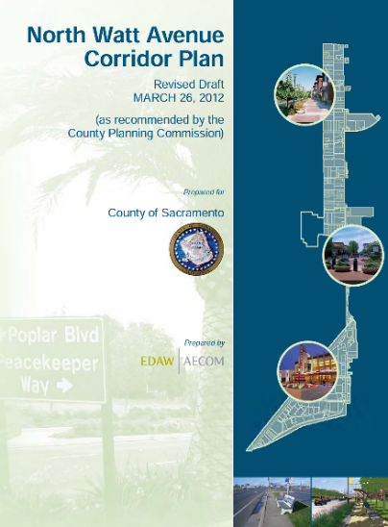

Project Background
North Watt Avenue Corridor Plan (2012)
Guide infill growth and public improvements
20-year planning horizon
Expansion of transit with mixed use development
Designation of the Corridor as a Smart Growth Street
Requirements for vehicle travel
Need for continuous bike and pedestrian facilities that meet design standards
Location of the Corridor within an Environmental Justice community (2019)
Updated Corridor Plan funded by Caltrans Sustainable Communities Grant (2022)

Slide 5
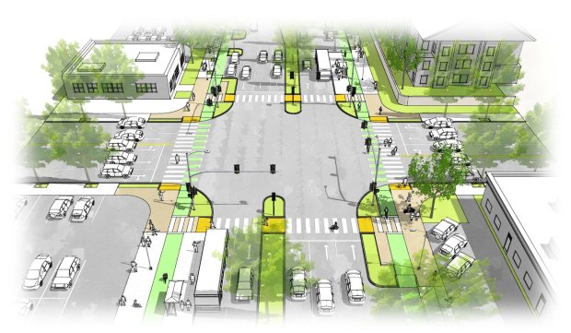
Purpose and Need
Re-Imagine North Watt Avenue as…
Multimodal, Sustainable, and Safe
Equitable and Connected
Work within existing constraints
Inconsistent existing right-of-way and frontage
High vehicle volumes and speeds
Comprehensive engagement
Local jurisdictions and regional planning agencies
Residents, business owners, and community-based organizations
Disadvantaged communities
Rendering of Bascom Avenue in the South Bay. (Santa Clara Valley Transportation Authority)

Slide 6

Schedule and Status
Outreach
Existing Conditions and Site Review
Corridor Advisory Team
Existing Conditions Report
Focus Groups
Community Workshop
Alternatives Analysis
Recommended Final Alternative
Corridor Advisory Team
Community Charette
Summary Report
Stakeholder Interviews and Surveys
Implementation Plan
Corridor Advisory Team
Draft Report
Community Workshop
Final Report
Board Presentation
Committee
Presentations
Adoption

Slide 7

Planned Outreach
Corridor Advisory Team
Three meetings to provide feedback on key deliverables
Stakeholder Interviews and Surveys
Discussions with local and regional agencies, community-based organizations, and disadvantaged community members
Lessons learned, challenges, goals and objectives
Focus Groups
Small group discussions with disadvantaged communities
Community Workshops
Open houses and on-site charettes to discuss key project elements

Slide 8
Existing Conditions

Slide 9
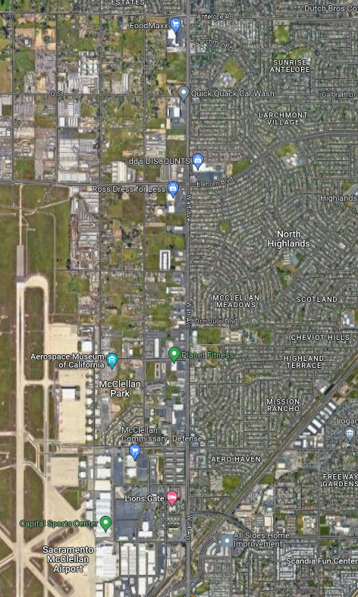
Study Area Extent
North Watt Avenue
Antelope Road to Peacekeeper Way
3.0 Mile Corridor
4-6 Lanes; 35 mph-45 mph speed limit
Adjacent Land Use
Variety of commercial use either directly adjacent or part of larger combined facilities
Churches, schools, and community centers
Residential uses either directly accessible or on adjacent frontage roads elements

Slide 10
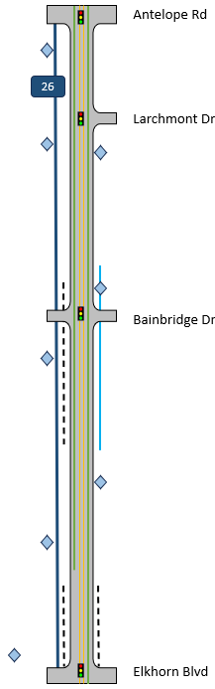
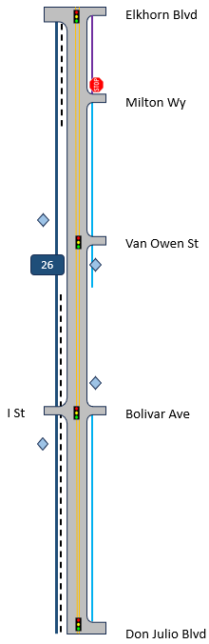
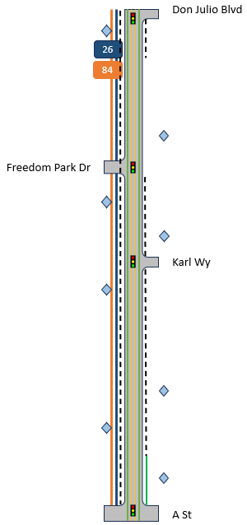
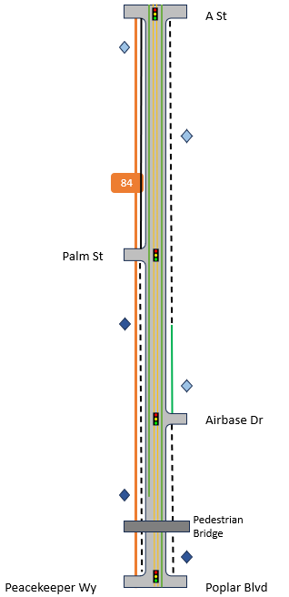
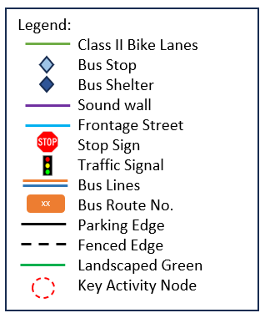
Study Area Segments
Speed Limit
35
Speed Limit
45
Speed Limit
35
Speed Limit
35

Slide 11
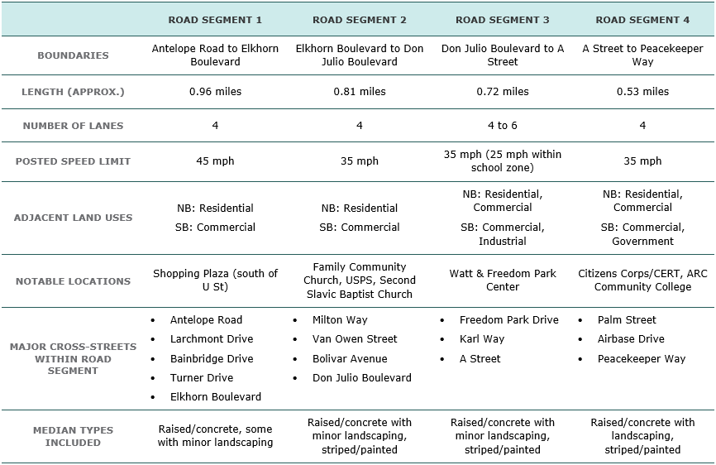
Study Area Description

Slide 12
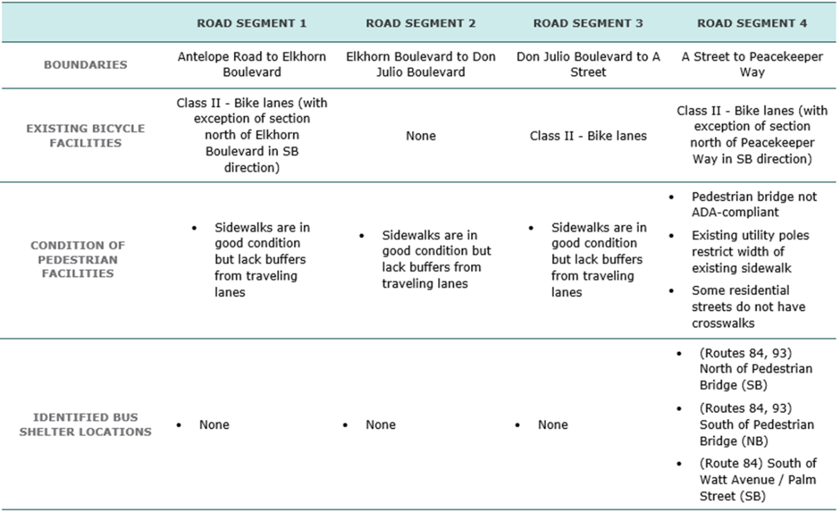
Study Area Description

Slide 13
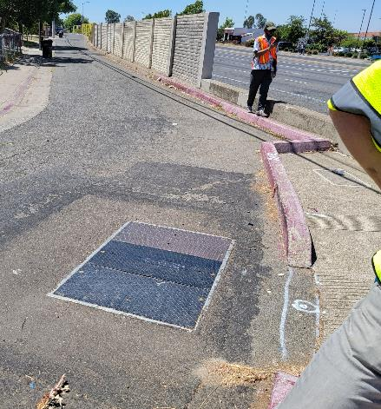
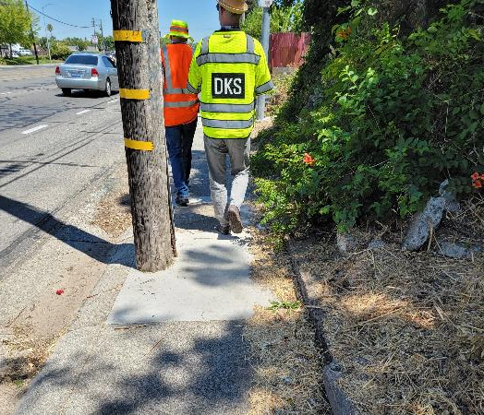
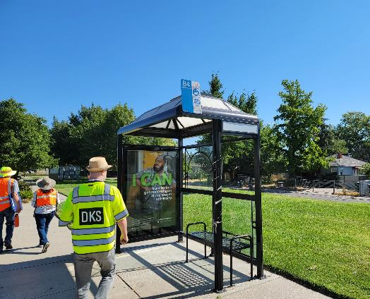
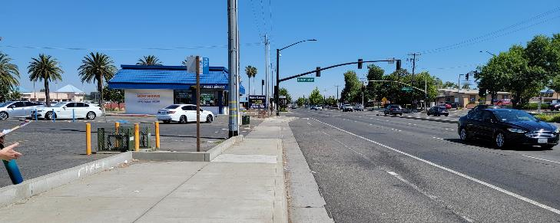
Site Walk
Project Team performed a site walk
July 17, 2023
Representatives from Sacramento County and the Consultant Team were present
The team walked and drove the corridor, focusing on multimodal conditions along key segments and intersections

Slide 14
Modal Review

Slide 15

Modal Review - Pedestrian
Sidewalks
Frequent gaps in existing sidewalks along the corridor
Utility poles and other fixed objects reduce available space
Crossing opportunities at signalized intersections
Right-of-Way availability leads to segments where the sidewalk make sudden turns
CAT observations and feedback
Group Discussion

Slide 16

Modal Review - Bicycle
Bicycle lanes
Inconsistent along the corridor
Grade changes in the middle of the lane
Not always bi-directional
Lack of a buffer between bicycle lane and high-speed vehicles (Not meeting All Ages and Abilities)
Right-of-Way availability leads to segments where bike lanes make sudden turns
CAT observations and feedback
Group Discussion

Slide 17

Modal Review – Transit
Transit Service
Multiple lines providing service, overlapping along some segments
Bus Stop Amenities
Bus shelters only present at the southern edge of the corridor
High volume bus stops often only marked with a sign
Lack bus pullout pads, blocking traffic
Minimal to no shade available
CAT observations and feedback
Group Discussion

Slide 18

Modal Review – Auto/Truck
Operations
Segments and intersections along the corridor meet operational thresholds
Safety
Most common cause of crashes is unsafe speeds and rear-end collisions
Approximately 5% of crashes were fatal or resulted in severe injuries
The recent Local Roadway Safety Plan identified the intersection of North Watt and Elkhorn as a priority safety intersection
CAT observations and feedback
Group Discussion

Slide 19
THANK YOU
Josh Pilachowski, PhD, TE
Senior Transportation Engineer
josh@dksassociates.com
510.295.9741

