Slide 1

STOCKTON BOULEVARD COMPLETE STREETS PROJECT
Project Status Presentation for Sacramento County Bicycle Advisory Committee
March 20th, 2024
CAMERON SHEW, P.E., T.E.
PRINCIPAL CIVIL ENGINEER
shewc@saccounty.gov
916.875.5940

Slide 2
AGENDA
1 / PROJECT OVERVIEW
2 / PROJECT ALTERNATIVES
3 / PROJECT STATUS

Slide 3
PROJECT OVERVIEW

Slide 4
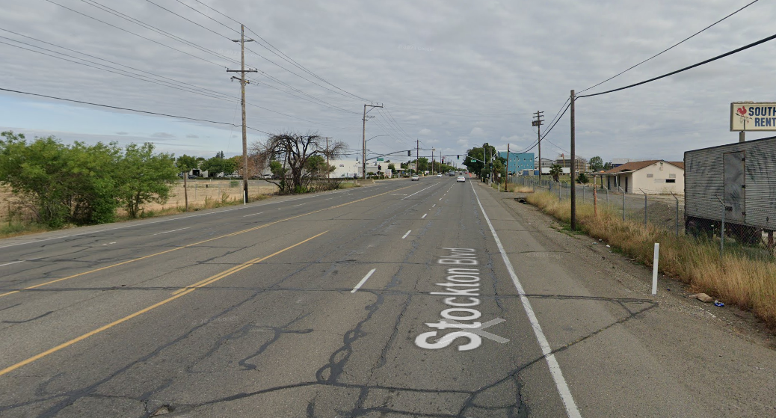
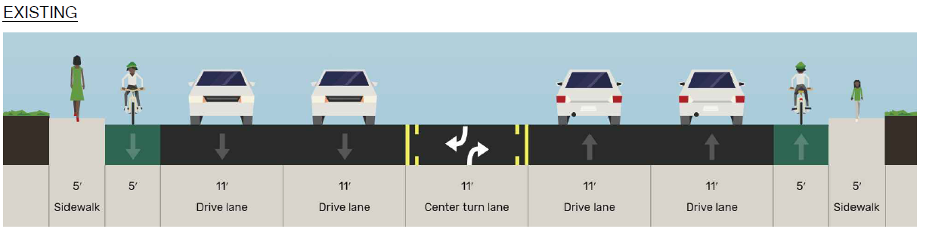
STOCKTON BOULEVARD TODAY
Stockton Blvd, North of Fleming Ave
4
STOCKTON BOULEVARD COMPLETE STREETS PROJECT - MARCH 20, 2024
Notes:
Four-lane roadway
Class II (striped) bike lanes
Fragmented sidewalk network
Bus route (Line 68)
Connects residential neighborhoods to the City of Sacramento to the north
Many community destinations (parks, schools)

Slide 5
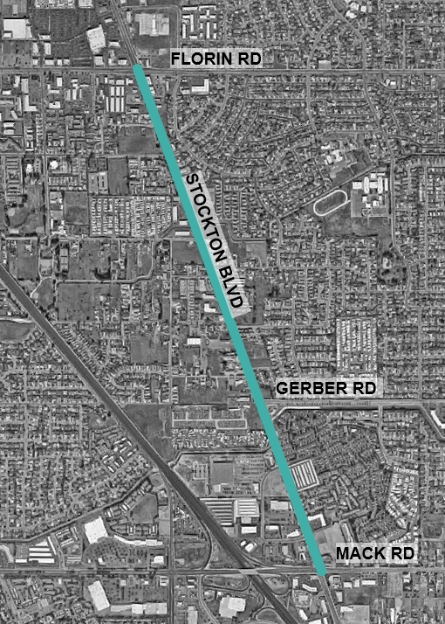
STOCKTON BOULEVARD TODAY
Existing traffic operations are generally acceptable¹ at signalized intersections along the corridor.
The County's 2030 General Plan classifies Stockton Boulevard between 65th Street Expressway and Mack Road as a 6-lane thoroughfare.
This project may require an amendment to the General Plan to reduce the number of lanes along the corridor from six to four.
1 All intersections operate within County thresholds for urban areas.
STOCKTON BOULEVARD COMPLETE STREETS PROJECT - MARCH 20, 2024
5

Slide 6
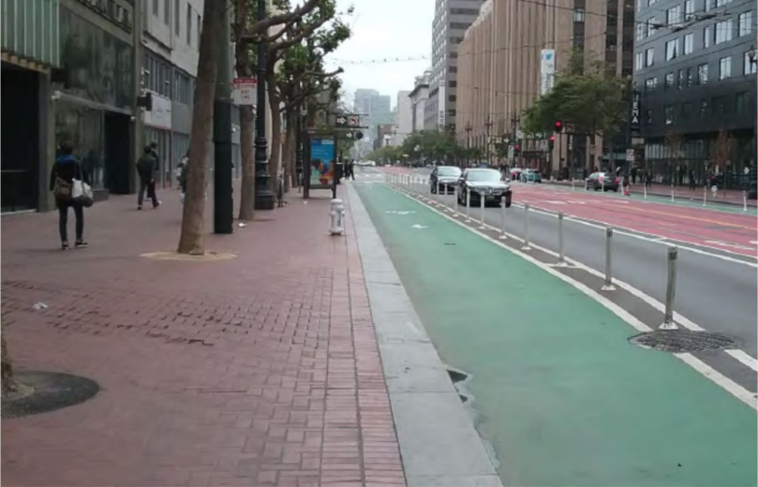
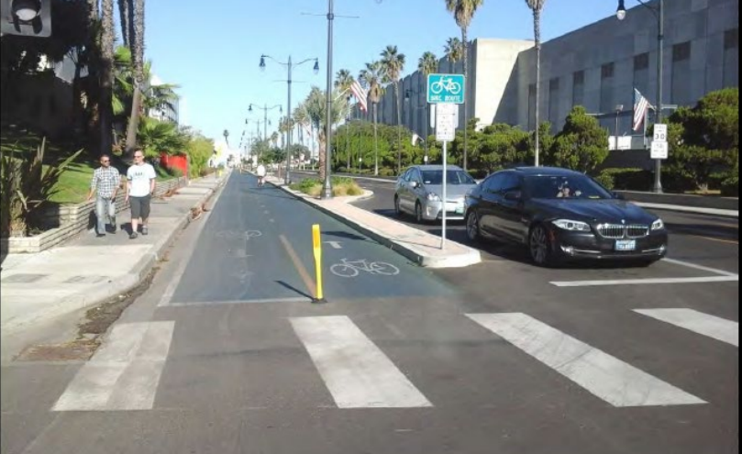
PROJECT FOCUS
Evaluating feasibility of:
Installing directional Class IV (separated) bikeways on both sides of the roadway
OR
Installing a two-way Class IV bikeway on one side of the roadway.
Both options include sidewalk infill and signal for pedestrian crossings.
Separated Bikeway in San Francisco (Source: Design Information Bulleten 89-01, 2018)
Two-Way Separated Bikeway in Redondo Beach (Source: Design Information Bulleten 89-01, 2018)
STOCKTON BOULEVARD COMPLETE STREETS PROJECT - MARCH 20, 2024
6
Notes:
Sacramento County is currently conducting a Feasibility Study to evaluate options for improving pedestrian and cycling conditions on Stockton Boulevard.

Slide 7
GOALS AND OBJECTIVES
1. Promote a mode shift to active transportation.
2. Improve access to community resources.
3. Create safer conditions through connected facilities for pedestrians and cyclists along the entire corridor.
STOCKTON BOULEVARD COMPLETE STREETS PROJECT - MARCH 20, 2024
7
Notes:
Provide lower-stress, safer facilities along Stockton Boulevard from Florin Road to Mack Road/Elsie Avenue.
Close existing gaps in cycling network.
Fill sidewalk gaps; add ADA curb ramps; signal for pedestrian crossings.
Improve accessibility to transit facilities.
Stockton Blvd connects residential neighborhoods to employment and services in the City of Sacramento.
Woody Hampton Park, Jack N. Sheldon Park, Rutter Park, Peoples Supermarket, and local schools are key destinations along the corridor.
Reduce multimodal conflicts through separated facilities
21 cyclist-involved crashes on the corridor (2015-2019)
27 pedestrian involved crashes on the corridor (2015-2019)
Focus on addressing common causes, such as pedestrian violations and wrong-way riding.
Align with Caltrans all ages and abilities guidelines for a safe and connected facility.

Slide 8
FUTURE PROJECT CONDITIONS

Slide 9
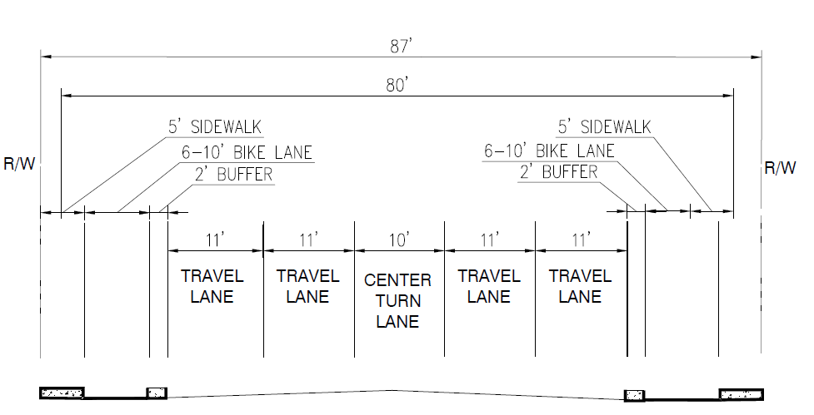
DESIGN ALTERNATIVES
ALTERNATIVE 1: ONE-WAY CLASS IV CYCLE TRACKS
Preliminary cost estimate: $15.9 million
STOCKTON BOULEVARD COMPLETE STREETS PROJECT - MARCH 20, 2024
9
Notes:
6 to 10 feet wide one-way Class IV protected bike lanes on both sides of the roadway.
Two 11-foot travel lanes in each direction.
10 to 11-foot center two-way-left-turn lane.
Sidewalk infill to close gaps in the pedestrian network.
Improvements to ADA curb ramps at intersections.
Physical separation of bike lanes from adjacent travel lanes using a raised median
Bicycle boxes at intersections to facilitate safer two-stage left turns
Bicycle detection systems and ADA curb ramp enhancements at intersections

Slide 10
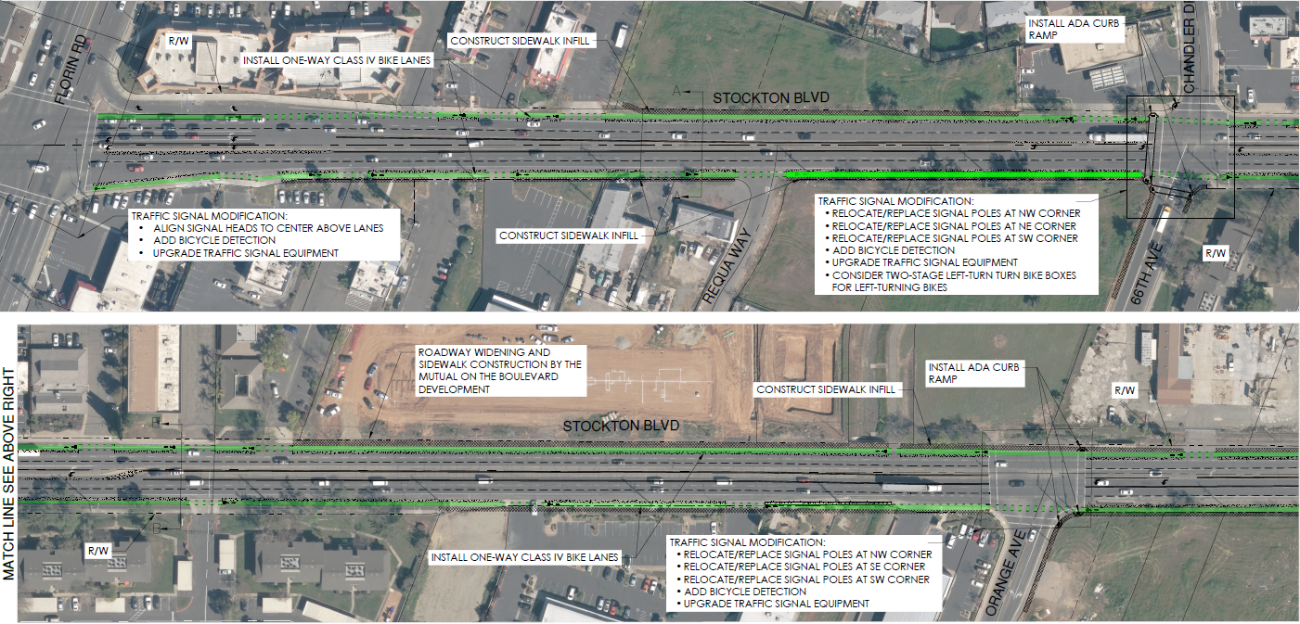
DESIGN ALTERNATIVES
ALTERNATIVE 1: ONE-WAY CLASS IV CYCLE TRACKS
STOCKTON BOULEVARD COMPLETE STREETS PROJECT - MARCH 20, 2024
10

Slide 11
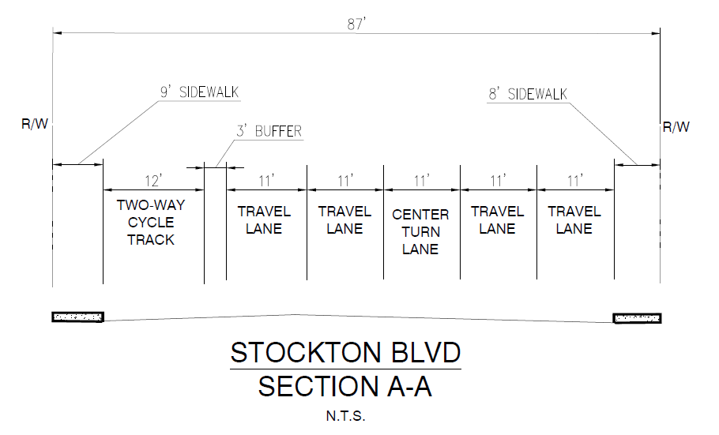
DESIGN ALTERNATIVES
ALTERNATIVE 2: TWO-WAY CLASS IV CYCLE TRACK
Preliminary cost estimate: $15.4 million
STOCKTON BOULEVARD COMPLETE STREETS PROJECT - MARCH 20, 2024
11

Slide 12
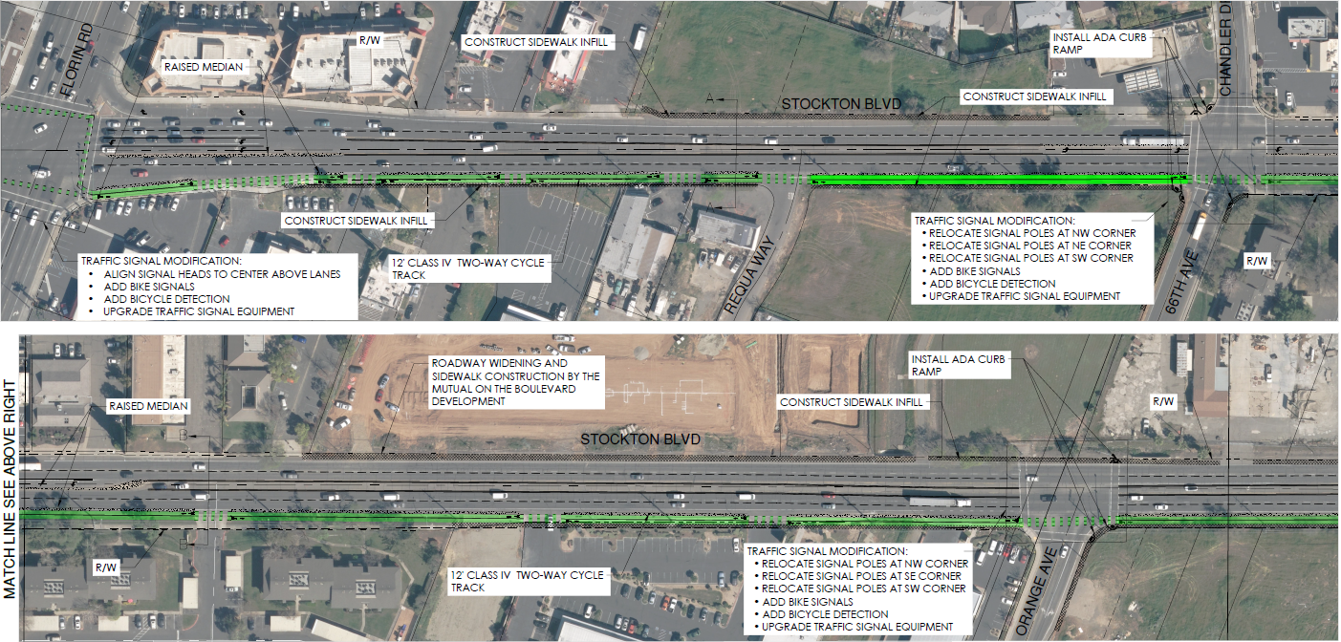
DESIGN ALTERNATIVES
ALTERNATIVE 2: TWO-WAY CLASS IV CYCLE TRACK
STOCKTON BOULEVARD COMPLETE STREETS PROJECT - MARCH 20, 2024
12

Slide 13
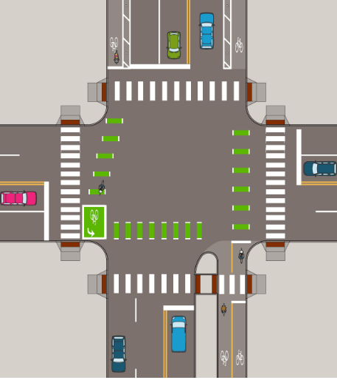
DESIGN ALTERNATIVES
Alternative 2 needs to consider how to transition between one-way and two-way facilities at end of project area.
Cyclists travelling against traffic (contra-flow) need to cross the road, challenging traffic norms
Design needs to make it easy for cyclists to know where to go, and communicate clear right of way priority for all users
Source: Minneapolis DOT
ALTERNATIVE 2: TRANSITION AT PROJECT EXTENTS
STOCKTON BOULEVARD COMPLETE STREETS PROJECT - MARCH 20, 2024
13

Slide 14
COMPARISON OF ALTERNATIVES
 | Alternative 1 | Alternative 2
Visibility and Predictability | Greater predictability with one-way cyclist traffic, reducing crashes from contra-flow movements. | Less predictability with two-way cyclist traffic, raising crash risks due to contra-flow bicycle movements.
Intersection Design | Simpler designs with potential for cyclist-specific signal phases. | More complex designs for managing multi-directional conflicts, including protected intersections.
Crossing Movements | Lower risk of head-on cyclist collisions due to one-way flow. | Higher risk of head-on collisions with two-way cyclist traffic.
Cyclist Conflicts | Lower risk of head-on cyclist collisions due to one-way flow. | Higher risk of head-on collisions with two-way cyclist traffic.
Pedestrian Conflicts | Fewer conflicts expected with predictable cyclist direction. | Increased conflicts likely with cyclists moving in both directions.
ROW Requirements | 22,200 sq. ft | 18,350 sq. ft
Cost Estimate | $15.9 million | $15.4 million
AASHTO Guide for the Development of Bike Facilities, Fourth Edition; The FHWA Bikeway Selection Guide, 2019; Department for Transport Cycle Infrastructure Design, 2020; NACTO Urban Bikeway Design Guide, Second Edition
STOCKTON BOULEVARD COMPLETE STREETS PROJECT - MARCH 20, 2024
14

Slide 15
PROJECT STATUS

Slide 16
PROJECT STATUS
DECEMBER 2023:
Existing conditions assessment (complete)
JANUARY - FEBRUARY 2024:
Develop Conceptual Alternatives
Alternative 1: Directional Class IV (separated) bikeways on both sides of the roadway
Alternative 2: Two-way Class IV bikeway on one side of the roadway
Evaluate Conceptual Alternatives
MARCH 2024:
SacBAC and DAC presentations
April 2024:
Final Feasibility Report
STOCKTON BOULEVARD COMPLETE STREETS PROJECT - MARCH 20, 2024
16

Slide 17
THANK YOU
CAMERON SHEW, P.E., T.E.
PRINCIPAL CIVIL ENGINEER
shewc@saccounty.gov
916.875.5940

Slide 18
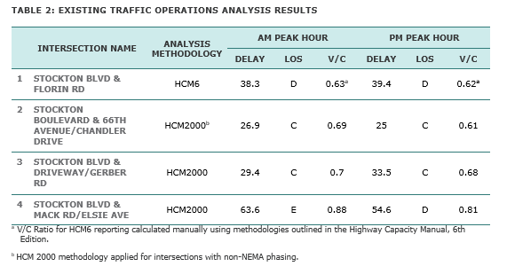
APPENDIX: EXISTING TRAFFIC OPERATIONS
STOCKTON BOULEVARD COMPLETE STREETS PROJECT - MARCH 20, 2024

Slide 19
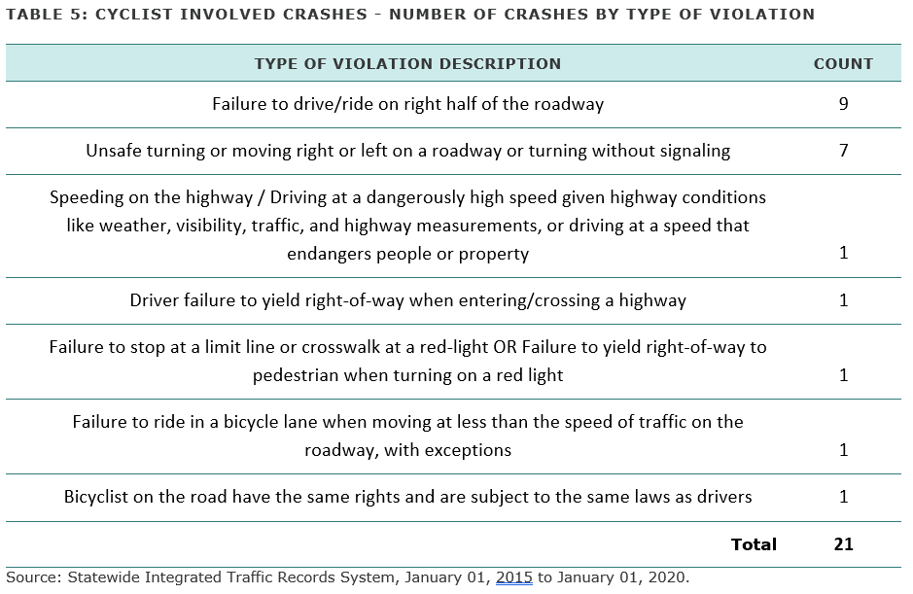
APPENDIX: CYCLIST INVOLVED CRASHES
STOCKTON BOULEVARD COMPLETE STREETS PROJECT - MARCH 20, 2024

Slide 20
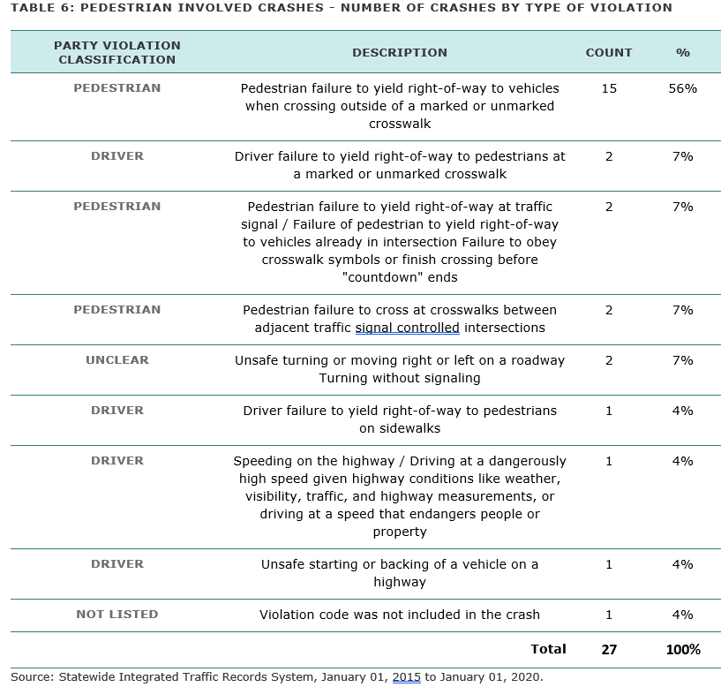
APPENDIX: PEDESTRIAN INVOLVED CRASHES
STOCKTON BOULEVARD COMPLETE STREETS PROJECT - MARCH 20, 2024

