Slide 1

Metro Cable Channel 14
Request for Feedback on Closed Captioning and Accessibility of Metro Cable 14’s Broadcast

Slide 2
Introduction
Presenter: Kristin Riggs, Production Director, Metro Cable Channel 14
Channel 14 is overseen by the Sacramento Metropolitan Cable Television Commission
We broadcast gavel to gavel government meetings in Sacramento County, including Board of Supervisors and six cities (member agencies) and 14 non-member agencies.
Notes:
Channel 14 is on Comcast, U-Verse (DirectTV), and our 24/7 programming is livestreamed. Closed captioning can be toggled on/off by the viewer

Slide 3
Captioning History
The Commission initiated closed captioning in 2007 using a live human captioning service. We learned that there was a need when deaf and hard of hearing individuals reached out to us.
For over a decade, we closed captioned about 80% of our meetings.
In the past year, we have reached 100% of government meetings closed captioned.

Slide 4
Captioning History
Metro Cable 14 is considering alternate options for captioning. For cost-saving and consistency, we may move away from human captioners and migrate to increasing ASR (Automatic Speech Recognition) “AI” captioning.
I am seeking your input on what we can do to make our meetings more accessible.
Notes:
PSA videos on bulletin board are not captioned or open-captioned. Open-captioning is where the captioning is burned into the video image and cannot be turned off. Note that all the “AI” CC we have looked at have been ASR (Automatic Speech Recognition). Not the generative AI like Chat GPT.

Slide 5
Live Human Captioning versus ASR/AI Captioning
Both live human and ASR captioning need internet connections and/or the proper devices to embed captioning in video.
Workflows vary control room to control room. You often get what you pay for in quality and accuracy.

Slide 6
Live Human Captioning versus ASR/AI Captioning
Human captioners are scheduled ahead of time, and are expensive. Humans may paraphrase if dialogue is fast/difficult to follow.
Humans are better at understanding context and the difference between words that sound the same, but mean different things.

Slide 7
Live Human Captioning vs. ASR/AI Captioning
AI/ASR captioning software recognizes spoken words. It will catch most every word, but may not understand the context.
Software will post incorrect words that a normal human would label ‘unintelligible’ rather than post the wrong word.
The cost is a fraction of the cost of human captioning. Software is available anytime you need it.
Notes:
(Possibly note that ASR is not the same as Large Language Model generative AI like Chat GPT)

Slide 8
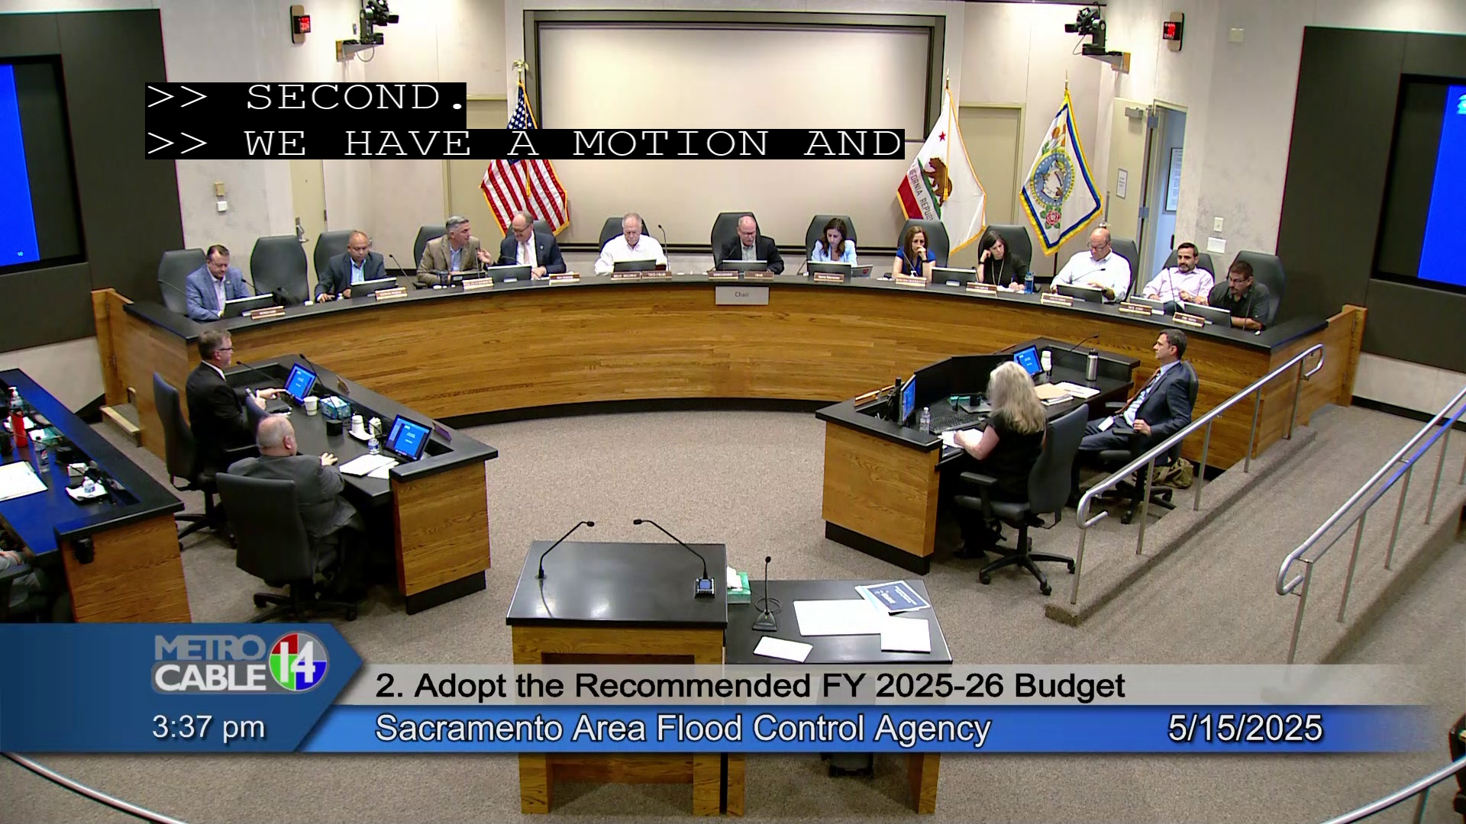
Metro Cable 14 captions are in English-only on our Cable channel and YouTube stream.
Live human captioning is performed by Aberdeen for most meetings. They identify speaker changes, use punctuation, and write in capital letters (all caps).

Slide 9
Metro Cable 14 Captioning (continued)
Pre-recorded meetings are ASR captioned (auto-captioned or “AI” captioned) using our Cablecast video server. It uses punctuation and all caps; however, it does not indicate speaker changes.
For on-demand viewing, we upload to YouTube all of the meetings we broadcast. Our original captioning accompanies those uploads. You can choose YouTube text translations in the language of your choice for these files.
Notes:
Amazon Web Services (AWS) powers the engine behind our AI captioning. There are other vendors/software that use Speechmatics as their engine. Cost is similar, equipment varies.

Slide 10
Questions:
How do you view/listen to television broadcasts and live streams?
2. Do you currently tune-in to Metro Cable 14? Does it fit your needs and is closed captioning understandable and easy to follow?

Slide 11
Questions:
3. What would improve your accessibility with meetings?
4. Do you have any concerns about Metro Cable 14 moving to use ASR “AI” captioning, instead of human captioners?

Slide 12
Questions:
What additional platforms, services, or translations do you need to fully engage with the content? Specific devices and software would be helpful to know.
6. Any additional comments or requests?

Slide 13
Please contact me with feedback or suggestions.
Thank you!
Kristin Riggs, Production Director
riggsk@saccounty.gov
916-809-1216 (cell)
916-874-7685 (Metro Cable 14 office)

