Slide 1
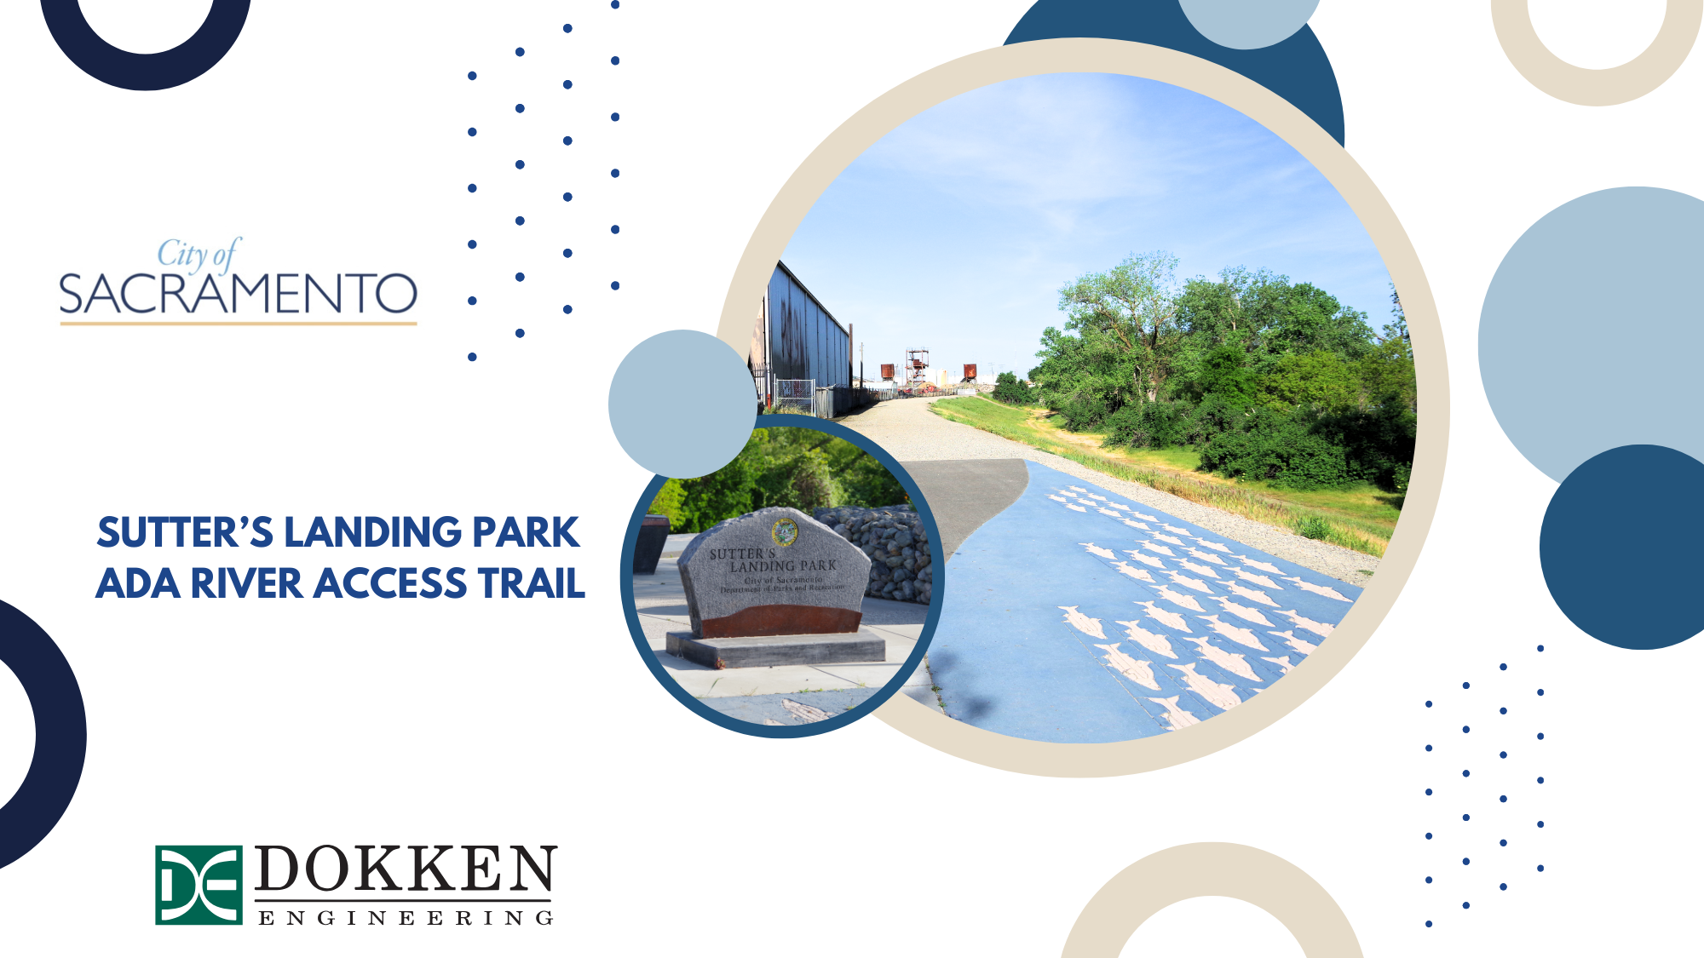
County of Sacramento
DAC Physical Access Meeting
April 15, 2025

Slide 2
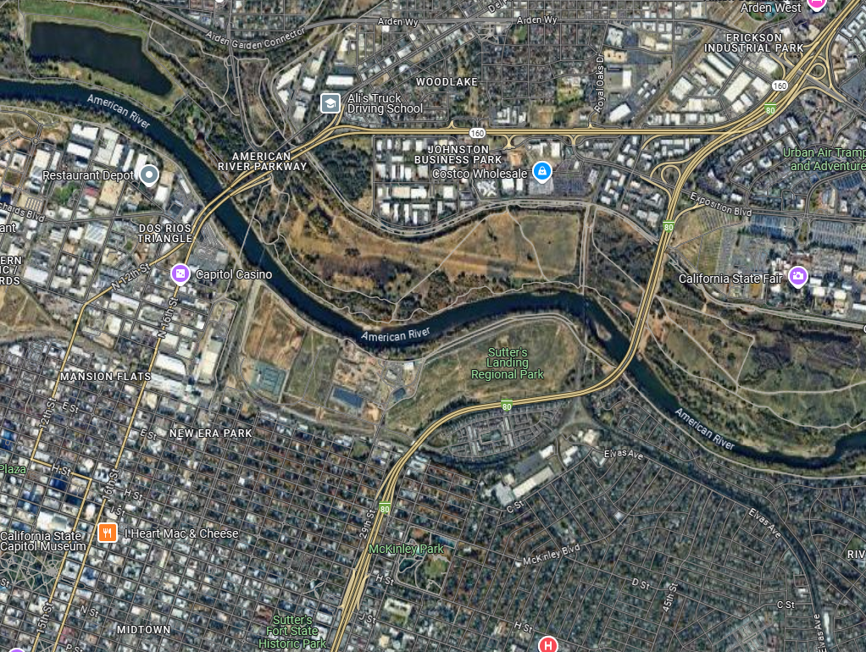
Project Location

Slide 3
Project Details
Project Sponsor: City of Sacramento Youth, Parks, and Community Engagement (YPCE)
Project Scope: Preliminary Engineering, Environmental Clearance, Final Design
Funding Source (Env/Design): California Wildlife Conservation Board
Funding Source (Construction): TBD
Environmental Document: CEQA IS/MND

Slide 4
Project Background
The City of Sacramento is finalizing a Parks Master Plan for Sutter’s Landing Regional Park.
Improvements include a kiosk that rents kayaks.
Sutter's Landing Beach does not currently have an ADA accessible path to the river.

Slide 5
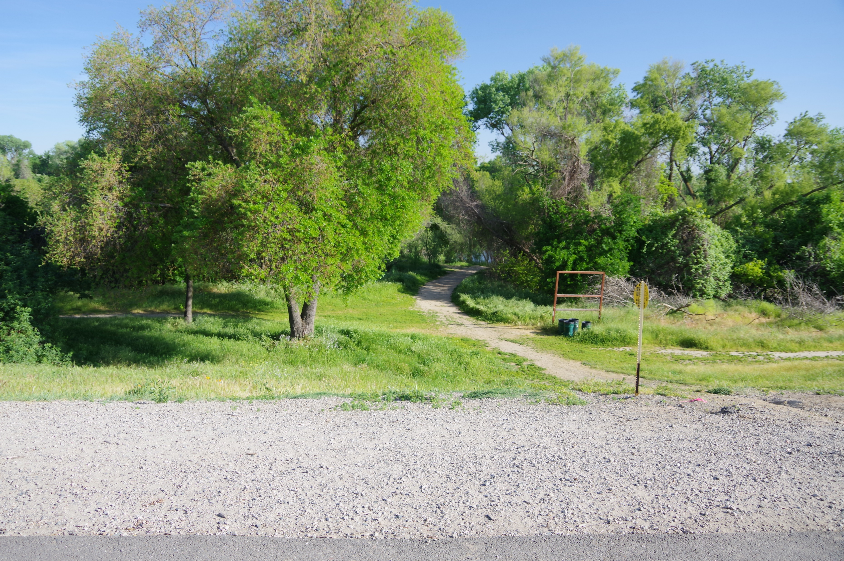
Project Objective
Provide ADA compliant pedestrian access to Sutter's Landing Beach
Ensure that the trail can accommodate kayaks
Provide habitat restoration

Slide 6
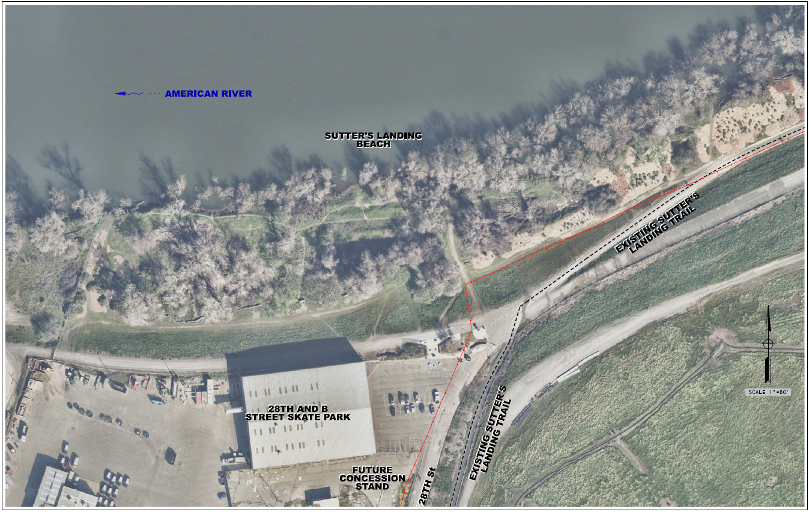
Existing Conditions
Gas Line

Slide 7
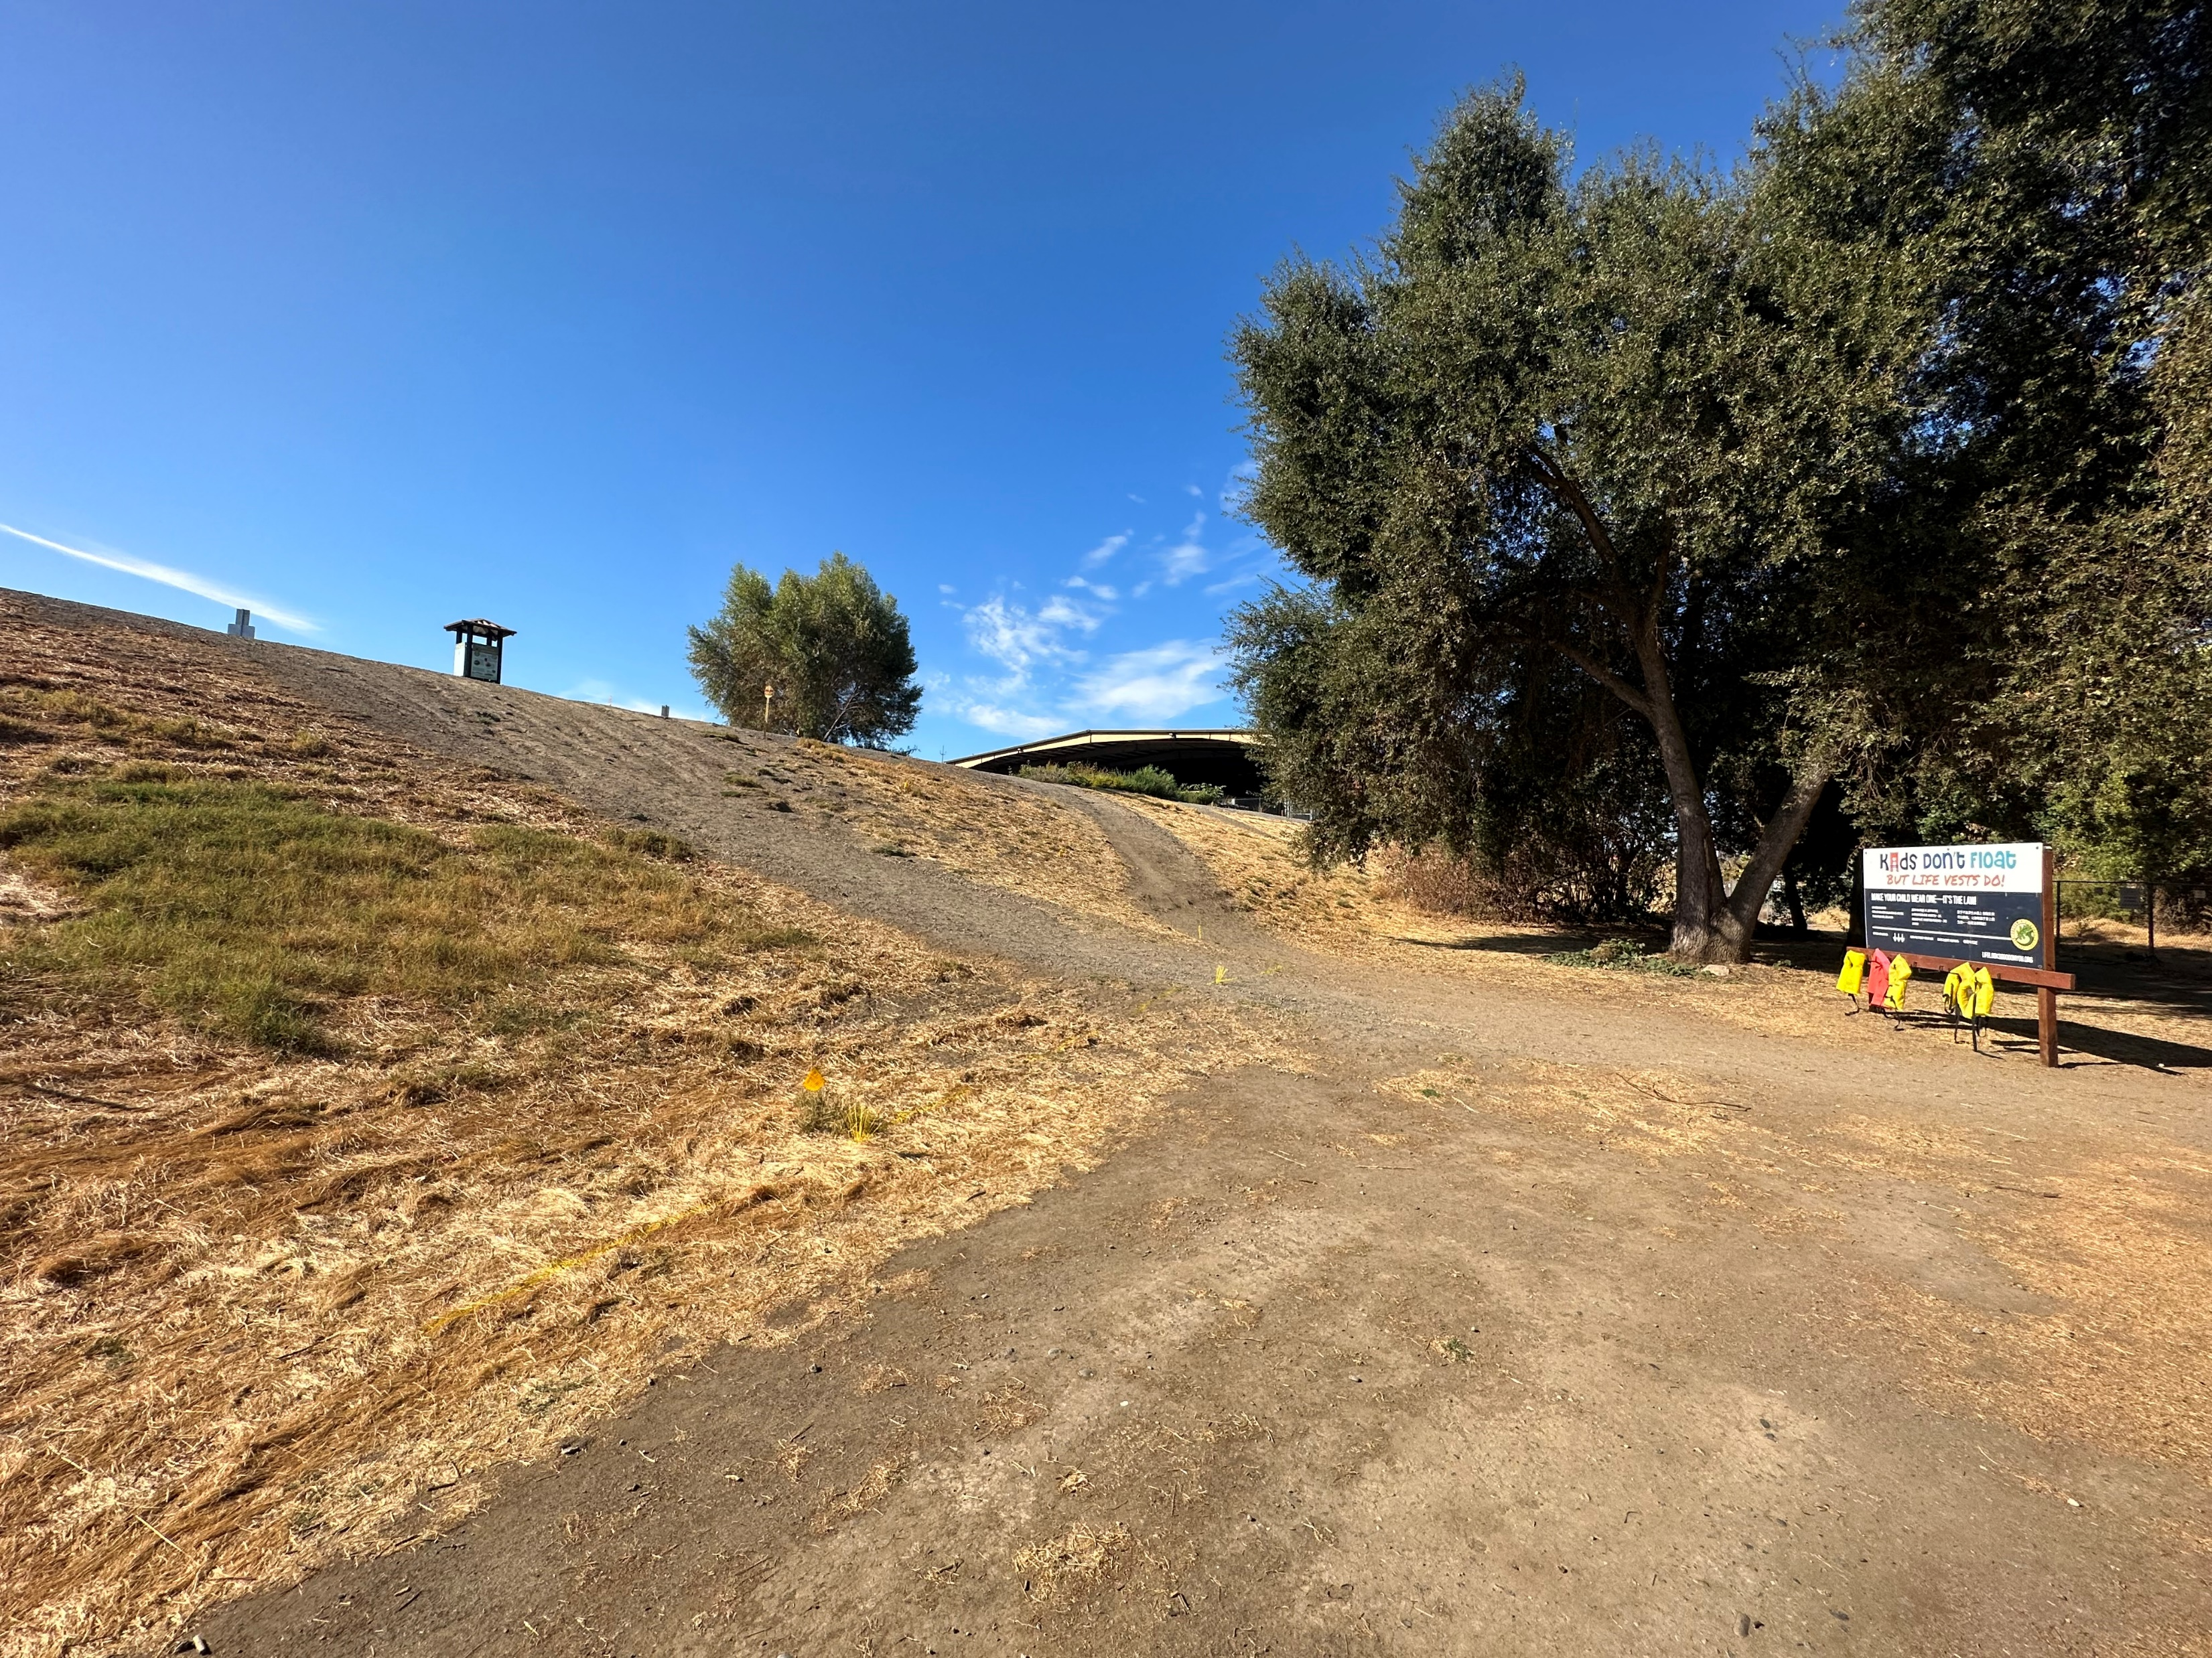
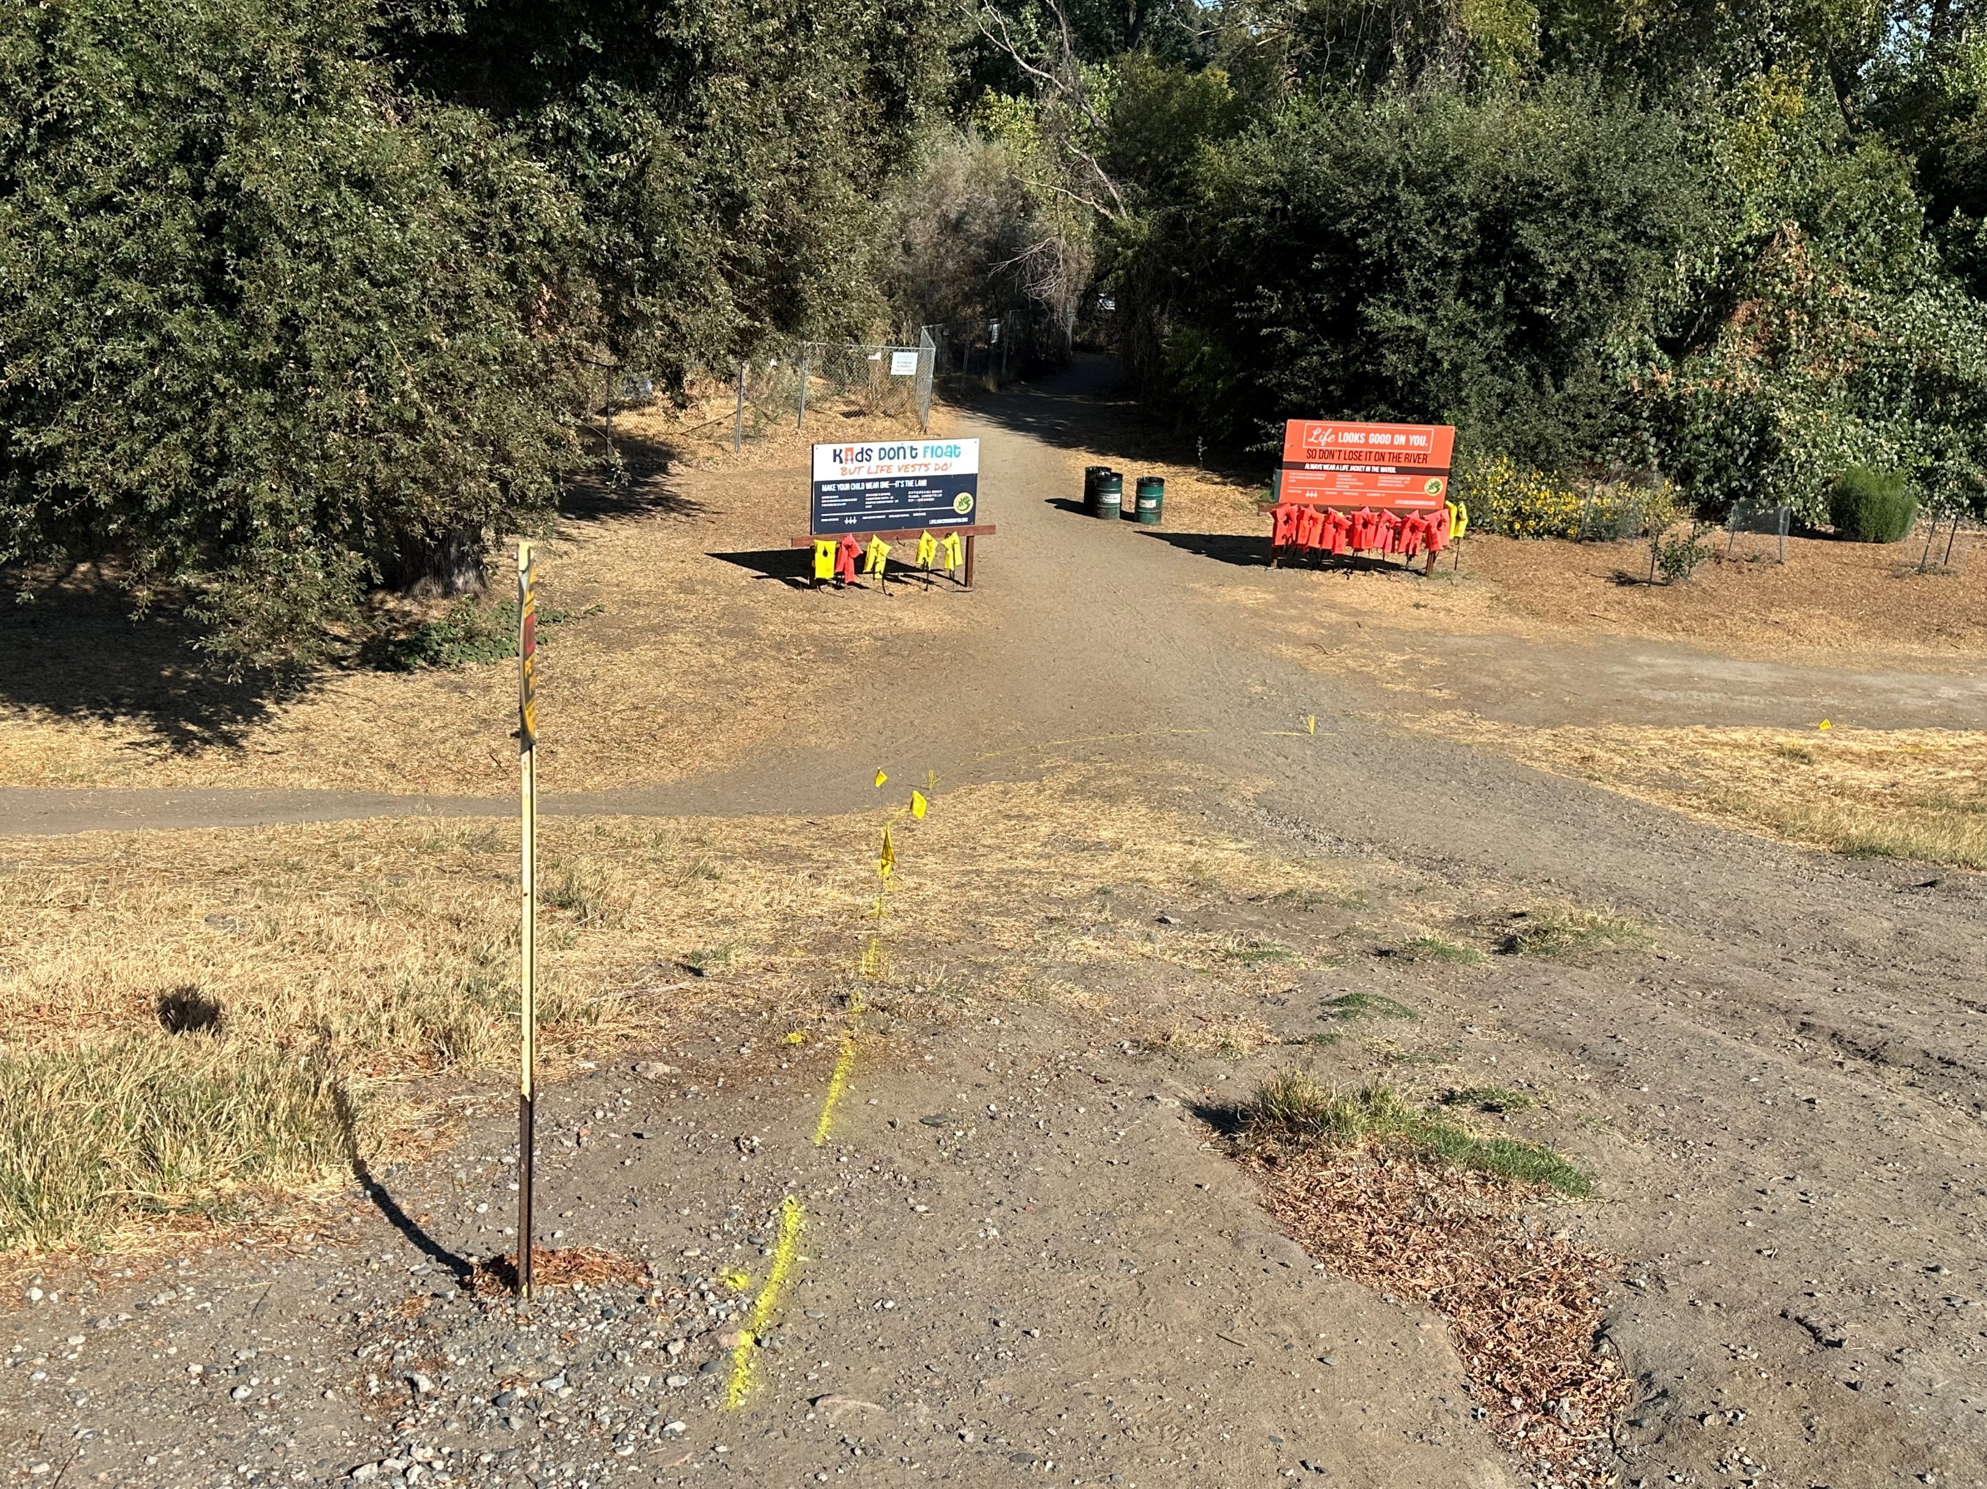
Existing Conditions
Looking southwest toward skatepark from toe of levee
Looking north toward the river from top of levee

Slide 8
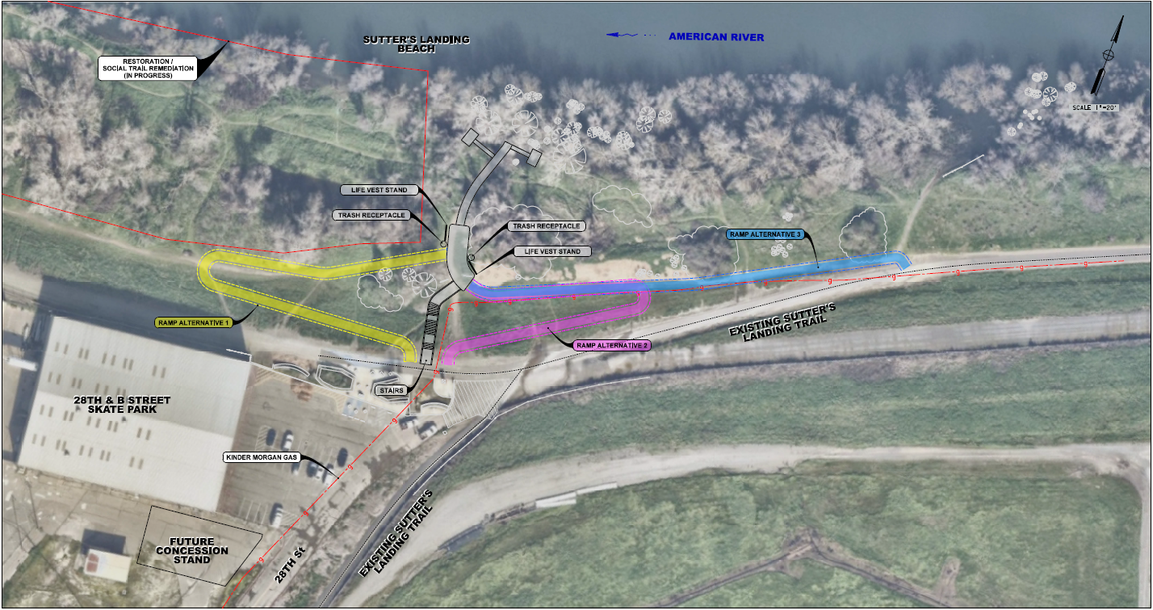
Trail Alternatives

Slide 9
Public/Agency Coordination
Friends of Sutter’s Landing (July 22nd, Aug 19th, Sept 20th)
American River Flood Control District (July 2nd)
City Maintenance Staff (July 30th)
CVFPB/ACOE Coordination Meeting (Oct 9th)
Public Workshop (Dec 12th)
American River Parkway Advisory Committee (Jan 3rd)
Sacramento County Recreation & Parks Commission (Jan 23rd)
On-line Public Survey (Feb 14-25th)
The Lionheart Community (Feb-March)

Slide 10
Alignment Evaluation
Cost
Hydraulic Impacts
Utility Impacts
Environmental Impacts
Public Feedback
Resource Agency Support
Ease of Access

Slide 11
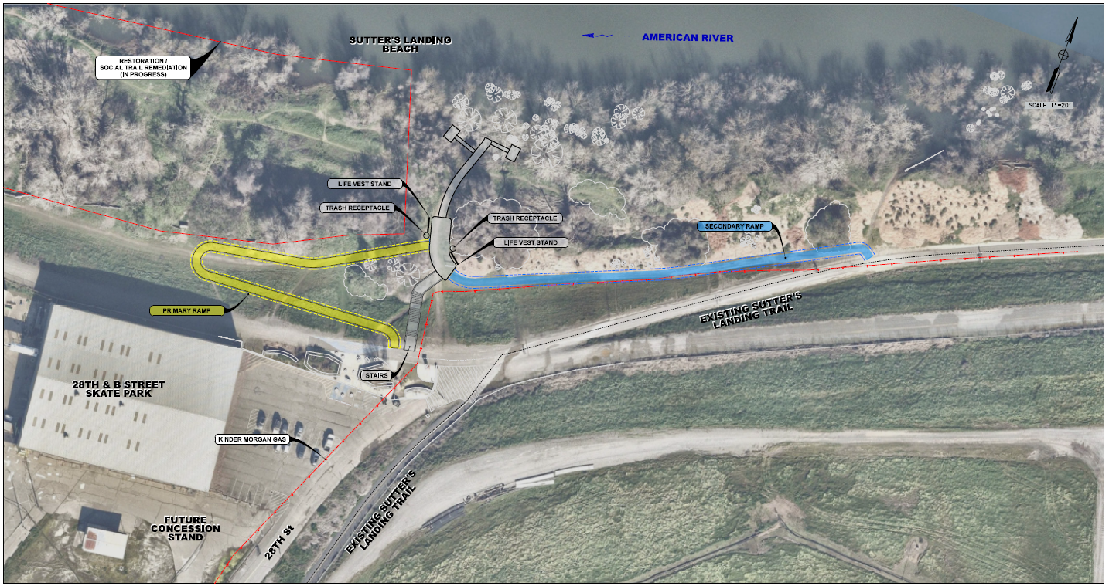
Preferred Alignment

Slide 12
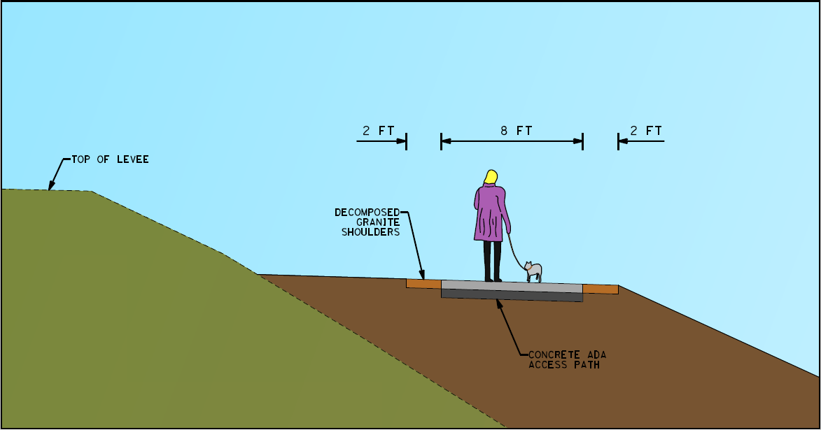
Ramp Design
Concrete path to maintain ADA attributes and long-term maintenance
Width = 8 feet for two-way use
Includes 2-foot shoulders

Slide 13
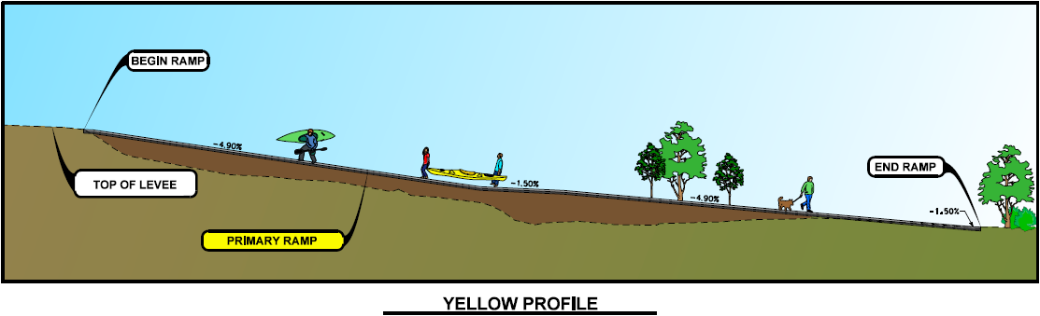
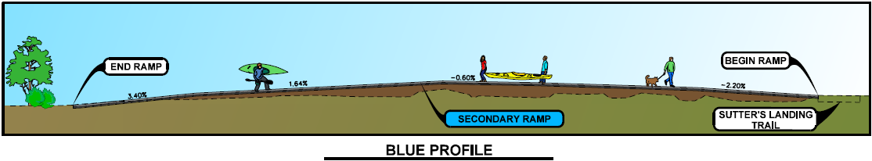
Ramp Design
Slopes are ADA compliant for both access ramps
Landings are provided at appropriate intervals

Slide 14
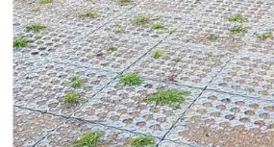
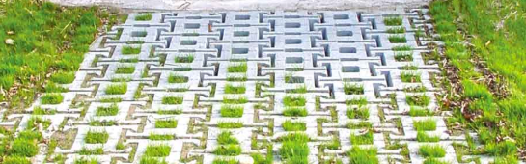
Additional Design Changes
Extend trail to water’s edge
Stabilize edge of trail

Slide 15
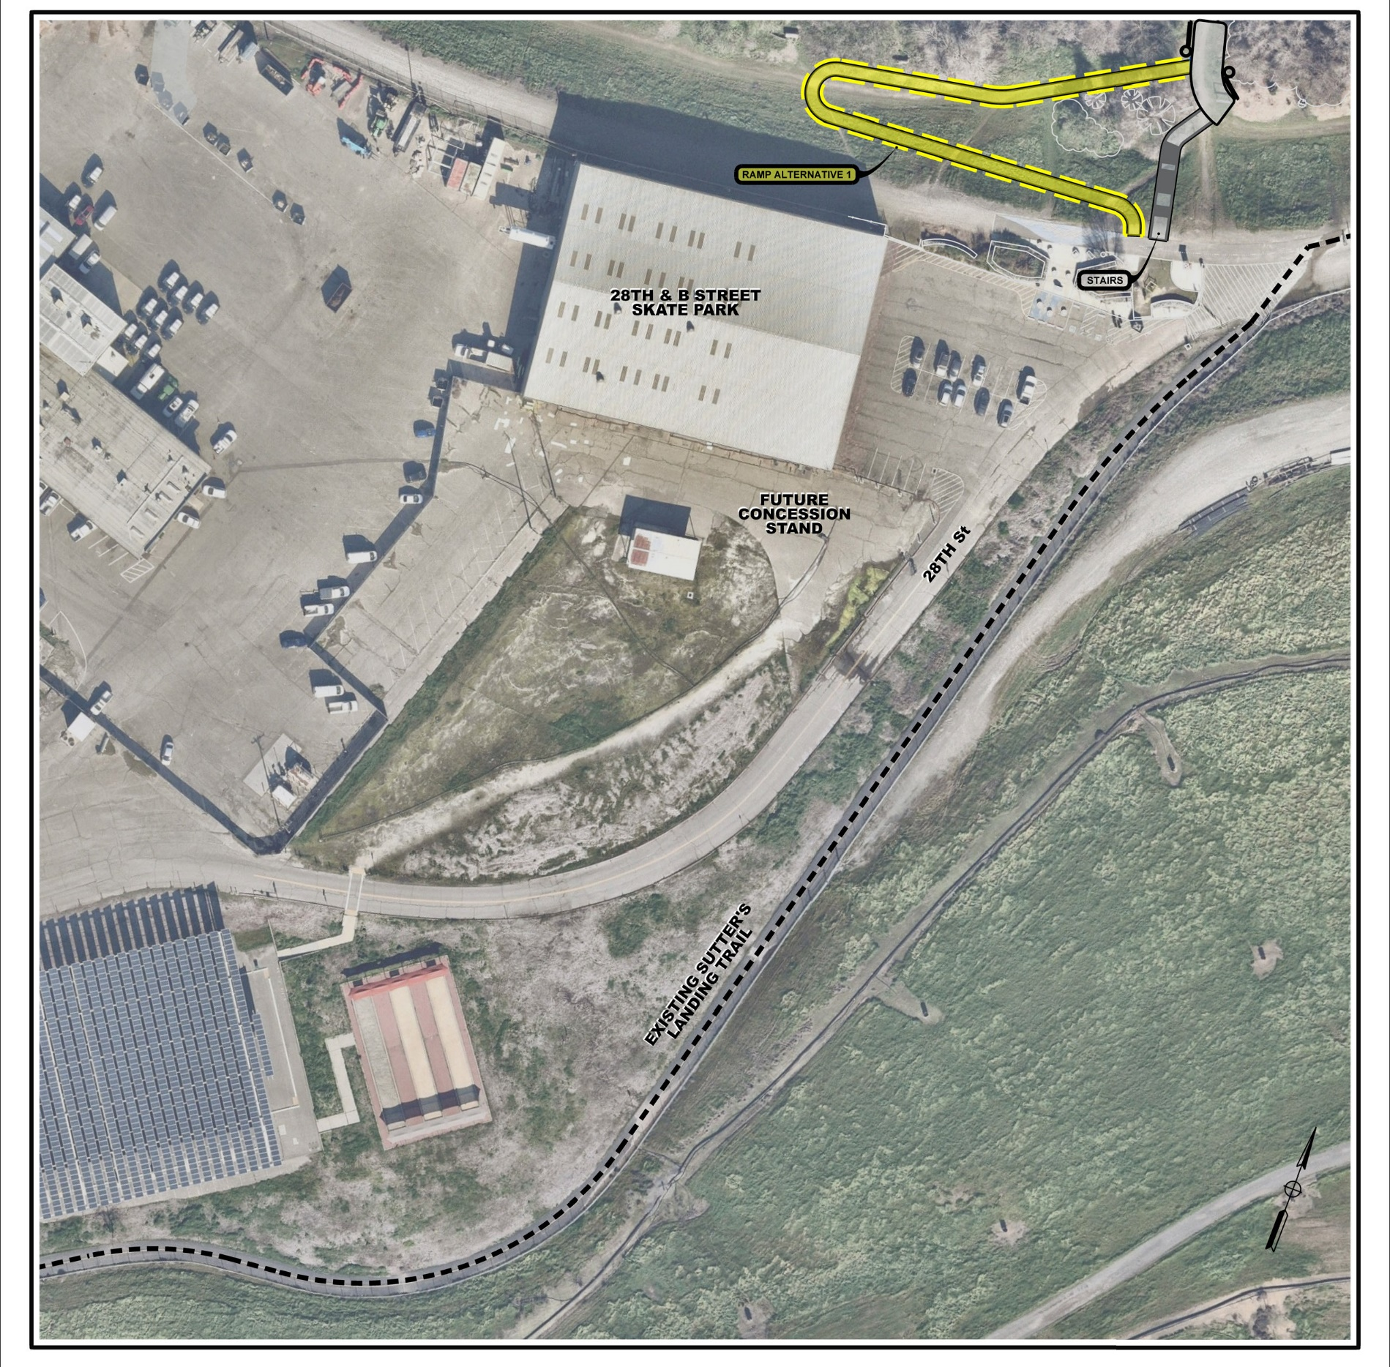
ADA Path of Travel (POT)
Two parking lots serve the Sutter’s Landing Beach area.
An ADA path of travel will be provided from each parking lot.
Parking Lot 1
Parking Lot 2

Slide 16
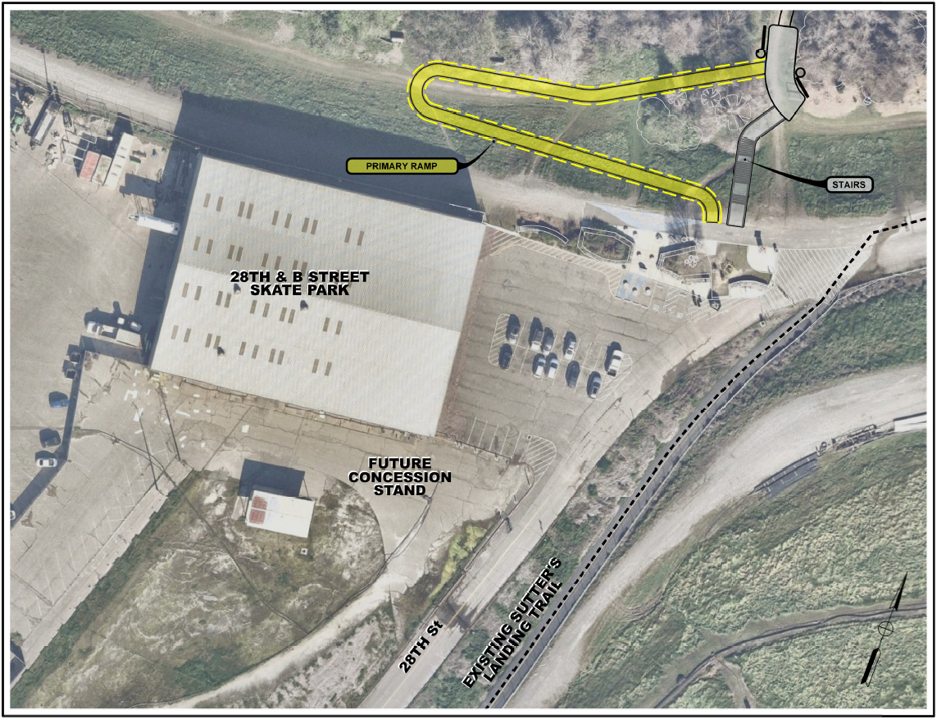
ADA Path of Travel (POT) – Parking Lot 1
Parking Lot 1

Slide 17
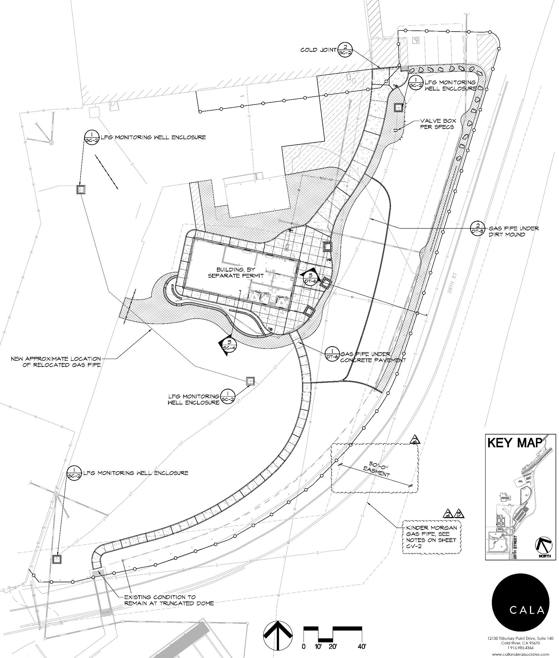
ADA Path of Travel (POT) – Parking Lot 2
Parking Lot 1
Parking Lot 2

Slide 18
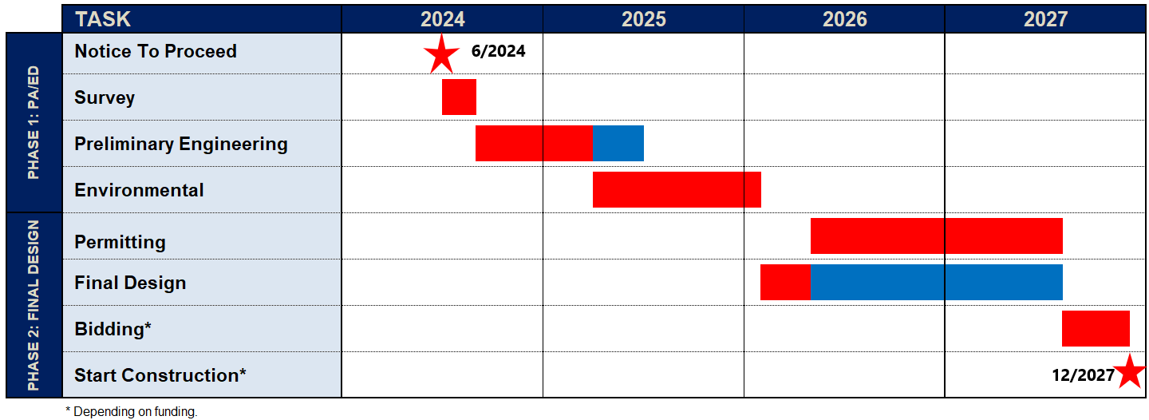
Schedule

Slide 19
Questions?

