Slide 1
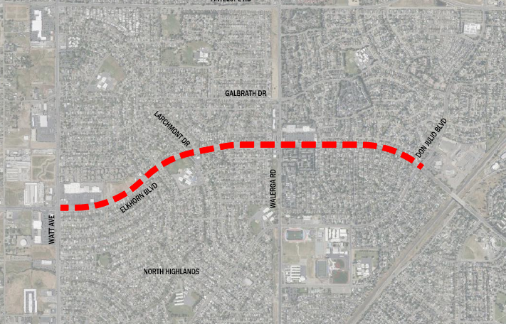

Elkhorn Boulevard Complete Streets
Project Limits Map
Notes:
Project limits are from Watt Avenue to Don Julio Boulevard.
Project will also include the approaches to Elkhorn Boulevard along Walerga Road.

Slide 2
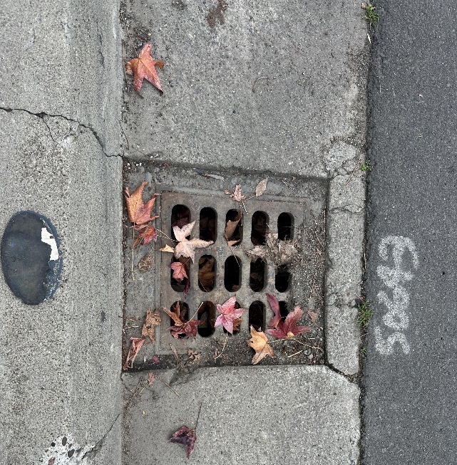
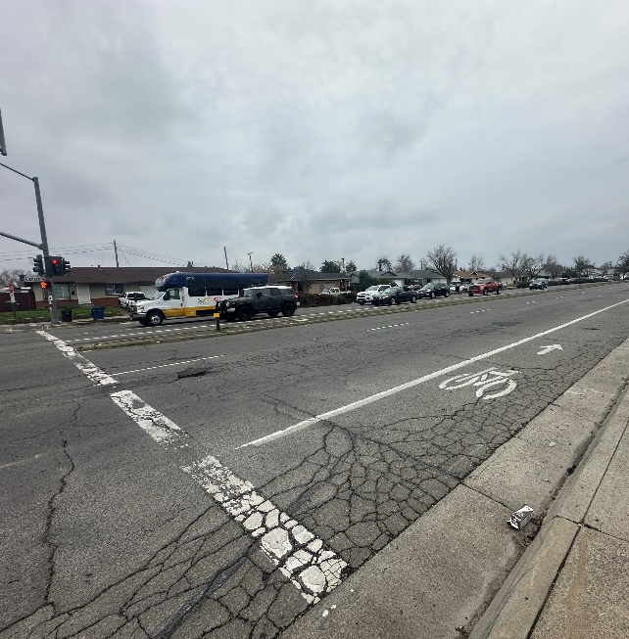
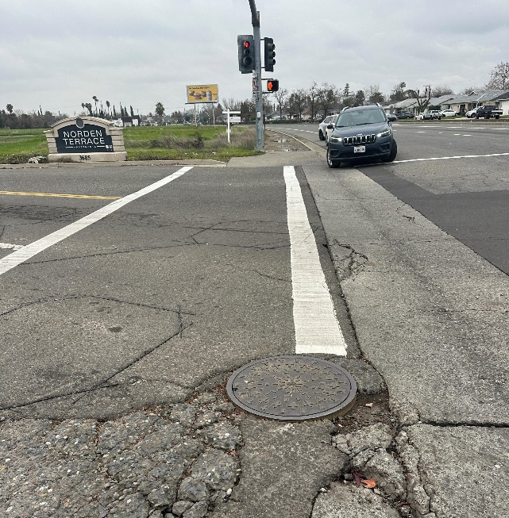
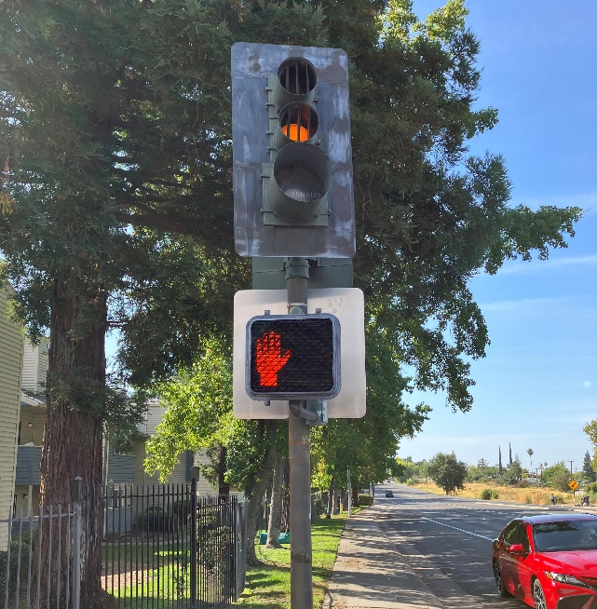
Current Conditions
Existing Drainage Inlet
Failing Pavement
Failing Pavement
Existing Signal Head
Notes:
Existing pavement is in poor condition.
Drainage inlets at various locations within project limits are in sub standard and will be replaced.
Existing Signal equipment is outdated and will be upgraded.

Slide 3
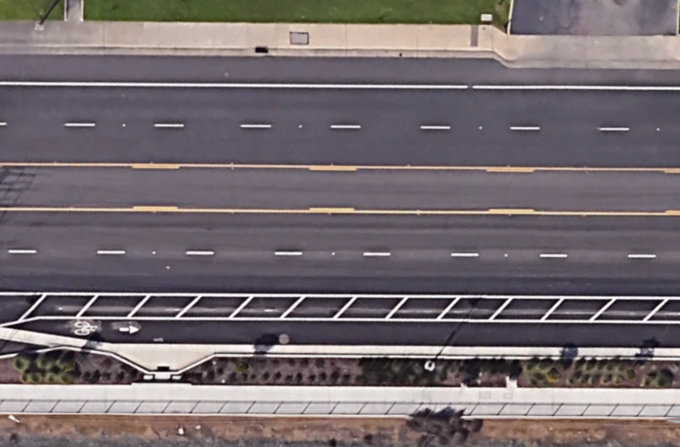
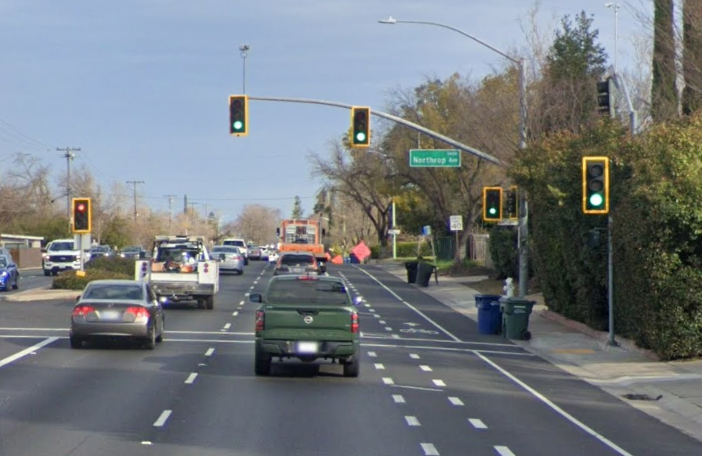
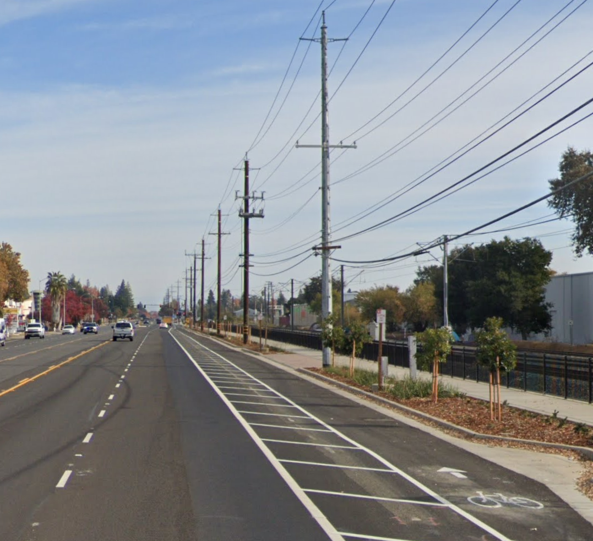
Project Overview
The Elkhorn Boulevard Complete Streets Project aims to enhance safety, mobility, and infrastructure along Elkhorn Boulevard in unincorporated Sacramento County. The project will incorporate road rehabilitation, pedestrian and bike improvements, traffic calming measures, and infrastructure upgrades such as lighting enhancements and signal improvements.
Key Objectives:
Improve pedestrian and bicycle safety with dedicated bike lanes and crosswalk enhancements.
Reduce traffic congestion and enhance mobility through lane reconfigurations and signal upgrades.
Create a safer and more accessible corridor for all users, including drivers, cyclists, and pedestrians.
Notes:
Project will enhance safety and mobility for cyclists by the addition of class IV bikeways on both sides of Elkhorn Boulevard.
The project will add flexible plastic bollards in a varying width buffer. At intersection approaches, we will add green paint to enhance visibility for cyclists.
The project will also refresh the existing crosswalks and striping within the project limits.

Slide 4
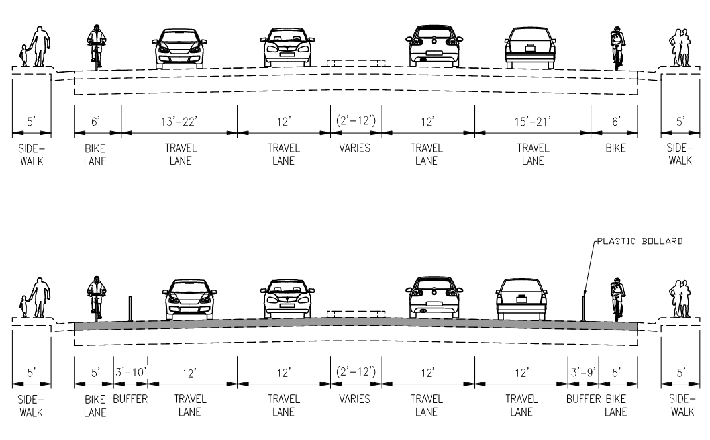
Roadway Cross Sections
Existing
Westbound
Eastbound
Proposed
Westbound
Eastbound

Slide 5
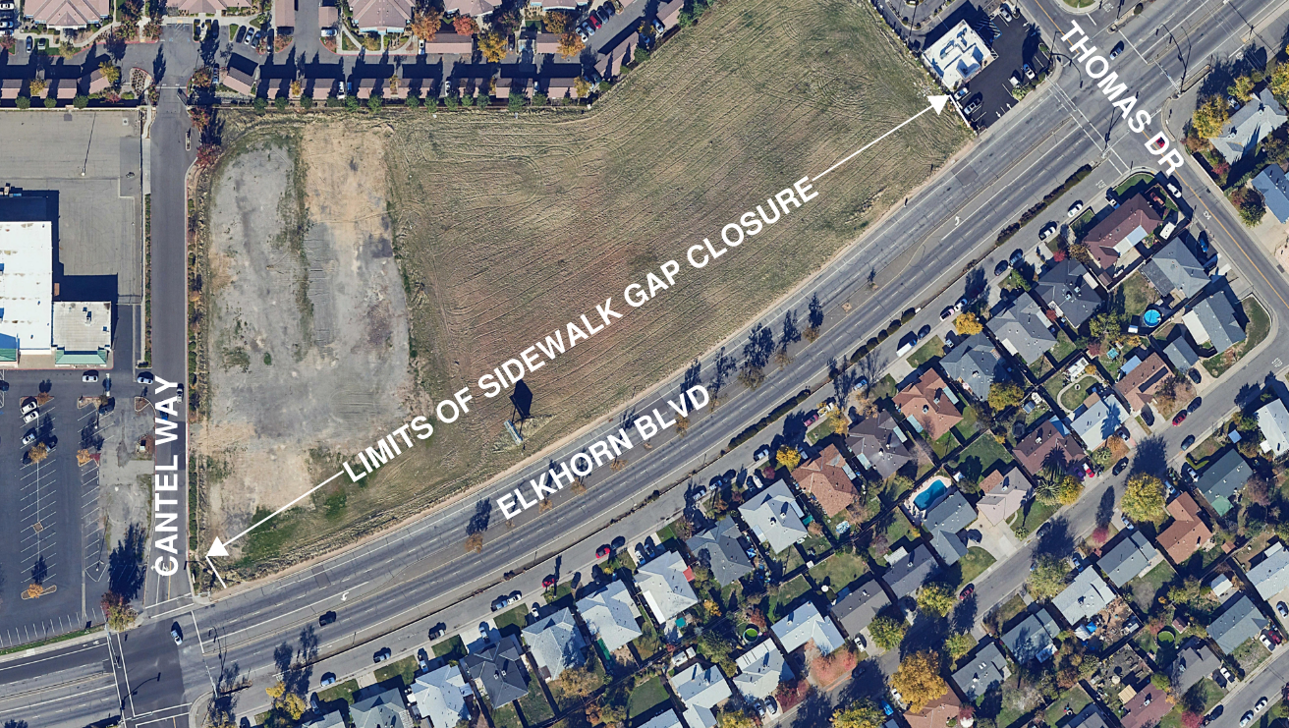
Gap Closure and Streetlighting
AND PROPOSED STREETLIGHTING
Sidewalk gap closure from Cantel Way to Thomas Drive

Slide 6
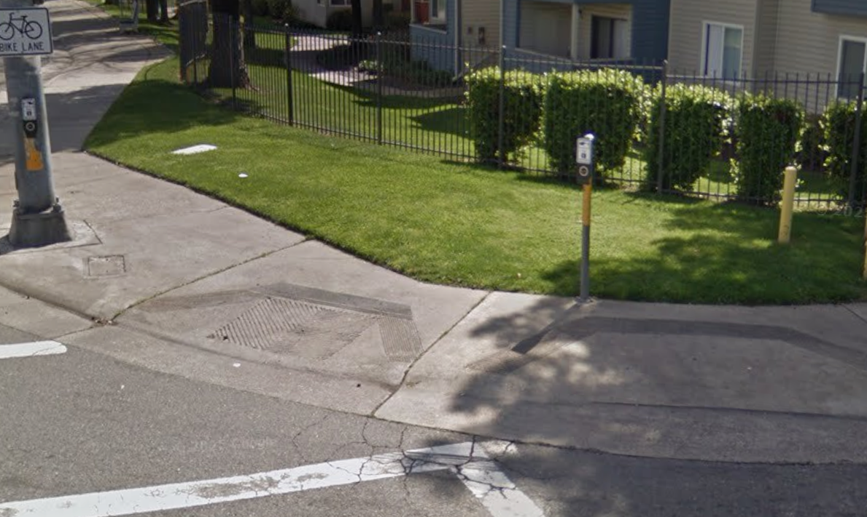
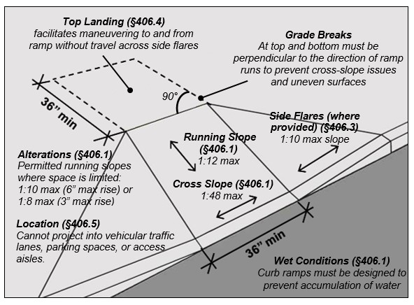

Pedestrian Improvements
Existing Curb Ramps
PROWAG Guidance
Upgrade inadequate curb ramps to ADA compliant Curb Ramps
Auditory push buttons installation at signalized intersections
Audible Push Button

Slide 7
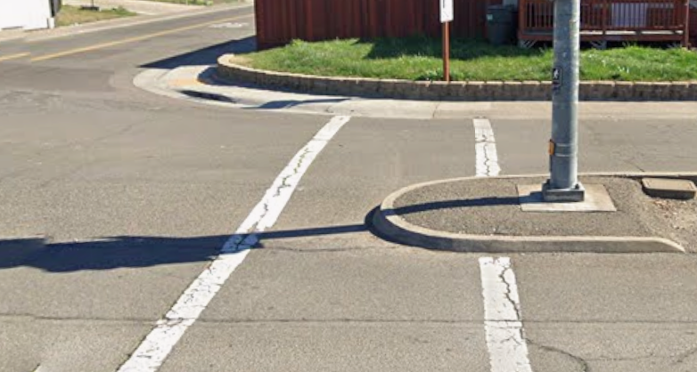
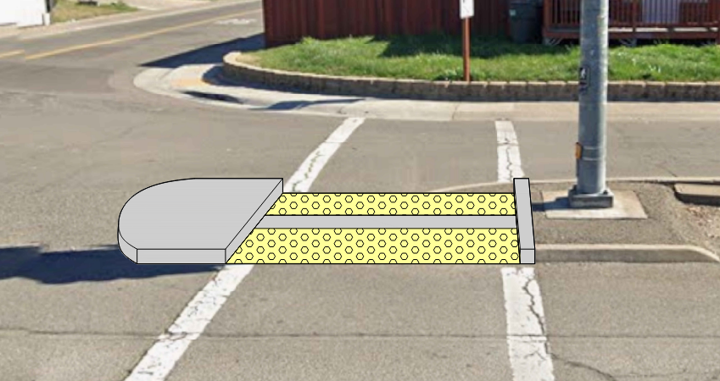
Pedestrian Refuge Island
Existing Condition
Proposed Ped Refuge
Pedestrian Refuge Installation

