Slide 1
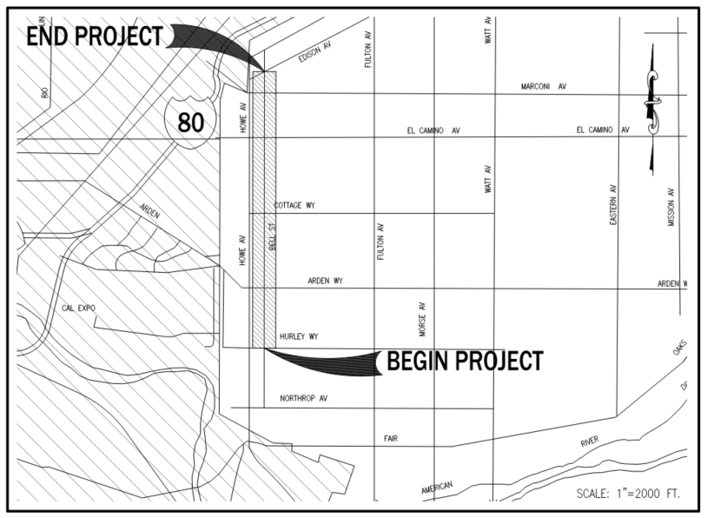

Bell Street Safe Routes to Schools Project
Project Limits Map – Begin Project along Bell St - Limits Between Hurley Way and Edison Avenue
Notes:
**Dane Updated**

Slide 2
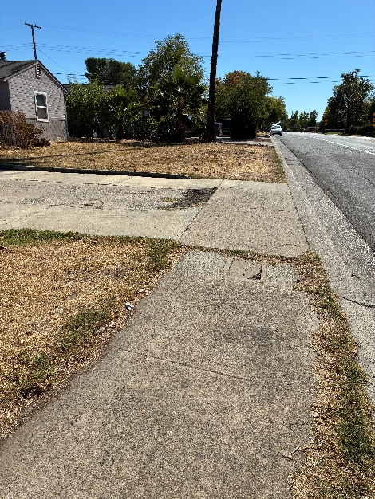
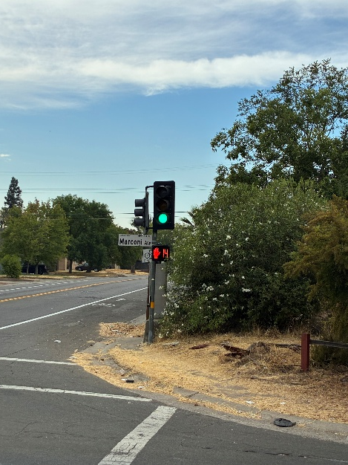
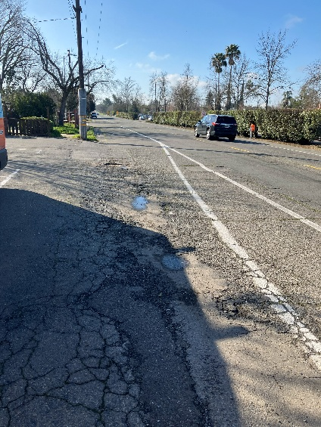
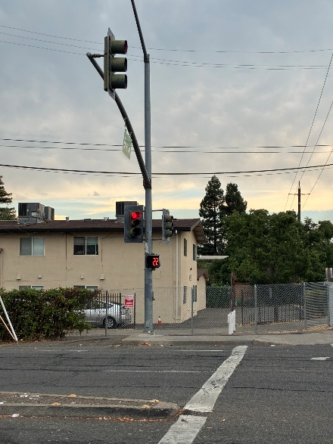
Bell Street – Photos of Current Conditions
Curb & Gutter – No Sidewalk
Substandard or Missing Curb Ramps
Photo 1
Photo 3
Failing Pavement
Photo 2
Photo 4
Sub Standard Traffic Signals
Notes:
**Dane Updated**
Existing pavement is in poor condition.
Drainage inlets at various locations within project limits are in sub standard and will be replaced.
Existing Signal equipment is outdated and will be upgraded.

Slide 3
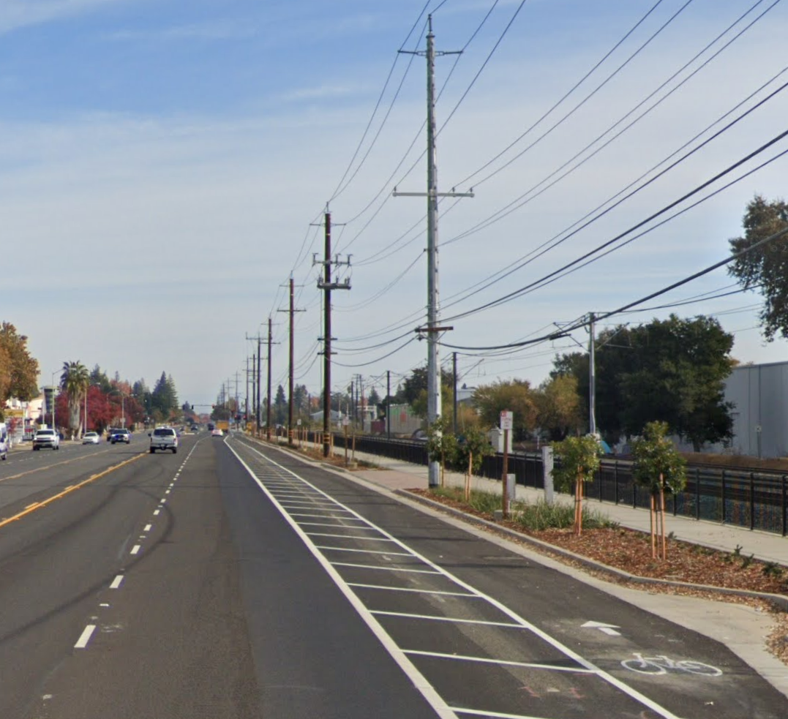
Bell Street Project Overview
The Bell Street Safe Routes to Schools Project will add new sidewalks, Class II bike lanes, ADA curb ramps, and safety features such as flashing beacons and upgraded signals to improve mobility and safety for students and all corridor users.
Key Objectives:
Improve pedestrian safety and mobility with the addition of curb, gutter and sidewalk
Enhance interconnectivity and reduce conflict between pedestrians, motorists and cyclists through upgraded traffic signals and other intersection improvements.
Promote active transportation with the neighborhood and contribute to the vision and goals of the West Arden-Arcade Environmental Justice Community
Notes:
**Dane Updated, left the generic photos from the example**
Project will enhance safety and mobility for pedestrians and cyclists, including the addition of class II bike lanes on both sides of Bell St.

Slide 4
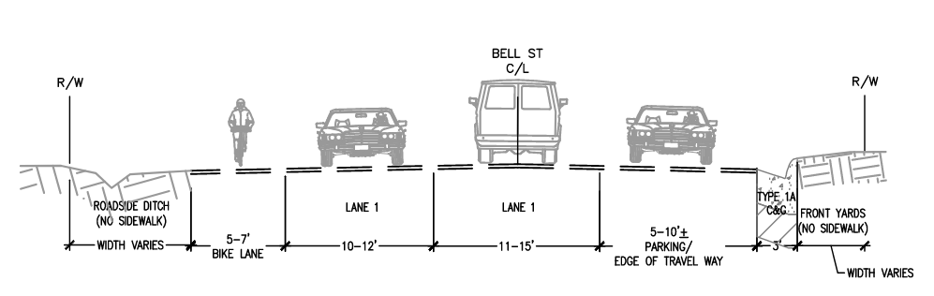
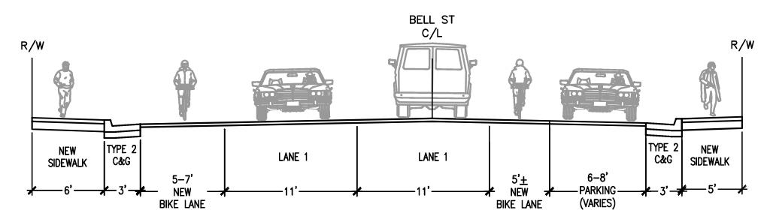
Bell Street - Roadway Cross Sections
Existing
Proposed
Westbound
Eastbound
Notes:
**Dane Updated**

