Slide 1

Arden Way Complete Streets Project Update
Department of Transportation
July 15, 2025
Stephen White, PE, TE,
Chief of Engineering & Design

Slide 2
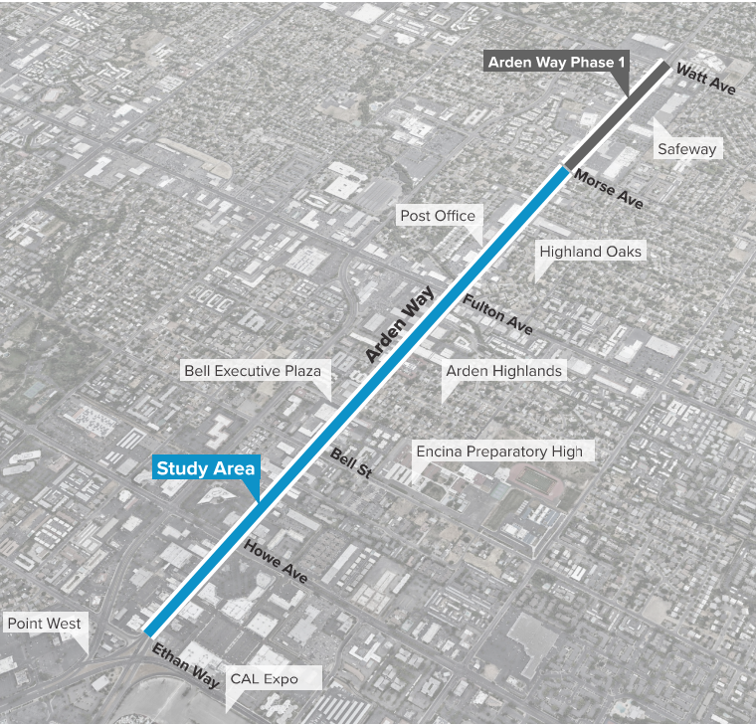
Project Overview
The Phase 1 Project is part of a larger study area between Ethan Way and Morse Avenue (1.3 mi)
Create a complete street framework to encourage active transportation choices

Slide 3
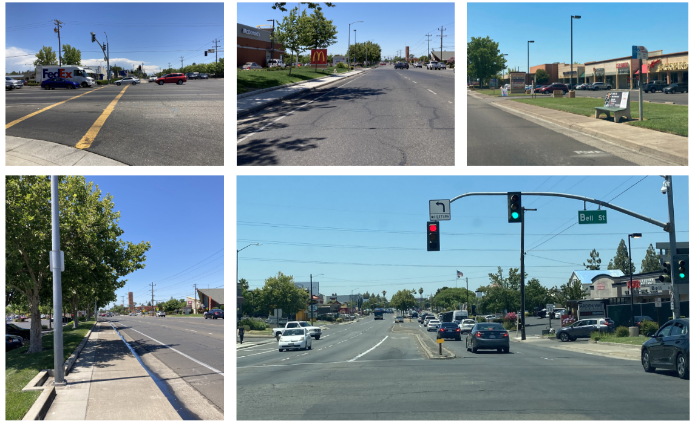
Site Context

Slide 4
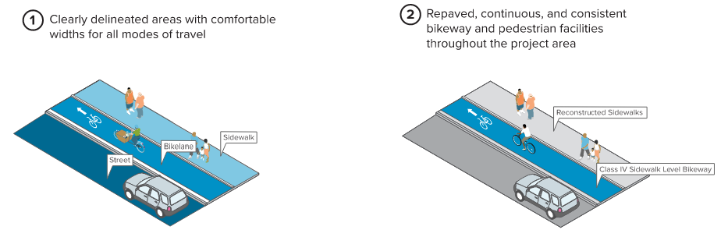
Conceptual Design Elements

Slide 5
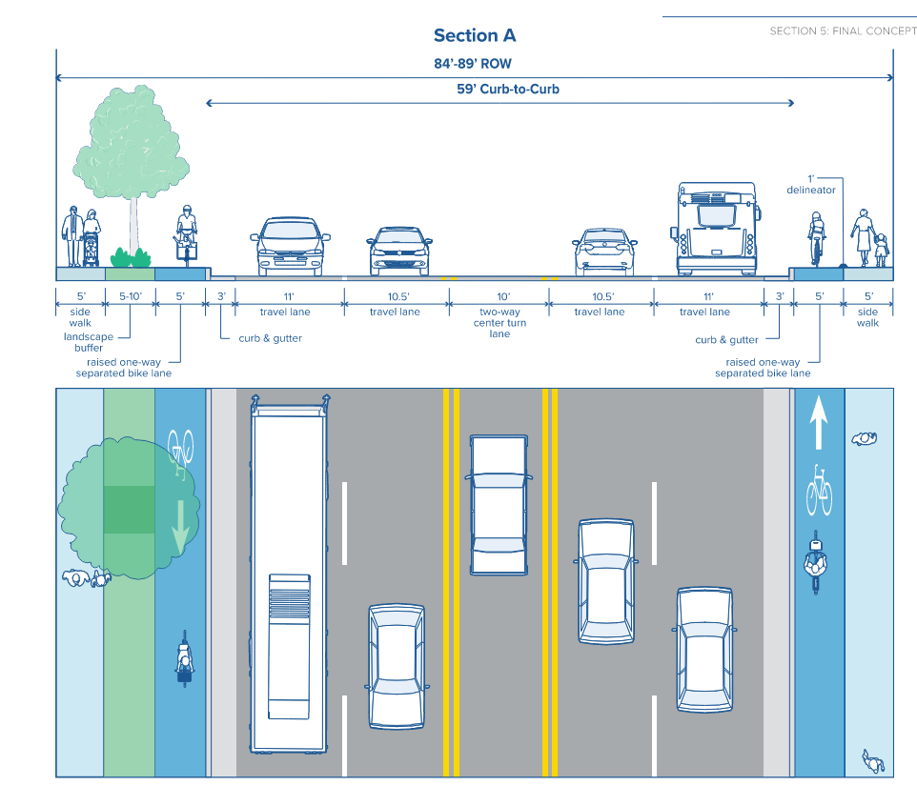
Typical Sections & Treatments

Slide 6
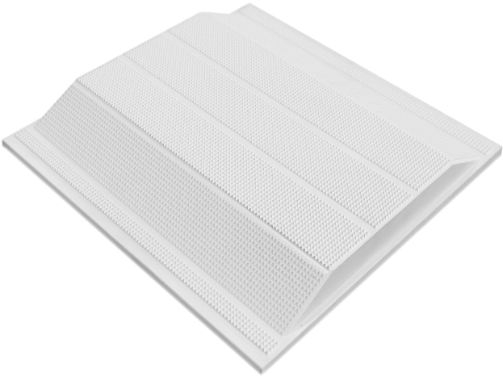
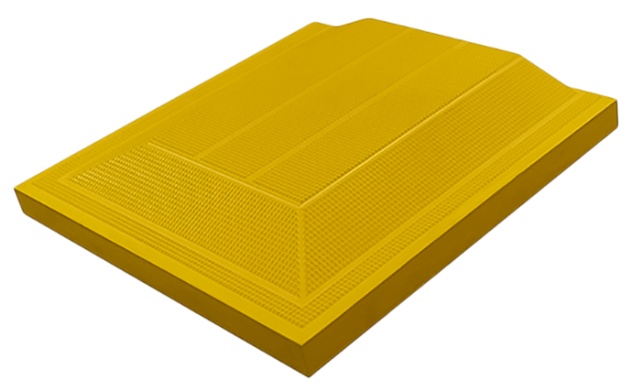
Trapezoidal Delineators
TekWay’s Trapezoid Delineators are the optimal solution for separating sidewalk-level bicycle & pedestrian pathways in urban areas. Federal Yellow will be used on the Arden Way Phase 1 Project.
As the only delineators on the market to have been tested and proven as an effective solution by SFMTA, TekWay Tactile Warning Delineators provide long-lasting and reliable devices for separating the visually impaired pedestrians from cyclists on separated bicycle lanes at sidewalk level. They are fully detectable for those with full low, and no vision and do not impede safe movement for the mobility impaired.

Slide 7
Project Milestone Schedule
BOS Construction Contract Award: December 2024
Groundbreaking: February 2025
Utility Relocation: December 2024 to present
Start of roadway/street construction: July 2025
Pave-out and construction complete: June 2026

Slide 8
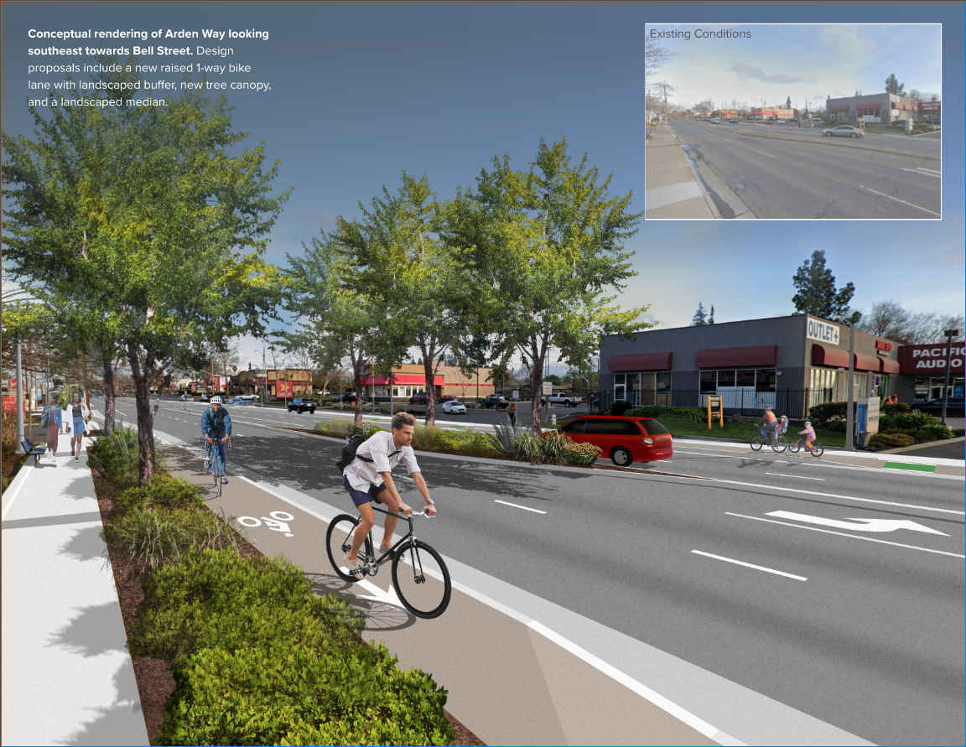
Questions

