Slide 1

ADA Programs Update
Department of Transportation
February 17, 2026
Thomas Cassera, PE
Associate Civil Engineer

Slide 2
Programs Overview – ADA Transition Plan
Special Request List
Funding Availability
ADA Transition Plan – Curb Ramps
ADA Transition Plan – Sidewalk Gaps
ADA Transition Plan – APS
SacDOT APS Policy

Slide 3
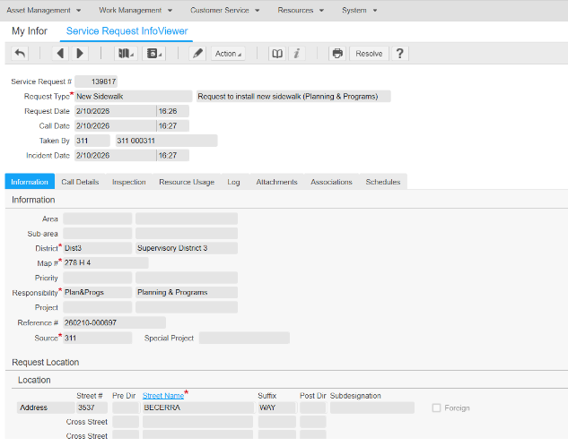
Special Request List
SacDOT maintains a Special Request List for ADA Curb Ramps, Sidewalk Gaps, Accessible Pedestrian Systems or APS Devices.
Community or Service Requests for ADA infrastructure are received through 311, INFOR, email, or phone. Responses to service requests are in-kind.
All service requests are logged and tracked using excel spreadsheet for monitoring and prioritization with future and planned projects.
$1.4 billion dollar funding shortfall with Transportation Improvements.
Service Requests for ADA curb ramps, Sidewalk Gaps, and APS Devices when added to SacDOT’s Special Request List are prioritized for consideration when funding becomes available.
Community Requests that have been mitigated are removed and placed into a completed file

Slide 4
ADA Transition Plan – Curb Ramps, Sidewalk Gaps, & APS devices
Service Request locations are verified using current ADA Transition plan, Sacramento County Active Transportation Plan, and other various planning documents.
Curb ramps: There are an estimated 3,503 curb ramps constructed through Capital Improvement Projects, including Accessible Curb Ramp, AC Overlay, and other private projects. There are 384 community requests that have been mitigated, and 152 community requests remain on the Special Request List.
Sidewalk Gaps: There are 1800 gap segments, consisting of 17.5 miles per ADA transition plan. Generally, improvement & maintenance along property frontages are the responsibility of the private landowner. SacDOT includes sidewalk gaps with Capital Improvement Projects when gaps are within project limits. There are 400 community requests on the Special Request List. SacDOT is vetting Special Request List to assess gaps that are mitigated.
APS Devices: There are 2,424 APS devices listed in ADA Transition Plan. SacDOT has installed 1242 APS devices. There are 43 community requests that have been mitigated, and 5 remain on the Special Request List.
Schedule for completion of priority Curb Ramps & APS Devices are 10 – 15 years depending on availability of Local, State, and Federal funding.

Slide 5
SacDOT APS Policy
APS policy – County requires updates to pedestrian equipment once pedestrian facilities are altered. Such as overlay projects, developer projects etc.
Signal Operations has no ongoing program to update to new APS push buttons.
SacDOT installs APS push buttons on new signals.
Signal maintenance replaces any knockdowns with existing equipment at the location.
Leading Pedestrian Interval (LPI) applied to all State-owned Intersections.

Slide 6
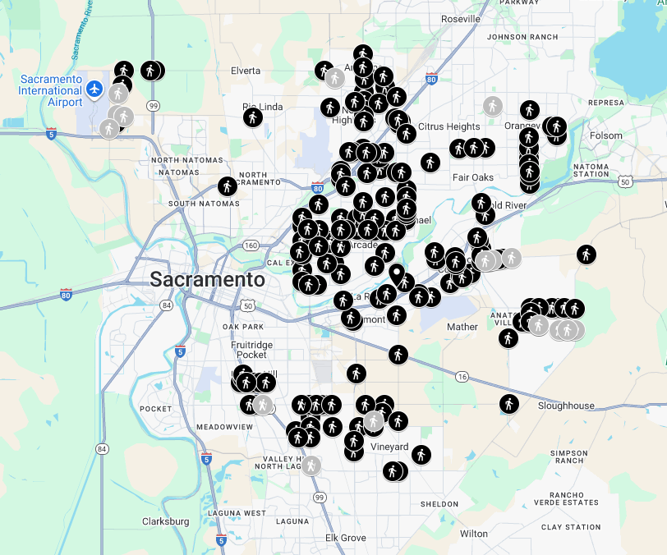
ADA Transition Plan – APS Devices
Map of intersections with APS devices installed in the County
2,424 APS devices listed in ADA Transition Plan
1242 APS devices installed
230 APS devices installed in Rancho Cordova (SacDOT coodinates)

