Slide 1




Presentation for
Stockton Boulevard Safety and Transit Enhancement Project (STEP)
Disability Advisory Commission
Physical Access Subcommittee Meeting - April 21, 2026
Prepared for
Prepared by

Slide 2
Multimodal and Bus Rapid Transit (BRT) Partnership
Established multi-jurisdictional partnership
  City of Sacramento – lead agency for current stages of project
  Sacramento County
  SacRT
Project funded by Federal and State Funds
  Stage 1 – Alternatives Analysis (2025 – 2026)
  Stage 2 – Environmental Review & Preliminary Engineering (2026 – 2027)

Slide 3
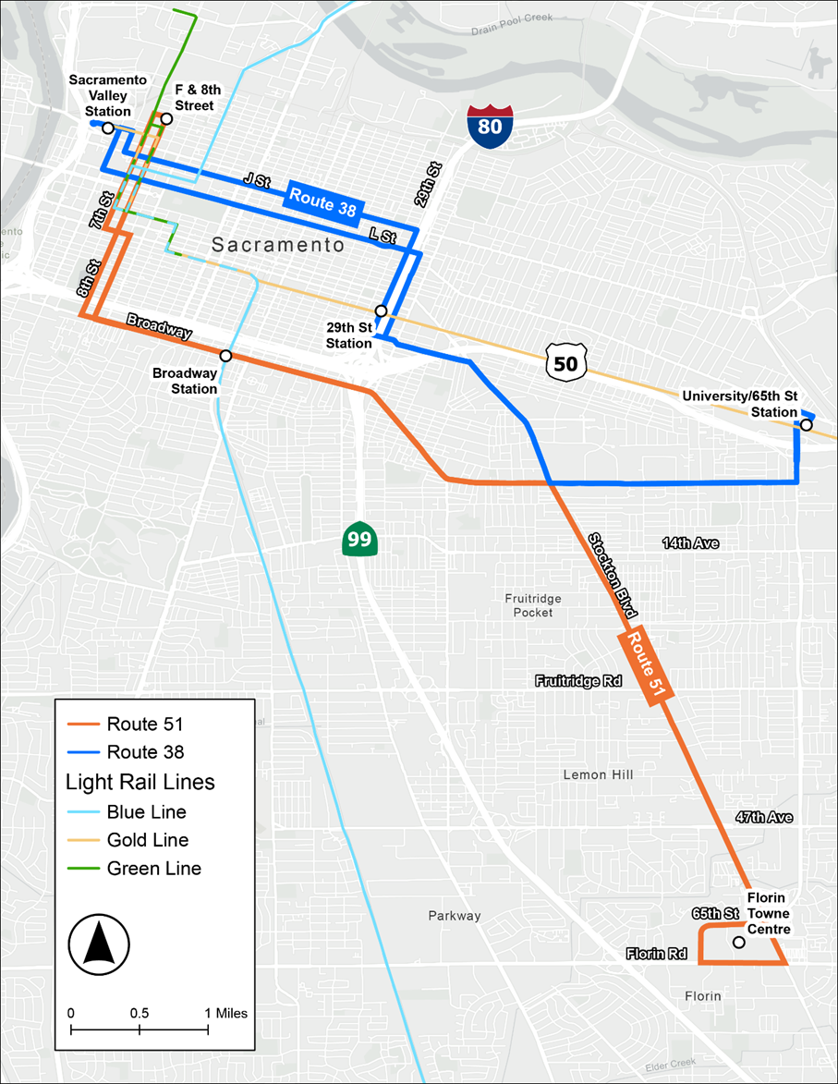

Project Area Map
Complete Streets Improvements Limits
Complete Streets Improvements Limits

Slide 4
Vision for the Project, Corridor, and Community
Safety | enhance safety for all users
Multimodal | advance Complete Streets improvements to transform corridor from vehicular thoroughfare to multimodal corridor
Premium Transit | serve riders via frequent, accessible and reliable service
Sustainability | adapt to changing climate and implement durable solutions
Community | facilitate access to opportunities and foster inclusion
Create an inviting and safe environment for all modes and establish a sense of place and community
Notes:
After slide, pause and ask for feedback from group
What’s import

Slide 5
Purpose and Objectives
Purpose | Objective
Improve Safety | Reduce fatal and serious injury crashes and incorporate safety countermeasures.
Improve Multimodal Infrastructure | Provide safe corridors to walk, bicycle, and access transit.
Enhance Transit Service and Customer Experience | Increase transit ridership.
Support Economic Development | Increase access to homes, jobs, education, and services.
Deliver a Fiscally Responsible Project | Develop a cost-effective project that can be built in a reasonable timeframe.

Slide 6
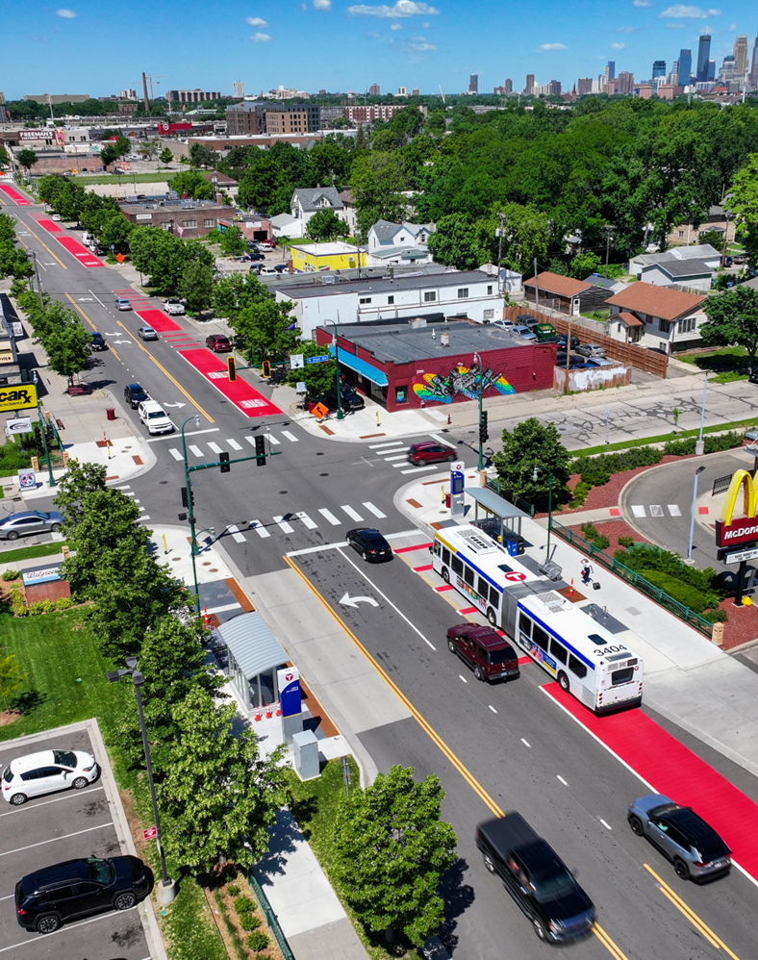
Bus Rapid Transit (BRT) Definition
High-quality bus system that may include:
  Dedicated bus lanes to provide faster service and consistent travel times
  Traffic signal priority (TSP) for buses at traffic lights
  Enhanced stations providing amenities and facilitating faster boarding
  Frequent service
  Branding as a differentiated premium service
Metro Transit B Line BRT – Minneapolis, MN
Notes:
BRT is not a one size fits all approach
Could be a combination of dedicated bus lanes, with mixed flow traffic
Providing shelter for the weather with the bus stations (heat and cold)
Light-rail on rubber tires/wheels, conceptually (many components of rail service, and bringing to bus service)

Slide 7
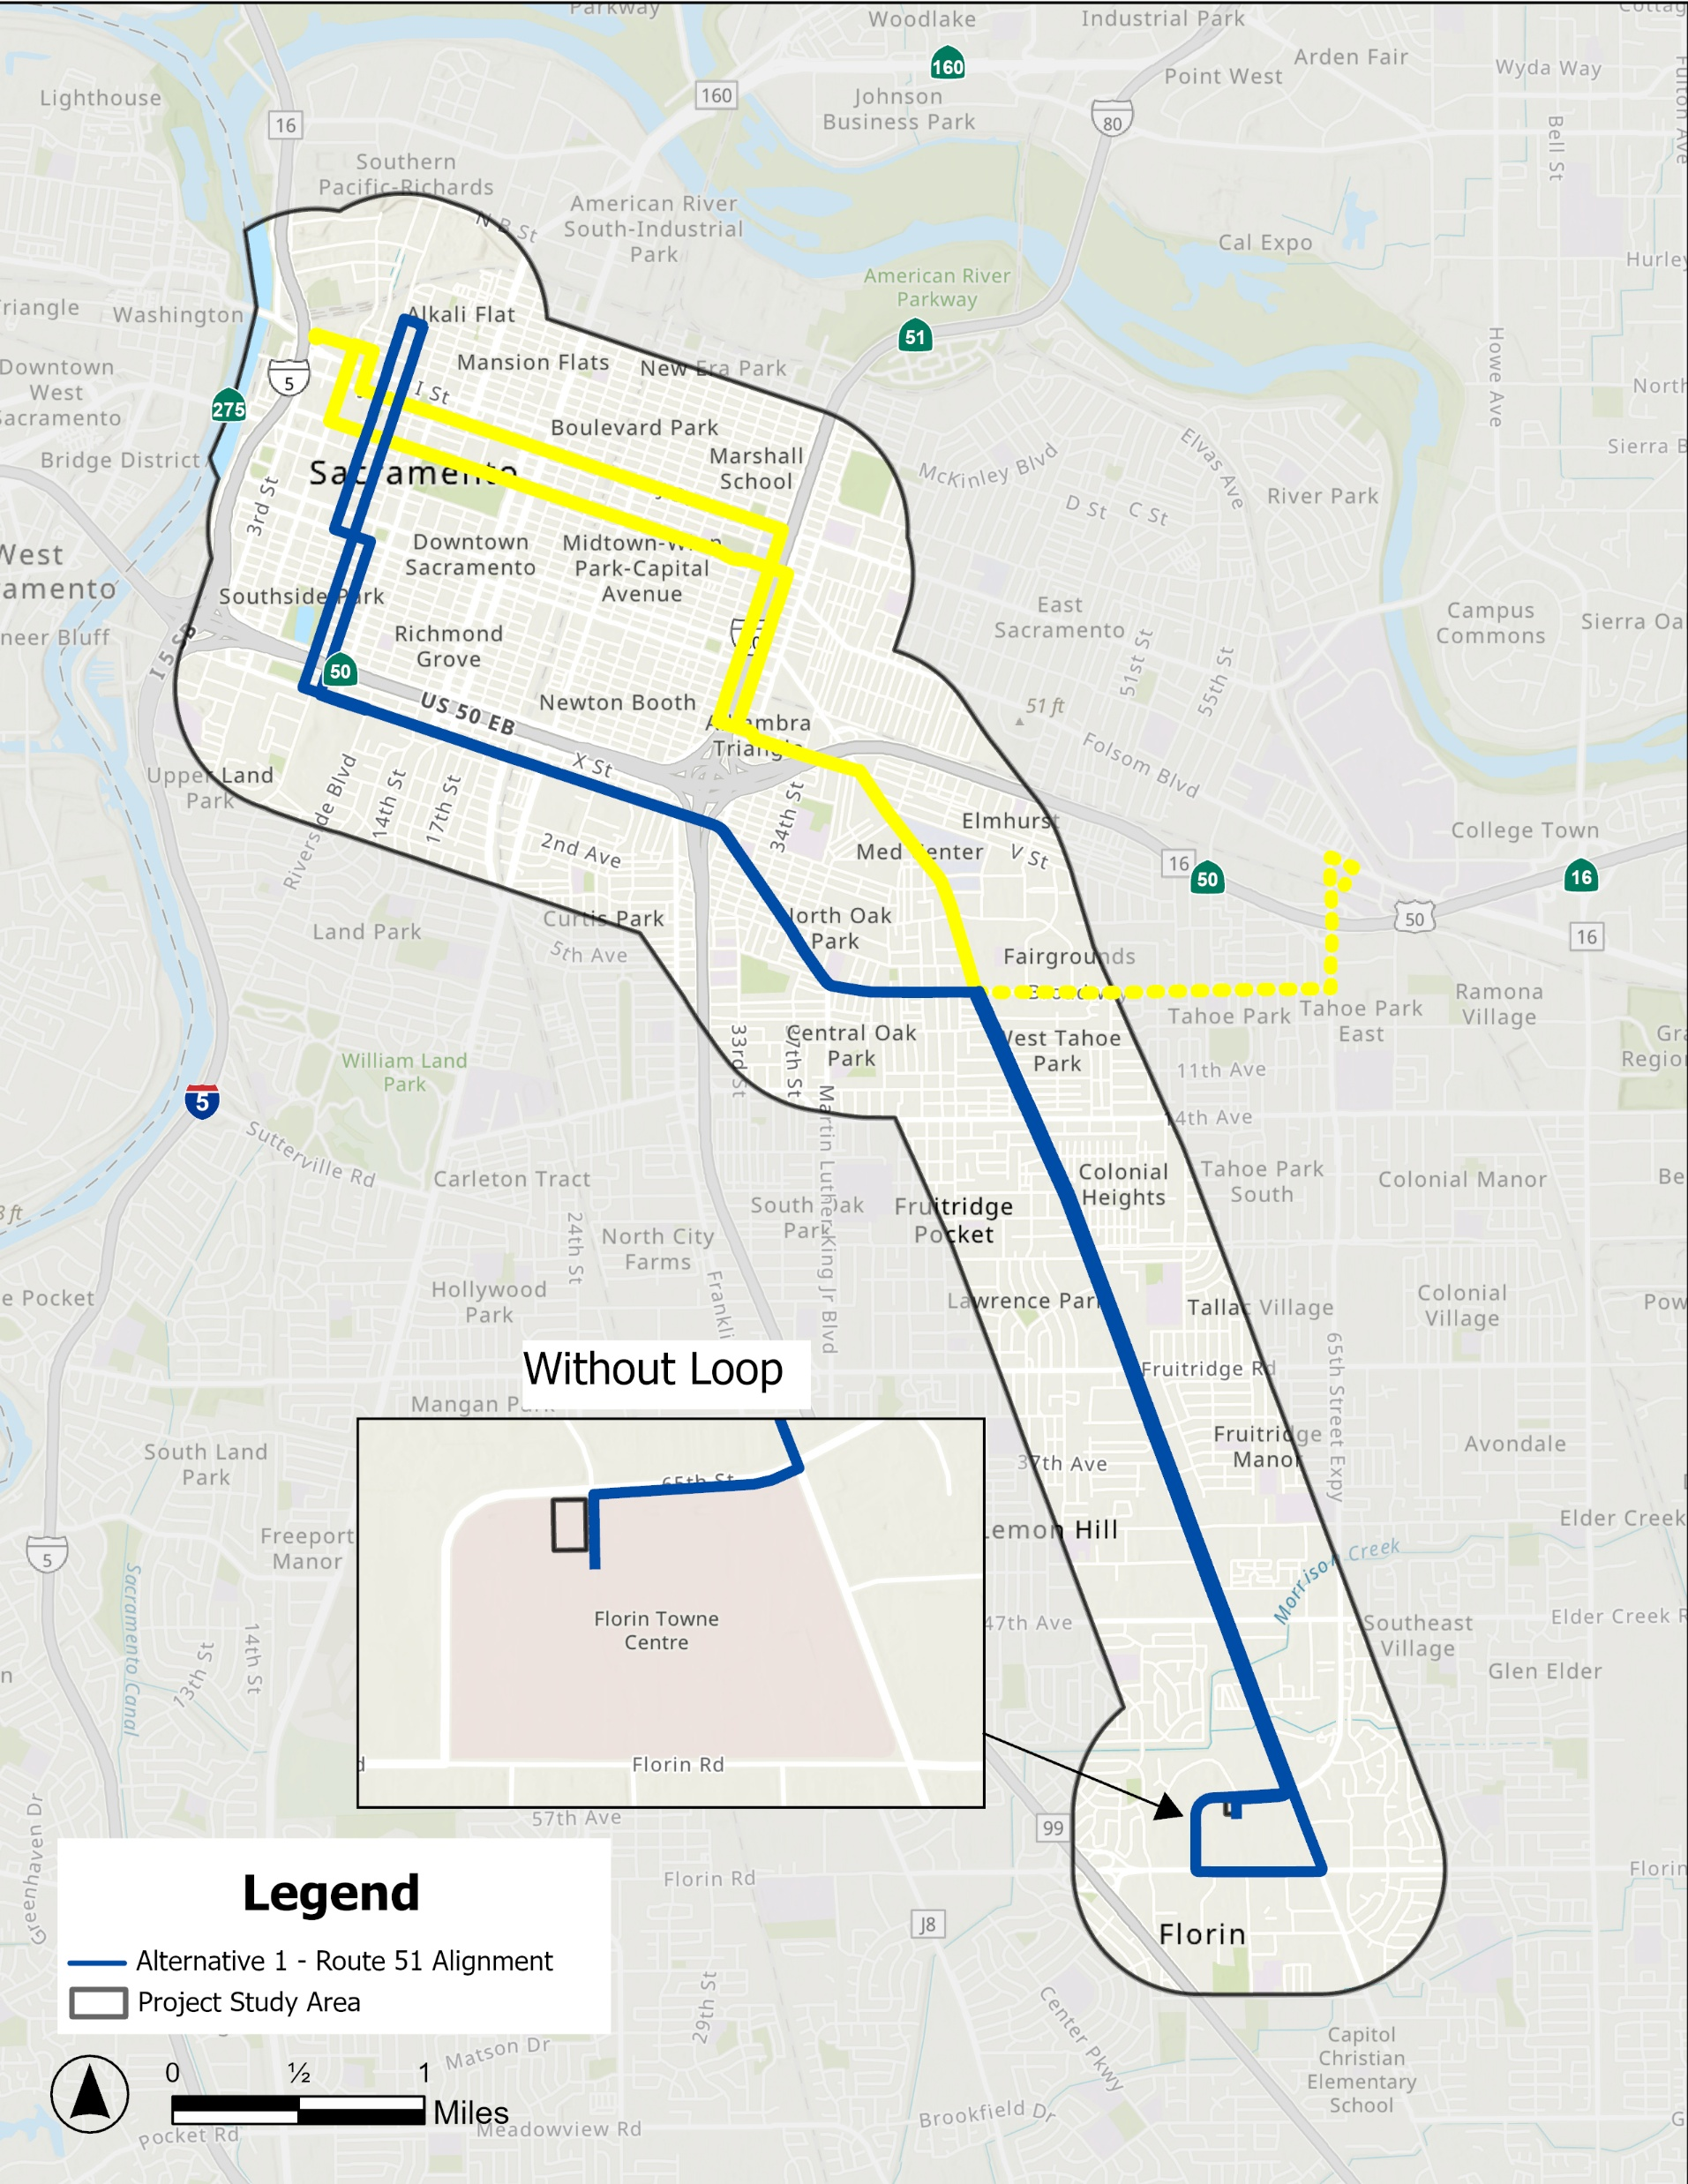
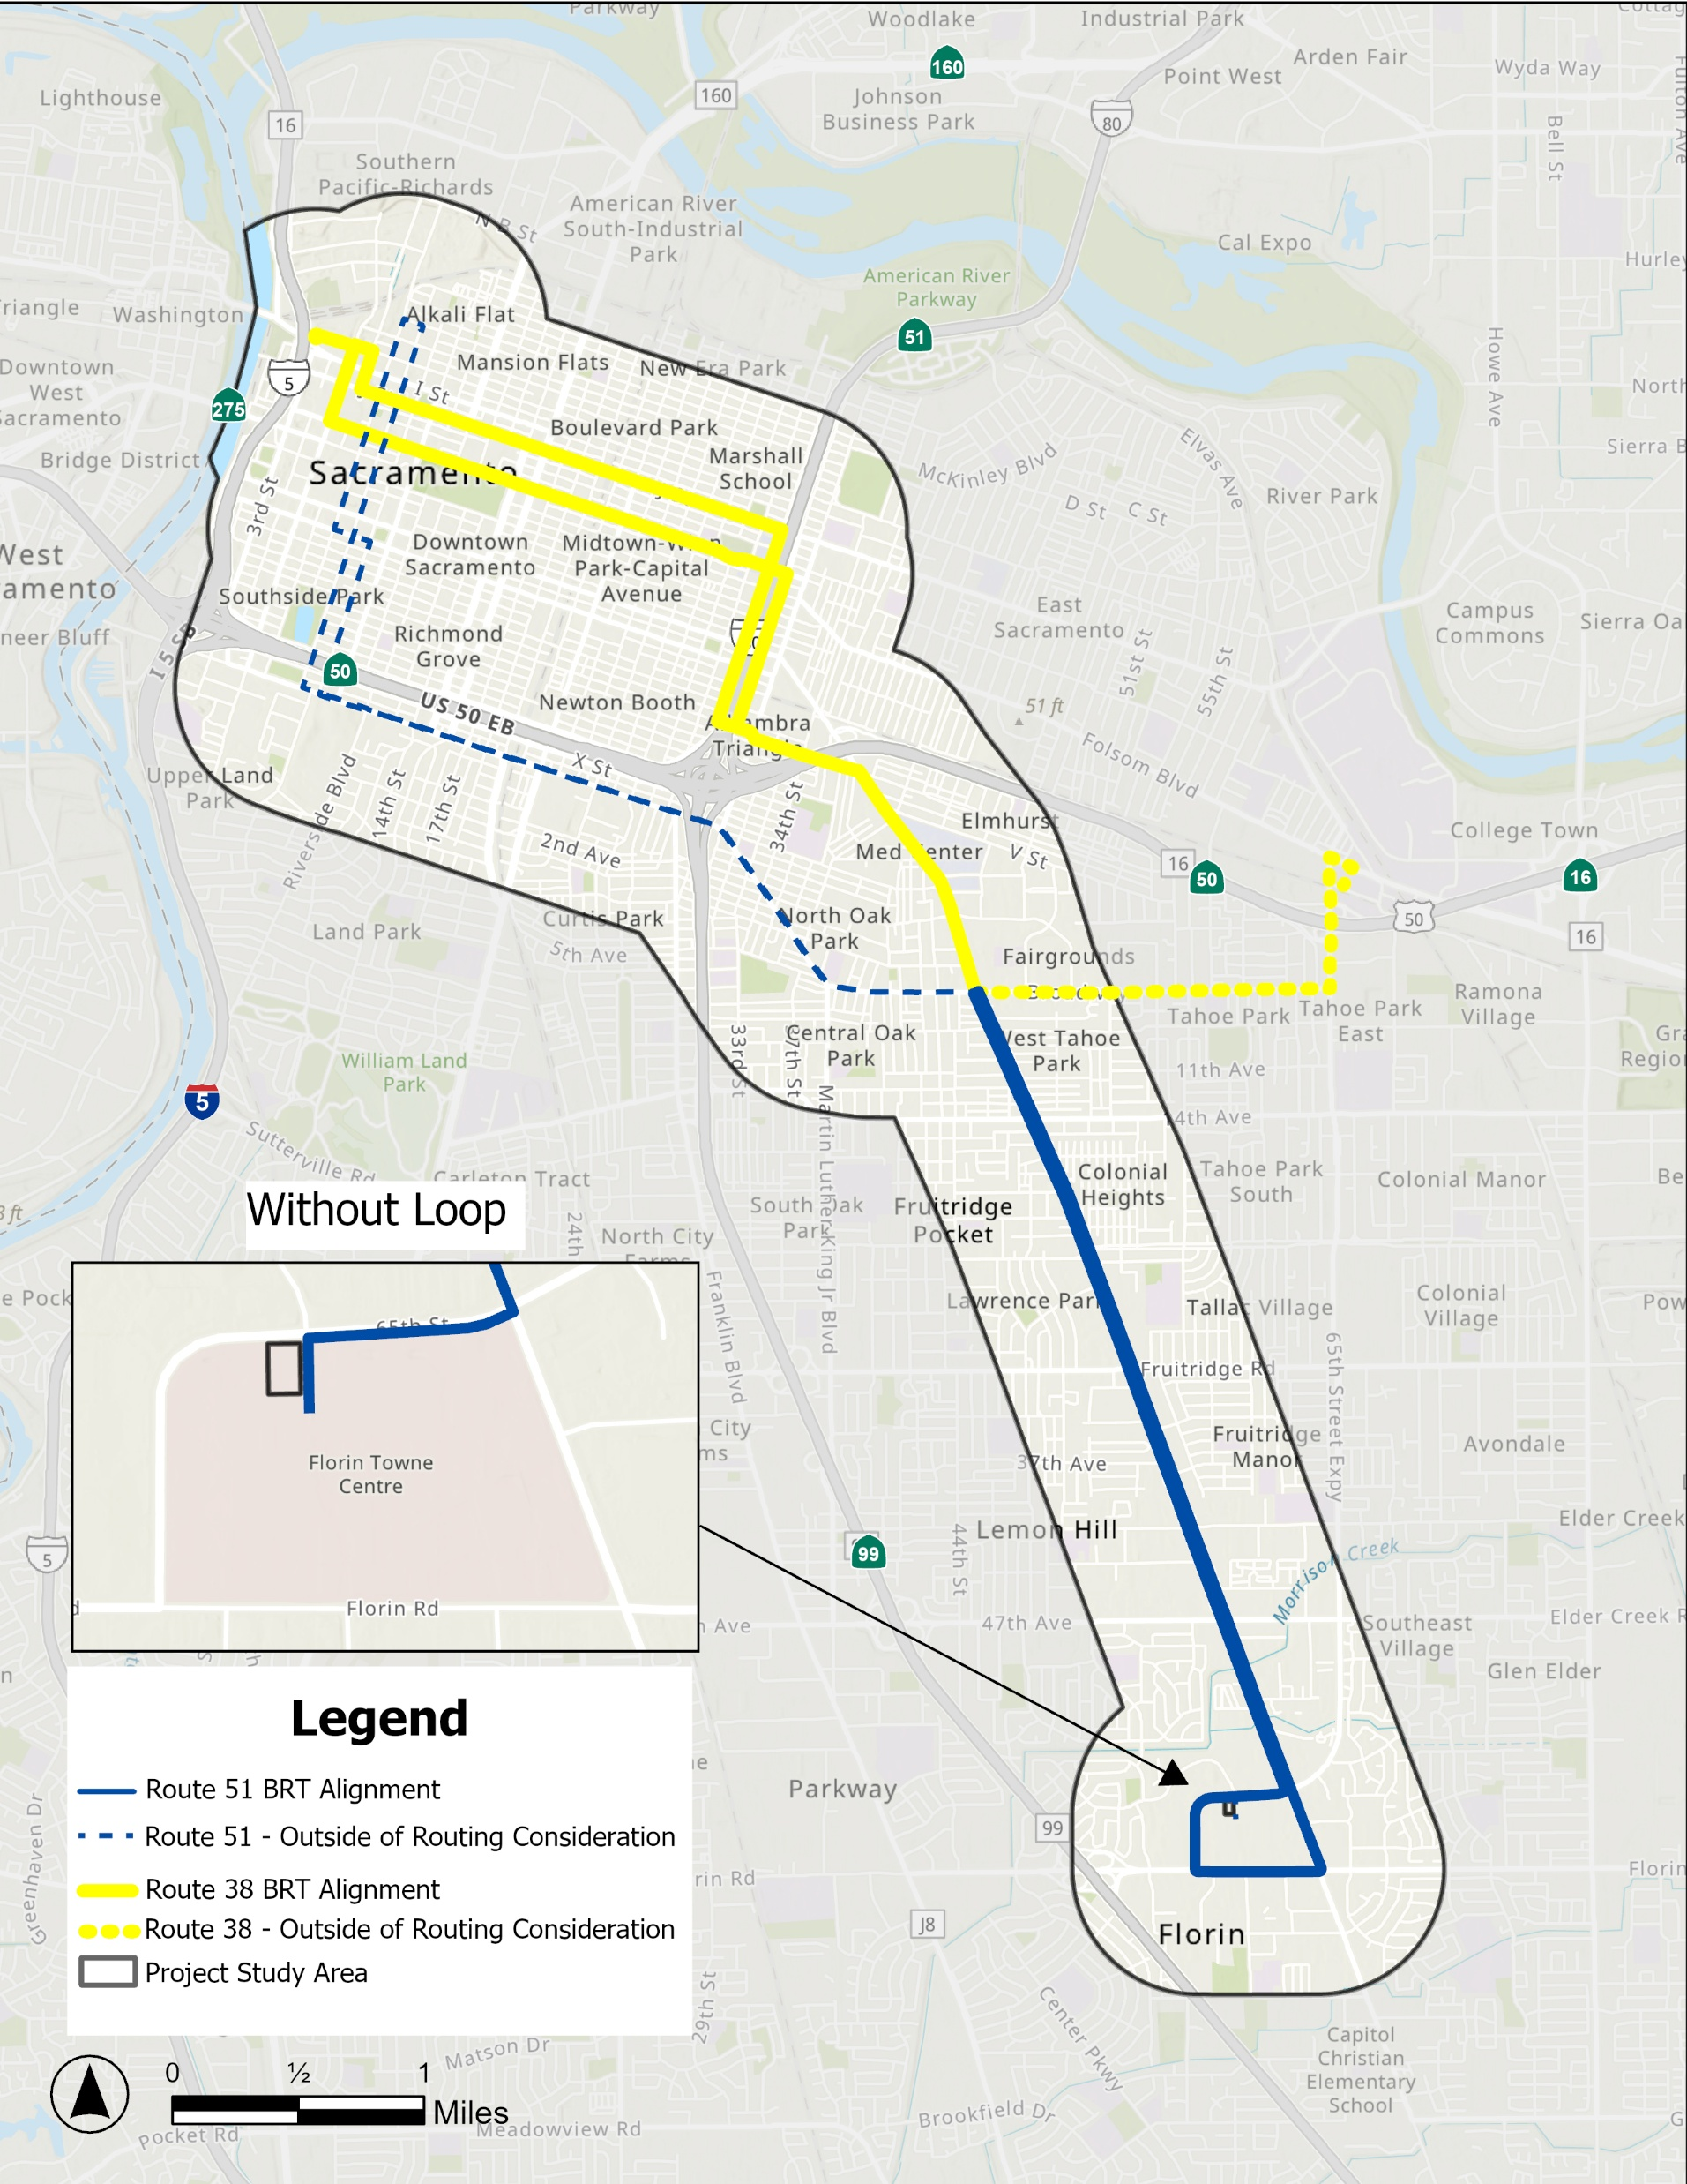
BRT Route Alternatives
  Alternative 1
  Route 51 Alignment
  Alternative 2
  Route 51/38 Hybrid Alignment

Slide 8
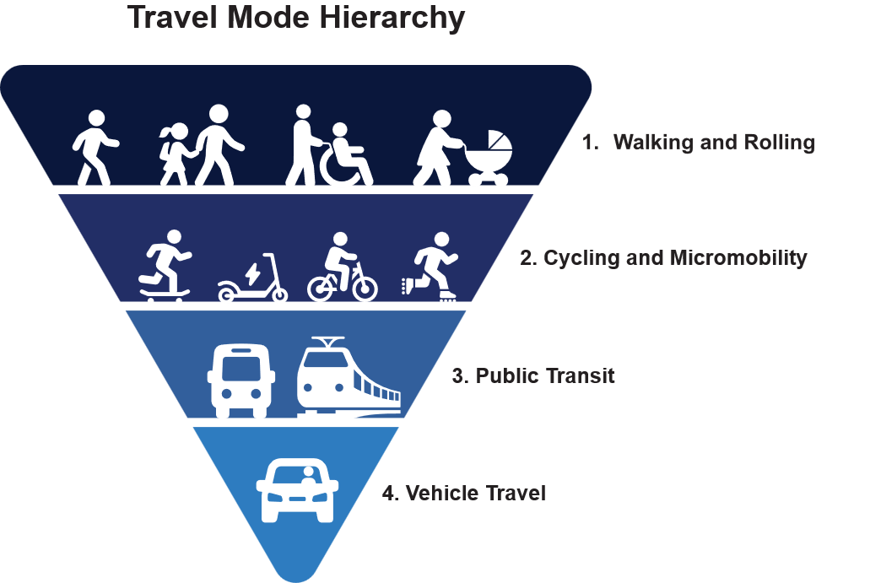
Complete Streets Definition
Roads designed to be safe for all users
Goal is for street to be comfortable and accessible for everyone, no matter their mode of travel or abilities
May include bike lanes, wider sidewalks, improved pedestrian crossings, and dedicated bus lanes

Slide 9
Sample Corridor Segment
Stockton Blvd from Florin Road to 65th Street
Notes:
Katie will open up meeting and introductions

Slide 10
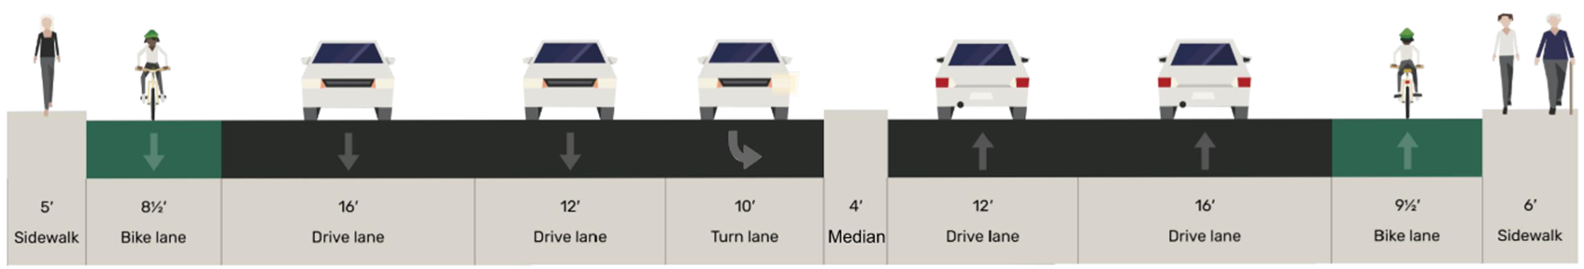
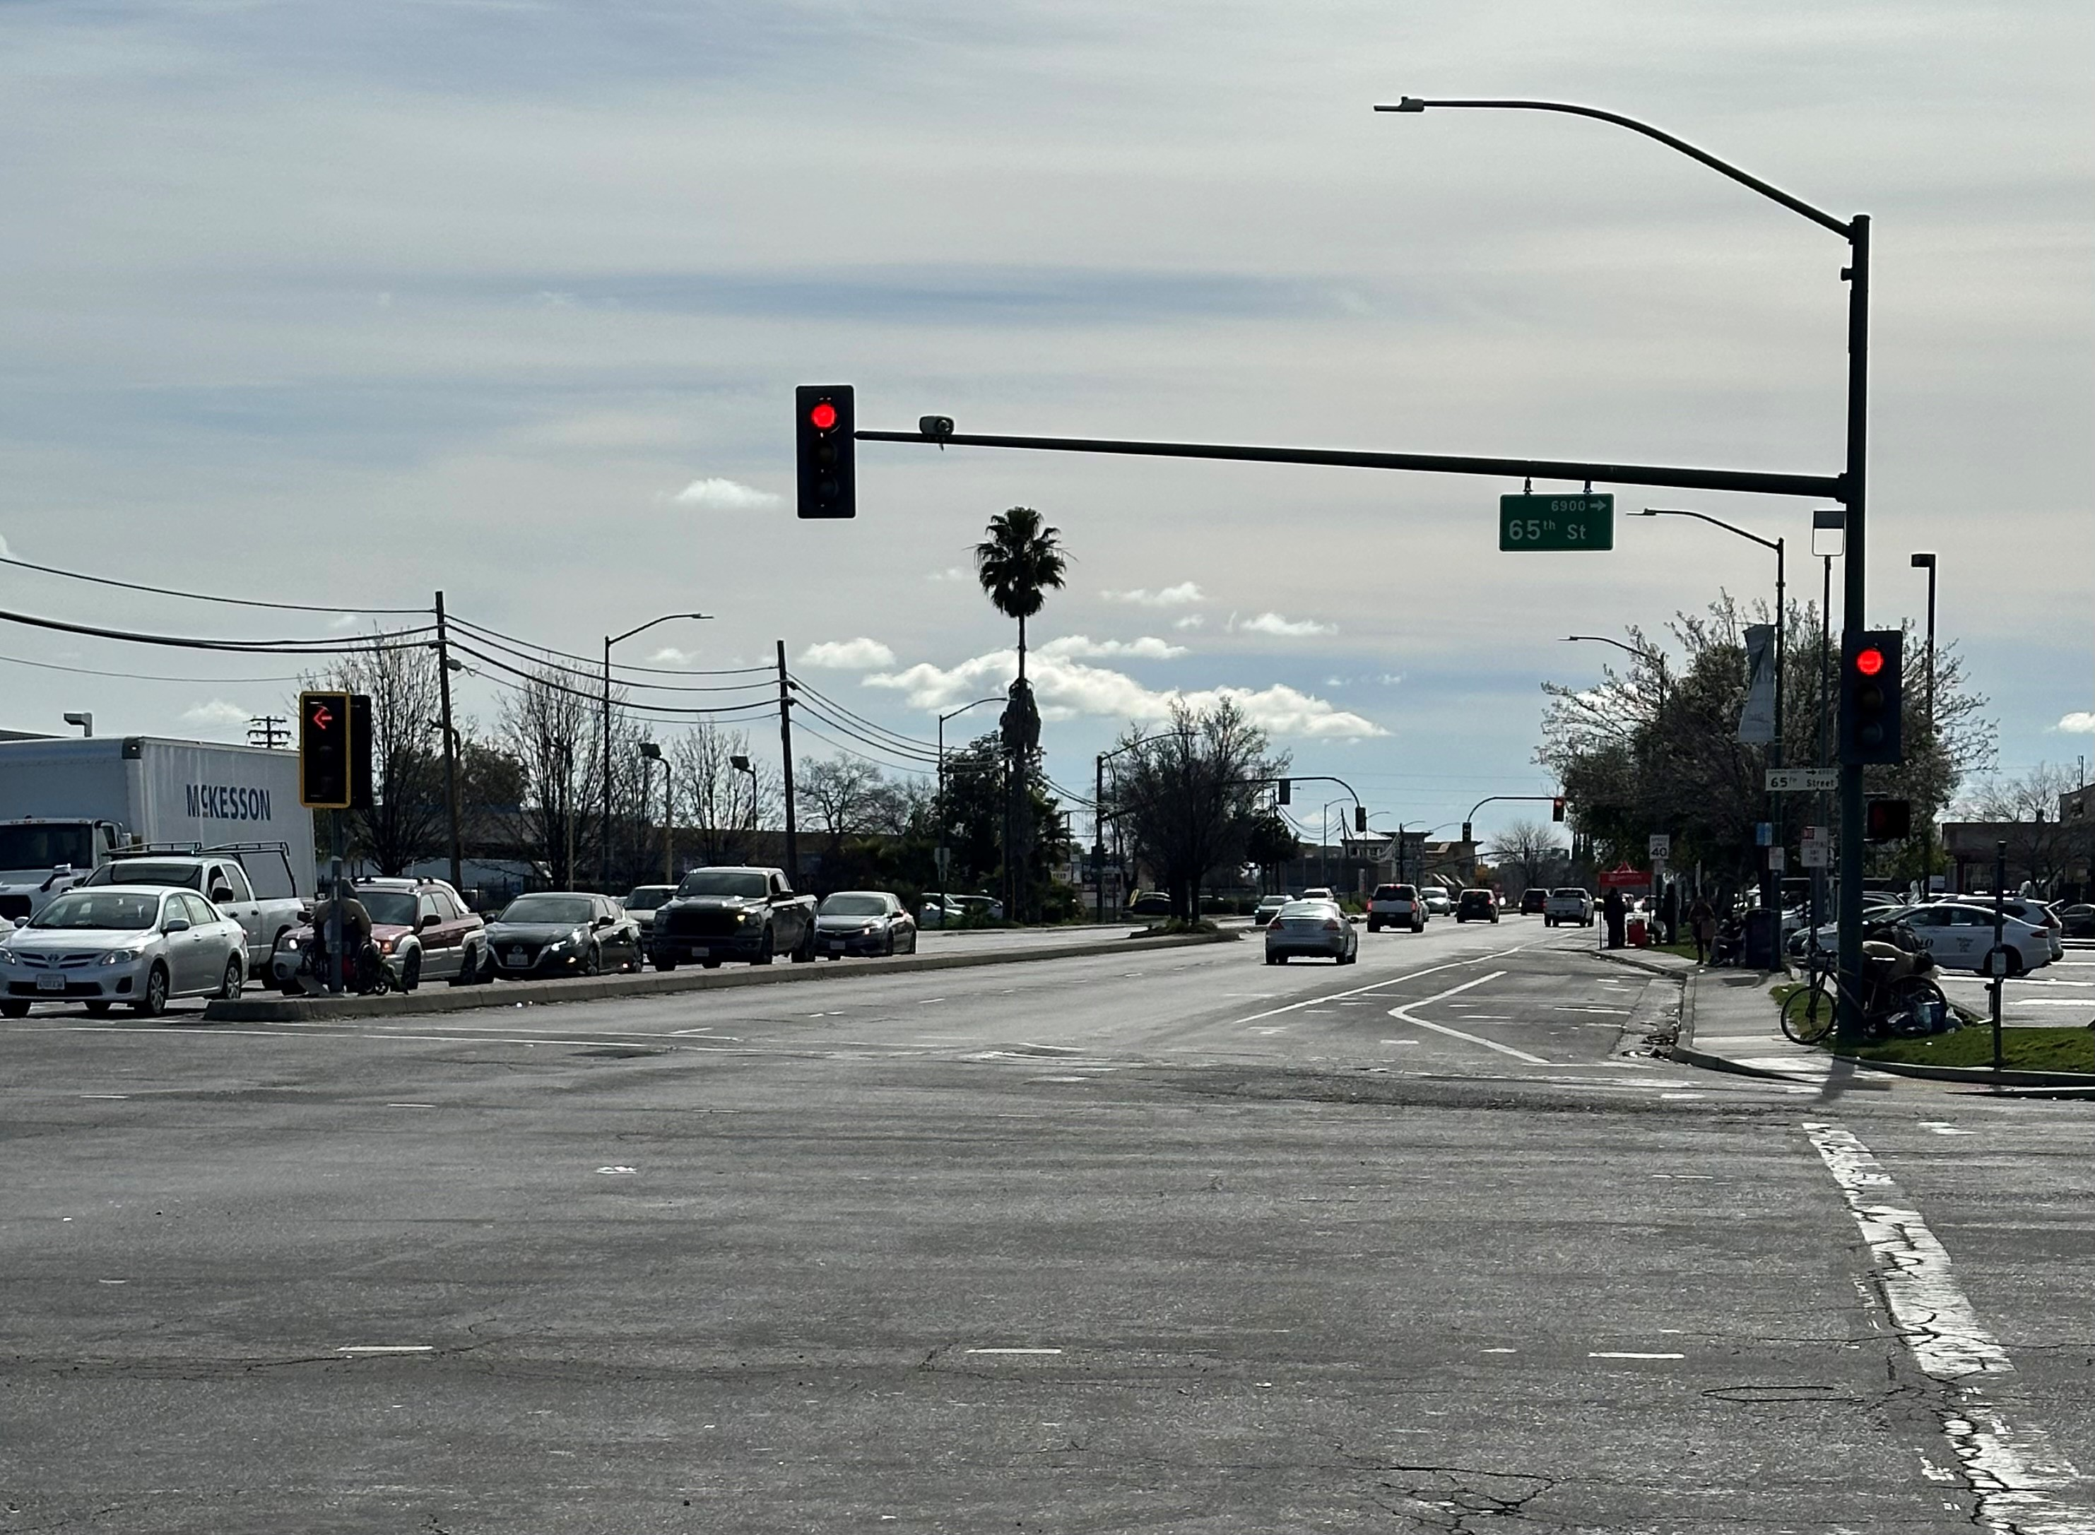
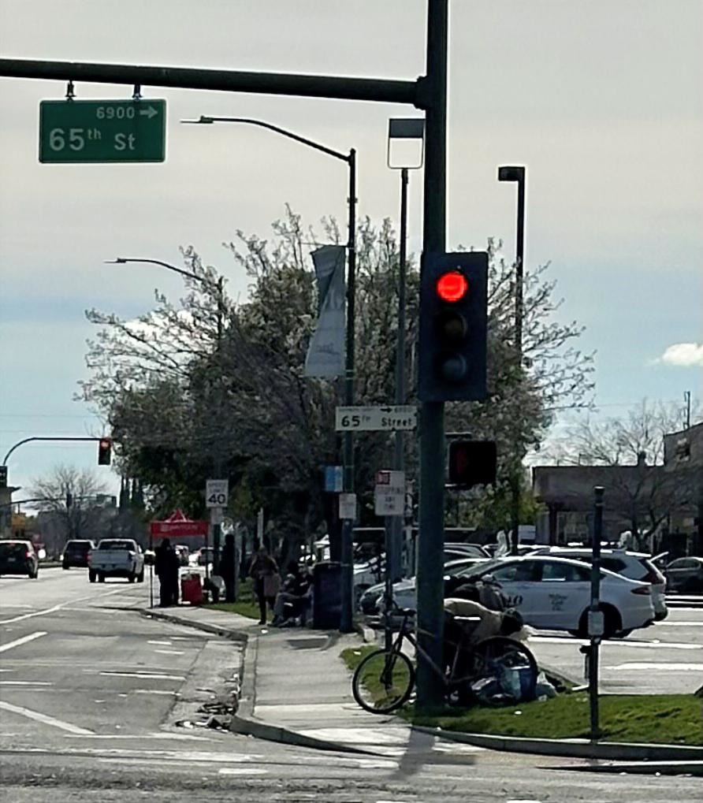
Stockton Blvd – Florin Rd to 65th St – Existing Conditions

Slide 11
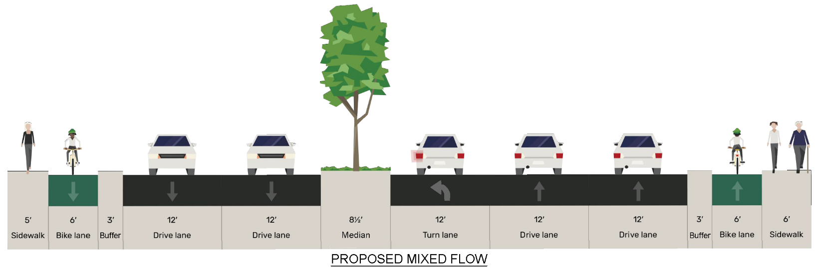
Stockton Blvd – Florin Road to 65th Street – Proposed Conditions
Pros
  Continuation of Stockton Boulevard Complete Streets improvements being implemented south of Florin Road
  Raised buffer provides grade-separated Class IV bike lanes
  Maintains existing number of vehicle travel lanes – no impact on vehicle capacity
Tradeoffs
  Nominal improvements for pedestrians, although pedestrian crossing distances could be reduced through “protected intersection” design
  Does not provide designated bus lanes, although BRT route may depart Stockton Blvd at 65th St

Slide 12
Project Status

Slide 13
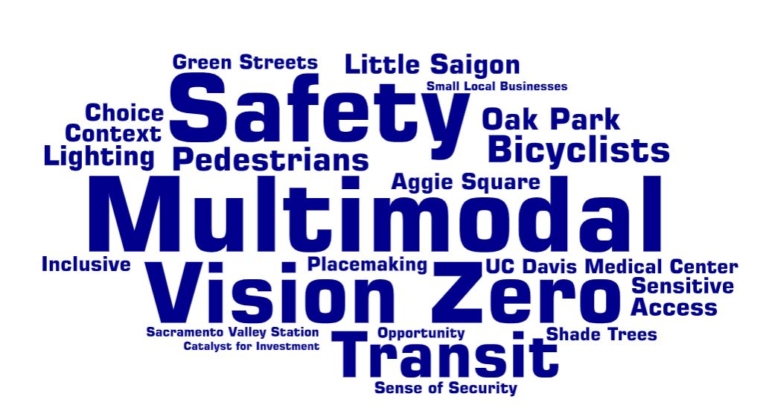
Project Phases
Stage 1
Alternatives Analysis (2025-2026) –Preferred Alternative by Summer 2026
Stage 2
Environmental Review and Preliminary Design (2026-2027)
Stage 3
Final Design* (2028-2029)
Stage 4
  Construction* (2030-2031)
* Subject to securing funding
Notes:
-Highlight 3 EAC Meetings
-1st meeting is to define community goals
-2nd is alternatives refinement and evaluation
-3rd is confirm LPA and BOD
Next Steps
Presentation of alternatives for public input and BAC comment
Final refinement of alternatives and cross‑sections for County segments
Continued coordination with SacRT regarding bus stop design and BRT compatibility
Advancing the project into environmental review in 2026–2027

Slide 14
Contact Information
Mikki McDaniel, Principal Planner, SacDOT
mcdanielm@saccounty.gov

